Slide 1
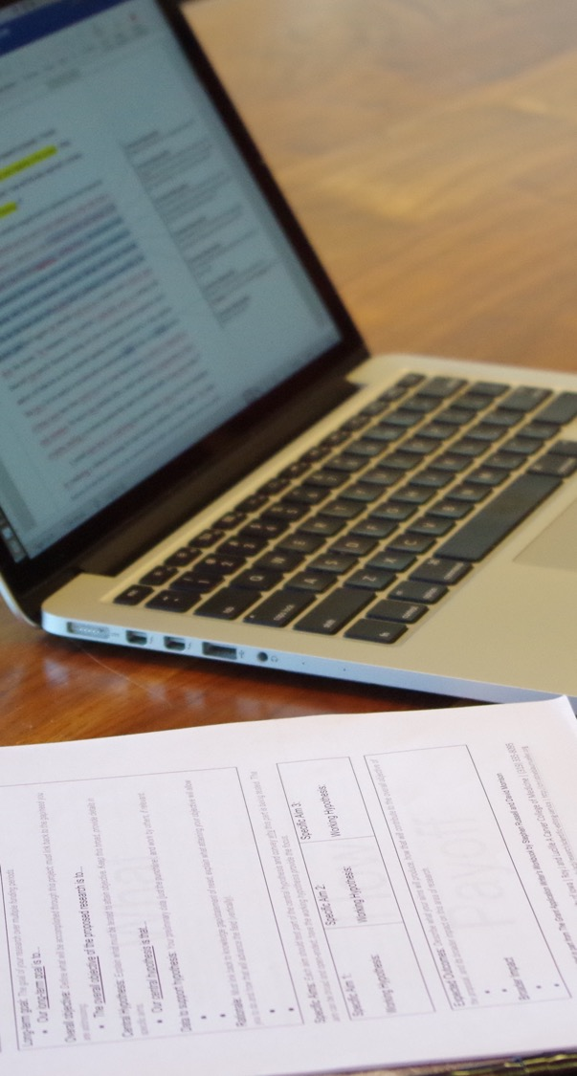
Preparing Your Biographical Sketch for NIH Grants
Jennifer Barr, PhD | SERCC
Institute for Clinical and Translational Science (ICTS)
February 16, 2026

Slide 2
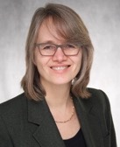
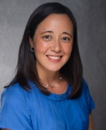
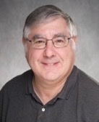
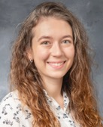
SERCC Editors
Advanced degrees in science | Laboratory experience | A love of clear writing!
Christine M Blaumueller, PhD
Director, Senior Scientific Editor and Writing Consultant
Over 14 years as a laboratory researcher | 6 years as a journal editor (EMBO) | Editor in CCOM since 2006 | Established SERCC in 2017
PhD from Yale University | Postdoctoral training at the European Molecular Biology Laboratory (EMBL).
Jennifer Y Barr, PhD
Assistant Director, Grant Writer
Over 12 years of experience as a laboratory researcher | SERCC editing internship 2015–2017 | SERCC editor since 2017
PhD and Postdoctoral training at UI | Has developed many of our author resources and directs our Scientific Editing Internship Program
Michael R Rebagliati, PhD
Scientific Editor and Writing Consultant
Ove 30 years of experience as a laboratory researcher.
PhD in biology from Harvard University | Postdoctoral training at the NICHD | Primary editor for the Stead Family Department of Pediatrics
Emily Huber, PhD
Scientific Editor and Writing Consultant
Over 10 years of research experience in cell biology, genomics, and virology | Has edited for both academic and industry laboratories
PhD in human and statistical genetics from Washington University in St. Louis
https://sercc.medicine.uiowa.edu/about

Slide 3
What editing staff do
Provide input on drafts of writing projects
Provide one-on-one consultation on writing strategy
Brainstorm with authors and faculty on Specific Aims
Teach scientific writing
Collect and generate resources
Changes in funding agency requirements
Grant writing templates (NIH “R”/“K/“F” grants)
Liaise with other RD professionals
National Organization of Research Development Professionals (NORDP)
Scientific Editors Network (ScENe)
American Medical Writers Association (AMWA)

Slide 4
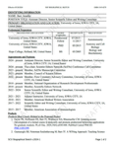
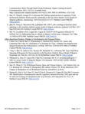



In this session
What is a biographical sketch (biosketch) and who must complete one
How reviewers use the biosketch
How to create a biosketch
General tips and resources

Slide 5
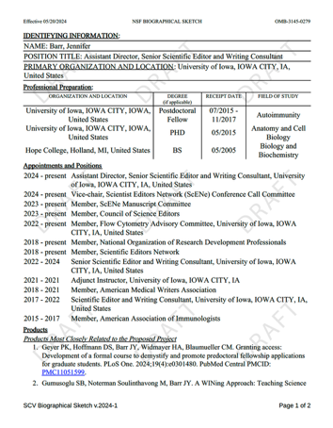

What is a Biosketch?

Slide 6
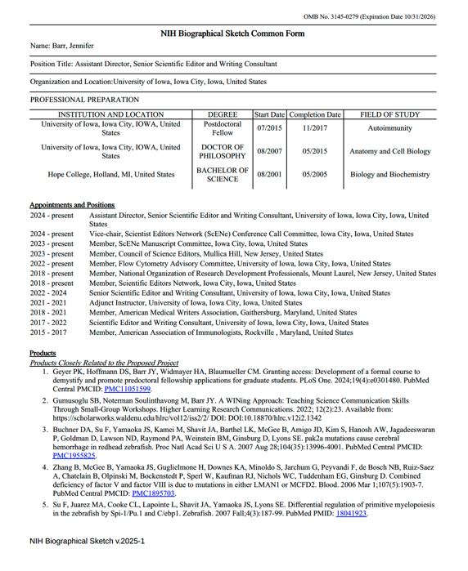
A biosketch is an abbreviated CV
An opportunity to showcase your
expertise
impact in the field
relevance to a specific project or role
track record of productivity
in support of your role in a grant application.

Slide 7
Who is required to submit a biosketch?
NIH requires submission of a biosketch if you are listed as a senior/key person or other significant contributor (OSC) on a grant application.
Principle Investigator (PI)
Program Director (PD)
Mentor/Preceptor
Consultant
Collaborator
Technical staff
Definition of senior/key personnel: PD/PI and other individuals who contribute to the scientific development or execution of a project in a substantive, measurable way, whether or not they receive salaries or compensation under the grant…Senior/key personnel must devote measurable effort to the project whether or not salaries or compensation are requested.
Definition of OSC: Individuals who have committed to contribute to the scientific development or execution of the project but are not committing any specified measurable effort (i.e., person months) to the project. These individuals are typically presented at “effort of zero person months” or “as needed.” Individuals with measurable effort may not be listed as Other Significant Contirbutors (OSCs). Consultant should be included if they meet this definition.
https://grants.nih.gov/grants/glossary.htm#S

Slide 8

How reviewers use the biosketch

Slide 9

Purpose of the biosketch
NIH staff and peer reviewers use the biosketch to ensure that individuals are equipped with the skills, knowledge, and resources needed to carry out the proposed project.

Slide 10
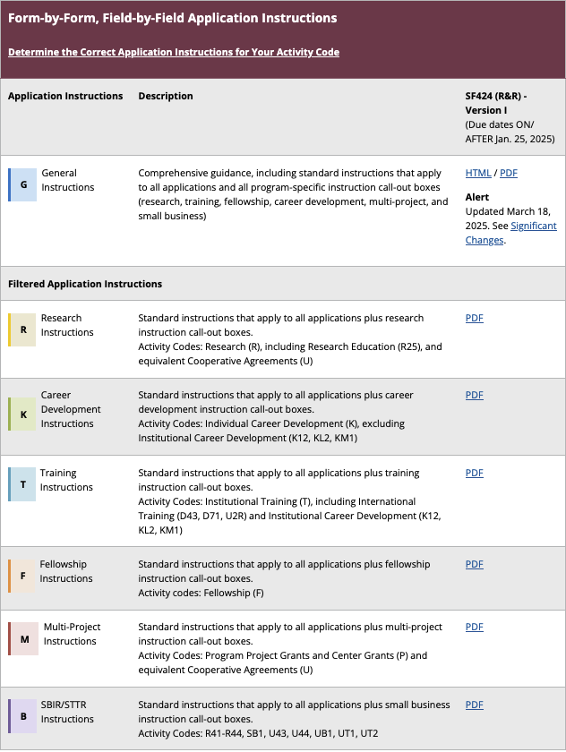
Review criteria vary depending on grant mechanism
Those most relevant to junior faculty:
Research (R)
Career Development (K)
The links on this page will take you to the “Forms I SF424” Instructions for specific grant types.
https://grants.nih.gov/grants-process/write-application/how-to-apply-application-guide

Slide 11
Difference between NIH R and K grants
Research (R) grants should
Career Development (K) grants should:
…have a sustained, powerful influence on the research field(s) involved
…enhance candidate’s potential for a productive, independent scientific career in a health-related field
Emphasizes the science
Emphasizes the science…
…and the training potential
For examples of both types of grants, see RDO Resource Library:
https://iowa.sharepoint.com/sites/vpr/GrantWritingResources/Forms/AllItems.aspx
Navigate to: Sample Proposals and Supporting Documents >> NIH Proposals >> Sample Proposals

Slide 12
How R and K grants are evaluated
Research (R) Grants
Career Development (K) grants
Overall impact score – assesses likelihood that the project will have a sustained, powerful influence on the research field(s) involved
Overall impact score – assesses likelihood that the proposed career development will enhance candidate’s potential for a productive, independent scientific career in a health-related field
Core review criteria:
Factor 1: Significance and Innovation (scored 1–9)
Factor 2: Approach (scored 1–9)
Factor 3: Expertise and Resources
Investigator(s), Environment
Core review criteria (each scored 1–9):
Candidate
Career Development Plan/Goals
Research Plan
Research Plan Mentors
Environment and Institutional Commitment
https://grants.nih.gov/policy-and-compliance/policy-topics/peer-review/simplifying-review/framework

Slide 13
Review of Investigators for R Proposals
Criteria for judging Factor 3 (Investigators, Environment)
Whether the investigator(s) have demonstrated background, training, and expertise, as appropriate for their career stage, to conduct the proposed work.
Whether institutional resources are appropriate to ensure successful execution of proposed work.
Evaluated as appropriate or gaps identified
Gaps require explanation
Not scored individually but considered for overall impact score
https://grants.nih.gov/policy-and-compliance/policy-topics/peer-review/simplifying-review/framework

Slide 14
Review of Candidates in K proposals
Criteria for judging the Candidate
Does the candidate have the potential to develop as an independent and productive researcher?
Are the candidate's prior training and research experience appropriate for this award?
Is the candidate’s academic, clinical (if relevant), and research record of high quality?
Is there evidence of the candidate’s commitment to meeting the program objectives to become an independent investigator in research?
Do the reference letters address the above review criteria, and do they provide evidence that the candidate has a high potential for becoming an independent investigator?
Mentored Clinical Scientist Research Career Development Award
(Parent K08 Independent Clinical Trial Not Allowed; PA-24-182)

Slide 15
Review of Mentors in K proposals
Criteria for judging Mentors, Co-Mentor(s), Consultants, Collaborators
Is mentor qualified in the proposed area of research?
Does mentor adequately address candidate's potential, strengths, and areas needing improvement?
Is description of quality and extent of mentor's role adequate?
Is mentor's description of activities, including formal course work, adequate?
Evidence of experience fostering development of independent investigators?
Evidence of current research productivity/peer-reviewed support?
Adequate support for proposed research project (active/pending)?
Adequate plans for monitoring/evaluating progress to independence?
Is any clinical trial supported by mentor expertise/experience/ability?
Mentored Clinical Scientist Research Career Development Award
(Parent K08 Independent Clinical Trial Not Allowed; PA-24-182)

Slide 16
Relevance of Biosketch in NIH R and K Proposals
Research (R) grants should
Career Development (K) grants should:
Emphasizes the science
Emphasizes the science…
…and the training potential
Investigator Biosketch should illustrate prior research accomplishments and evidence of expertise to carry out the proposed work
Candidate biosketch should illustrate prior research training and accomplishments and long-term goal and need for the proposed training
Mentor biosketches should demonstrate funding success and mentoring experience

Slide 17

How to craft a biosketch

Slide 18
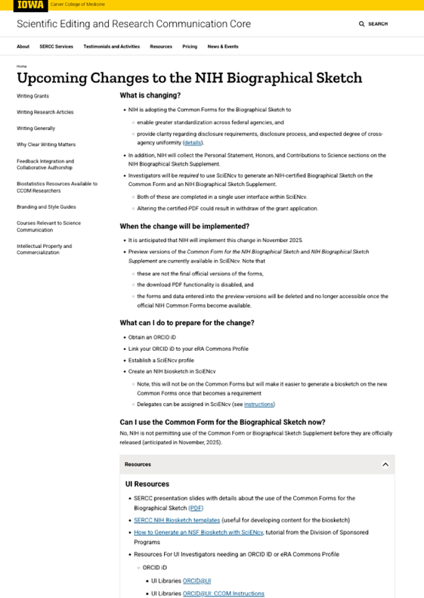
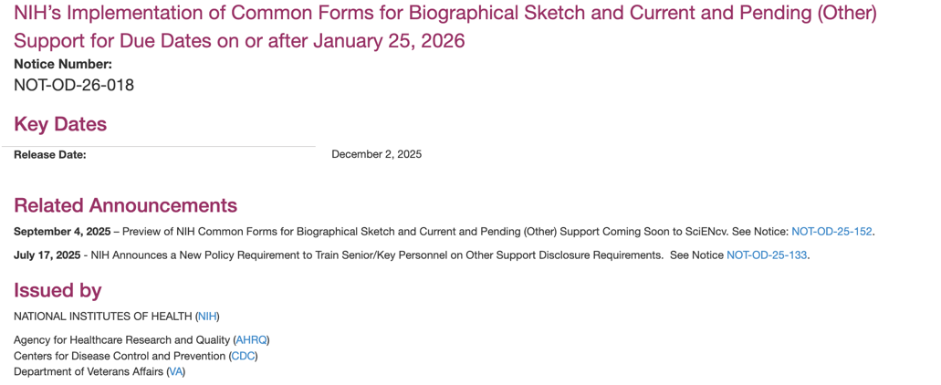
NIH Requires use of Common Forms for Biosketch
https://grants.nih.gov/grants/guide/notice-files/NOT-OD-26-018.html
https://sercc.medicine.uiowa.edu/upcoming-changes-nih-biographical-sketch-1

Slide 19
Goal of Switching to the Common Forms
Enable standardization across federal agencies
Provide clarity regarding disclosure requirements
Enforce certification that senior/key personnel do not participate in a malign foreign talent recruitment programs
Requires certification step

Slide 20
New Requirements with the Common Forms
Information previously collected in the biosketch is now collected in
the Common Form
an NIH Biographical Sketch Supplement
https://sercc.medicine.uiowa.edu/upcoming-changes-nih-biographical-sketch

Slide 21
Overview of NIH Biosketch Common Form + Supplement
Identifying Information, Organization, and Location
Name, title, ORCiD, eRA Commons ID
Professional Preparation
Education and training, including postdoctoral fellowships and residencies.
B. Appointments and Positions
Major academic, professional, or institutional roles (full-time, part-time, voluntary.
C. Products
5 related to proposal plus 5 additional, including publications, patents, presentations, datasets.
Common Form
Personal Statement
Up to 3500 characters about who you are and why you are well-suited for the project.
B. Honors
Up to 15 relevant academic and professional awards, scholarships, fellowships licensures, certifications.
C. Contributions to Science
Descriptions of up to 5 contributions, each limited to 2000 characters. Only reference citations in Products.
Supplement
Adapted from Robert Lawrence
https://medium.com/metascientific/entering-the-sciencv-era-for-nih-biosketches-5fdc1a96cd11

Slide 22
New Requirements with Common Forms
Information previously collected in the biosketch is now collected in
the Common Form
an NIH Biographical Sketch Supplement
Investigators will be required to use SciENcv to complete these forms
Both will be completed in a single user interface within SciENcv
Investigators can assign delegates to maintain their SciENcv profile, but they cannot complete the certification step
https://sercc.medicine.uiowa.edu/upcoming-changes-nih-biographical-sketch

Slide 23
Link ORCiD profile to eRA Commons account
ORCiD
Check if in registry
Create an account or complete profile
Instructions: https://guides.lib.uiowa.edu/ORCID
eRA Commons
Link your ORCiD profile to eRA Commons Personal Profile
Required for all NIH senior / key personnel
Instructions: https://www.era.nih.gov/erahelp/commons/PPF_Help/8_2_orcid.htm
SciENcv (access via NCBI)
Associate ORCiD profile with SciENcv account
Can assign a delegate who can create & update documents (but cannot download certified docs)
Instructions: https://www.nlm.nih.gov/ncbi/workshops/2023-10_SciENcv/SciENcv_what2know.html#delegation

Slide 24
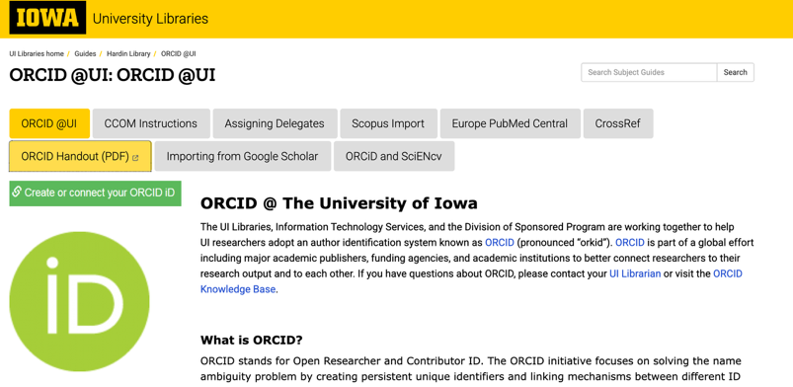
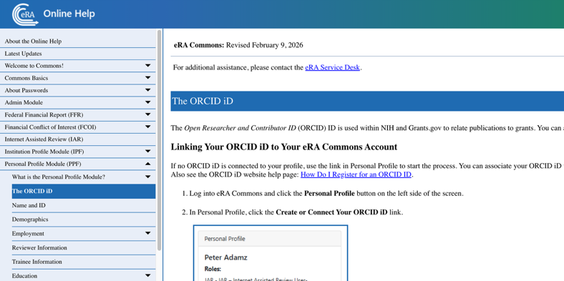
Resources for ORCiD and eRA Commons
Hardin Library Website
https://guides.lib.uiowa.edu/ORCID
Contact: Cassie Reed Thureson
eRA Commons Online Help
https://www.era.nih.gov/erahelp/commons/PPF_Help/8_2_orcid.htm

Slide 25
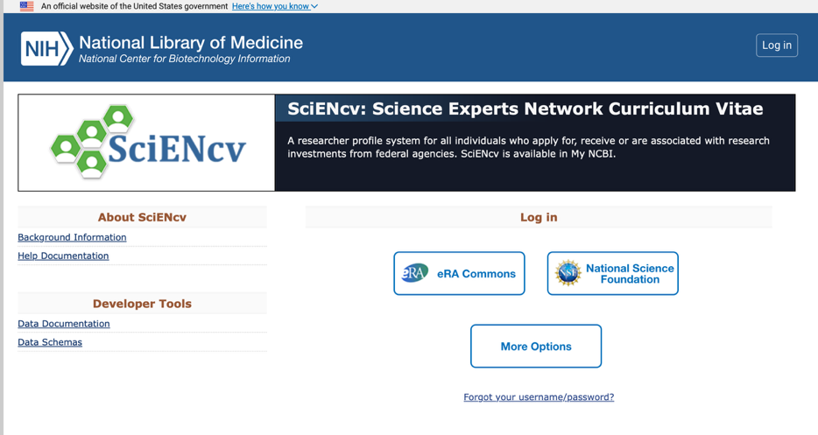
NIH requires use of SciENcv
Common Forms and biosketch supplement must be completed in SciENcv
SciENcv Help Manual:
https://www.ncbi.nlm.nih.gov/books/NBK154494/

Slide 26
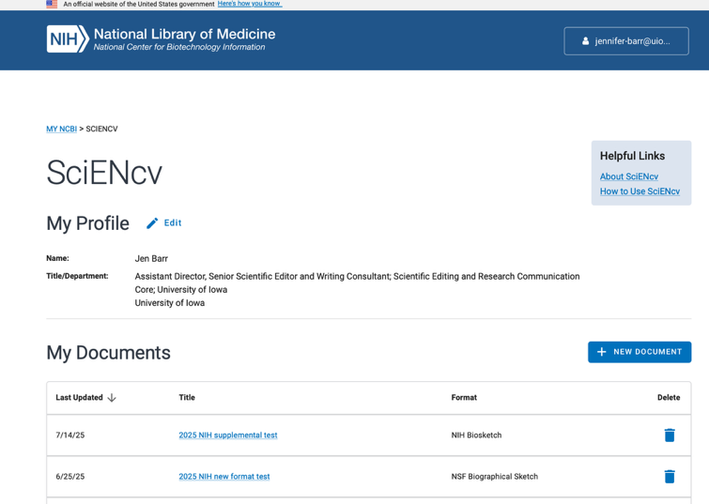
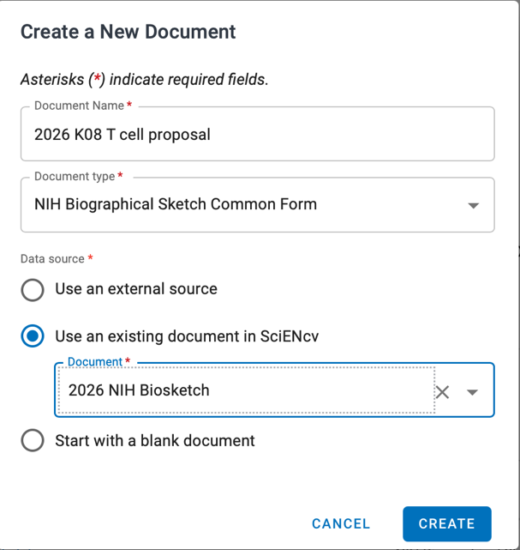
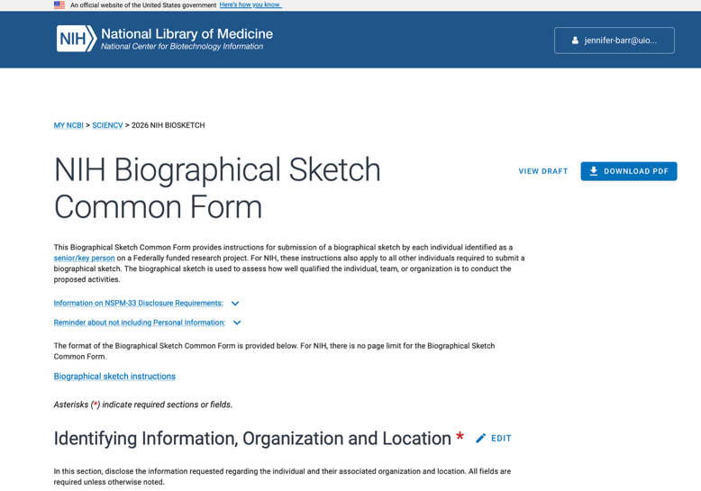
Using SciENcv to create your biosketch

Slide 27
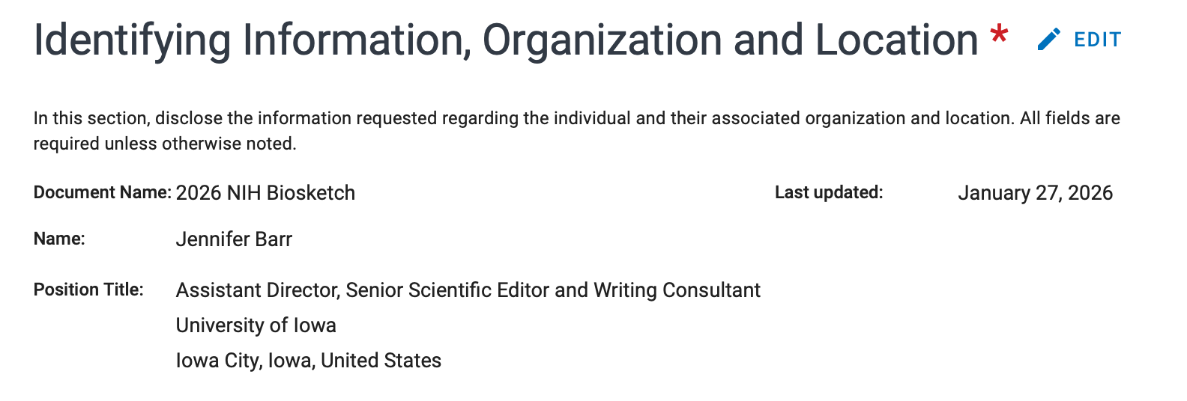
Identifying information
Populates automatically from ORCiD profile or previous biosketch
Persistent Identifier (PID): https://orcid.org/0000-0002-1688-730X
eRA Commons ID: barrjy
Last Updated: January 27, 2026

Slide 28
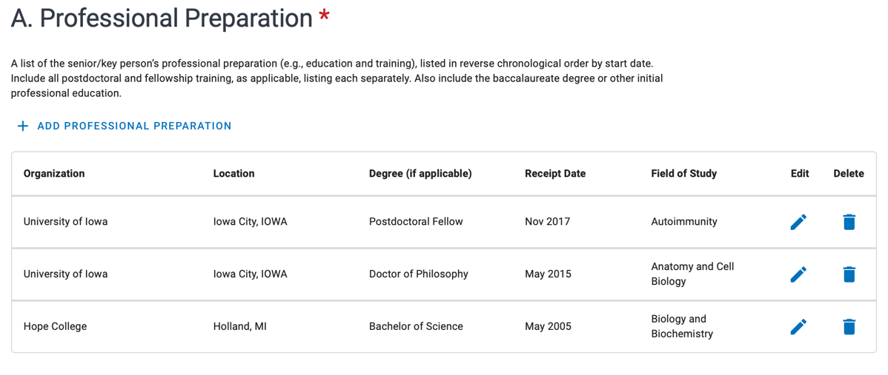
Professional preparation
List major academic or professional appointments, including postdoctoral and fellowship training
Information can be pulled from ORCiD profile or other biosketch
SciENcv will automatically organize in reverse chronological order

Slide 29
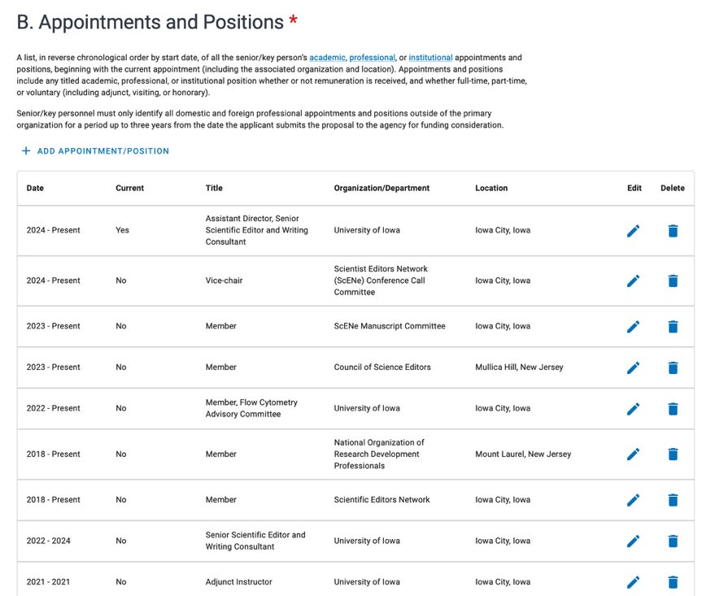
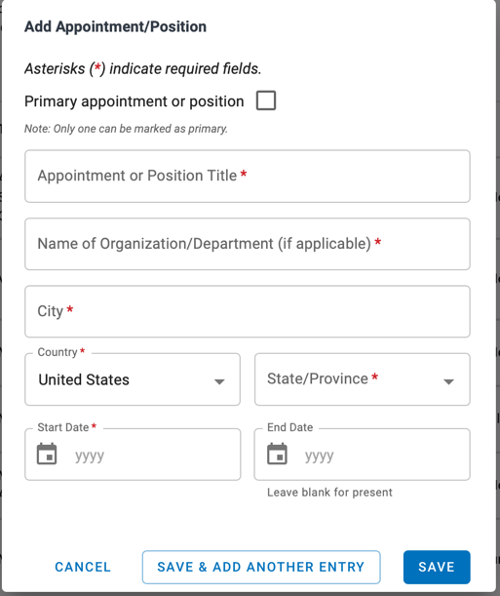
Appointments and Positions
Required to list all within the past 3 years but can also list older positions
Must indicate a primary appointment or position (can only list one)
Will show up as “Current” but does not appear in final PDF
Include leadership positions in professional organizations, service on NIH study sections, editorial review boards
Must include city, state, country of organizations
If a professional society, list the location of their headquarters

Slide 30
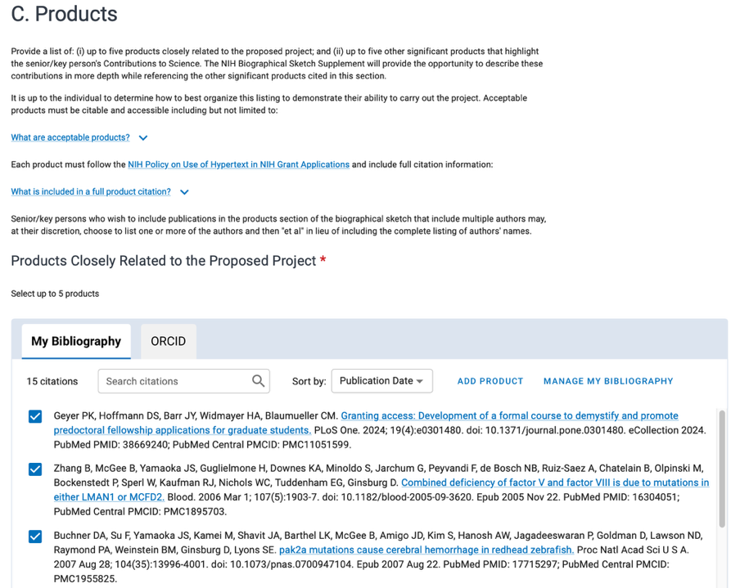
Products
Only include up to 5 products in two sections (10 total)
Products Closely Related to the Proposed Project
Other Significant Products Highlighting Contributions to Science*
Products pulled in from your My Bibliography and ORCiD profile
If you can’t find a product, check other tab (won’t show duplicates)
Link to full list of products (ORCiD profile) will be automatically populated at the top of the Biosketch upon export
Acceptable products:
Publications, conference papers, presentations
Website(s) or other Internet sites
Technologies or techniques
Inventions, patents, patent applications
Databases, datasets, software, models, curricula
* Only products listed in the Other Significant Products section can be referenced in the Contributions to Science paragraphs

Slide 31
NIH Biosketch Common Form + Supplement
Identifying Information, Organization, and Location
Name, title, ORCiD, eRA Commons ID
Professional Preparation
Education and training, including postdoctoral fellowships and residencies.
B. Appointments and Positions
Major academic, professional, or institutional roles (full-time, part-time, voluntary.
C. Products
5 related to proposal plus 5 additional, including publications, patents, presentations, datasets.
Common Form
Personal Statement
Up to 3500 characters about who you are and why you are well-suited for the project.
B. Honors
Up to 15 relevant academic and professional awards, scholarships, fellowships licensures, certifications.
C. Contributions to Science
Descriptions of up to 5 contributions, each limited to 2000 characters. Only reference citations in Products.
Supplement
Adapted from Robert Lawrence
https://medium.com/metascientific/entering-the-sciencv-era-for-nih-biosketches-5fdc1a96cd11

Slide 32
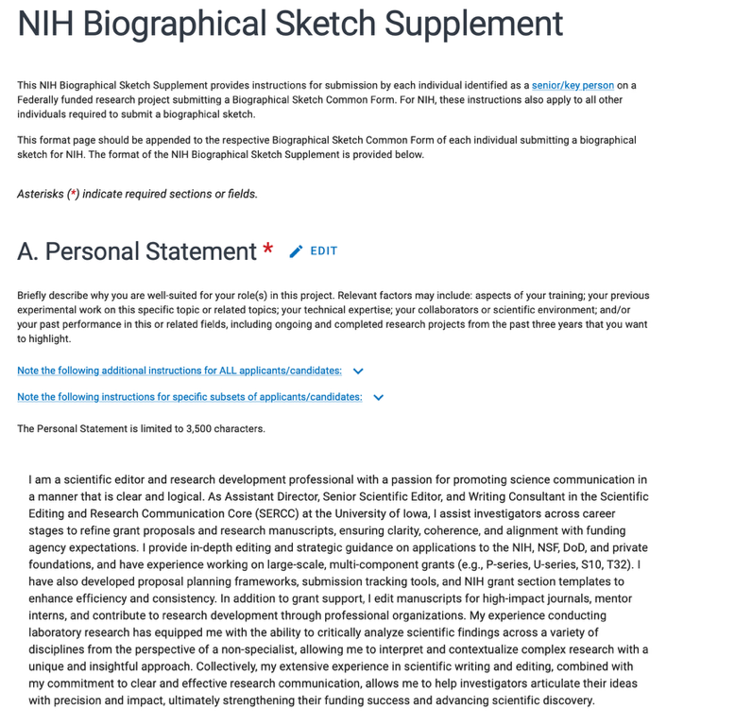
Personal Statement
Briefly describe the goal of the project and why you are well-qualified to achieve this goal. Relevant factors may include:
aspects of your training
previous experimental work on this topic or related topics
technical expertise
collaborators or scientific environment.
Limited to 3,500 characters
No longer allowed to include citations or list research support

Slide 33
Tips for writing the Personal Statement
Write in first person
If this is for a K award, make sure to describe long-term career goals and gaps you need to fill to achieve these
May describe impediments to past productivity
Indicate if you have published or created research products under a different name
Do not reference citations listed in Products Most Closely Related to the Proposed Project or Other Significant Products section in Common Form
Recommend general statements to research productivity
E.g., “We published standout article on neurological effects of chocolate in Science that has been cited 100 times.”
Tailor this for each specific grant application and make that obvious to reviewers
Mentors should highlight their previous experience with mentoring
Be specific
But be strategic and provide evidence of recovery

Slide 34
Personal Statement – Example 1 for K08
My long‑term goal is to become an independent physician‑scientist who leads a mechanistic immunology research program focused on translating discoveries in immune dysregulation into new therapies for autoimmune disease. My clinical work has shown me how limited current treatment options can be, and this motivates my commitment to research that bridges basic immunology with patient care. I am pursuing a K08 because I need focused training in advanced immunologic methods, single‑cell analysis, and computational approaches that will allow me to study immune circuits with far greater depth than my current experience permits. While my clinical and translational background has prepared me to identify important biological questions, I require additional mechanistic training to develop a fully independent research program. The proposed training plan—including coursework, mentored laboratory work, and computational skill development—is essential for acquiring these competencies. I am well prepared for this training based on my clinical expertise and research experience. During residency and fellowship, I completed several first‑author studies examining cytokine signaling and immune dysfunction in human disease samples. I have strong skills in flow cytometry, immune phenotyping, and translational biospecimen analysis, which provide a solid foundation for the more sophisticated mechanistic approaches I aim to master. I have assembled a highly complementary mentorship team with expertise in molecular immunology, computational biology, and translational research, creating an ideal environment for my development. The K08 award will provide the protected time, structured mentorship, and technical training needed to transition successfully to an independent, R01‑funded research career focused on unraveling and therapeutically targeting the molecular drivers of autoimmune disease.

Slide 35
Personal Statement – Example 1 notes
Clearly explains long-term career goal and provides rationale
My long‑term goal is to become an independent physician‑scientist who leads a mechanistic immunology research program focused on translating discoveries in immune dysregulation into new therapies for autoimmune disease. My clinical work has shown me how limited current treatment options can be, and this motivates my commitment to research that bridges basic immunology with patient care. I am pursuing a K08 because I need focused training in advanced immunologic methods, single‑cell analysis, and computational approaches that will allow me to study immune circuits with far greater depth than my current experience permits. While my clinical and translational background has prepared me to identify important biological questions, I require additional mechanistic training to develop a fully independent research program. The proposed training plan—including coursework, mentored laboratory work, and computational skill development—is essential for acquiring these competencies. I am well prepared for this training based on my clinical expertise and research experience. During residency and fellowship, I completed several first‑author studies examining cytokine signaling and immune dysfunction in human disease samples. I have strong skills in flow cytometry, immune phenotyping, and translational biospecimen analysis, which provide a solid foundation for the more sophisticated mechanistic approaches I aim to master. I have assembled a highly complementary mentorship team with expertise in molecular immunology, computational biology, and translational research, creating an ideal environment for my development. The K08 award will provide the protected time, structured mentorship, and technical training needed to transition successfully to an independent, R01‑funded research career focused on unraveling and therapeutically targeting the molecular drivers of autoimmune disease.
Need for proposed training (could be more specific)
Highlights previous experience, including publications
Further specifies benefits of K08 proposal

Slide 36
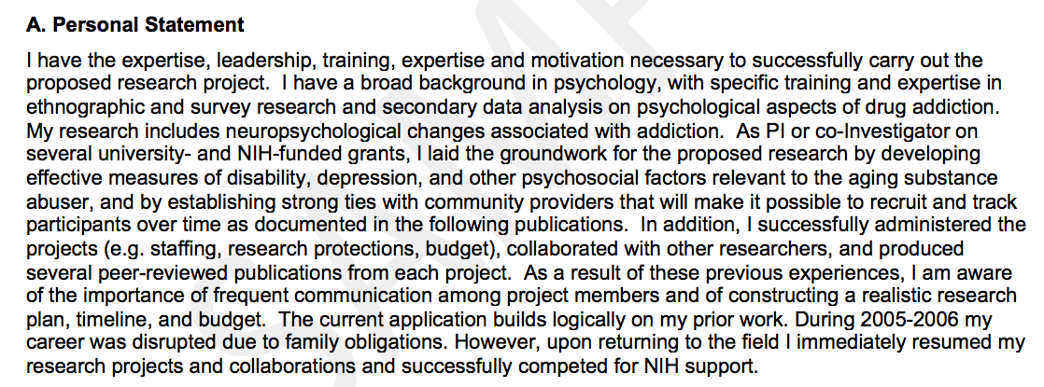
Personal Statement – Example 2 for R01*
*Older example before Common Forms were required

Slide 37
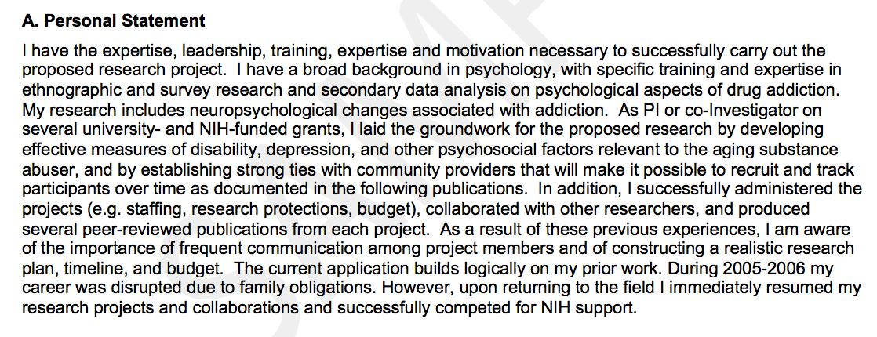
Personal Statement – Example 2 notes
Vague, would make this more specific to proposed project
Describes background and highlights past funding success.
Provides evidence for leadership abilities
Takes opportunity to explain factors that affected past productivity.
*Older example before Common Forms were required

Slide 38
Personal Statement – Example 3 for T32
I have more than 20 years of experience in graduate training, mentorship, and interdisciplinary research in cellular neurobiology. As Director of Graduate Training Initiatives in the Department of Neuroscience, I have overseen curriculum development, trainee progress assessment, and the coordination of cross-departmental training activities. I have mentored 16 PhD students and 8 postdoctoral fellows, many of whom now hold academic or industry positions. My research program integrates molecular neuroscience, systems physiology, and computational analysis—providing trainees with exposure to diverse experimental and analytical approaches.
I have led multiple institutional training efforts, including serving as Co‑Director of the Interdisciplinary Neuroscience Training Program from 2017–2024. My experience in program administration, commitment to trainee development, and track record of fostering inclusive, supportive training environments position me well to lead this T32 training program.

Slide 39
Personal Statement – Example 3 notes
I have more than 20 years of experience in graduate training, mentorship, and interdisciplinary research in cellular neurobiology. As Director of Graduate Training Initiatives in the Department of Neuroscience, I have overseen curriculum development, trainee progress assessment, and the coordination of cross-departmental training activities. I have mentored 16 PhD students and 8 postdoctoral fellows, many of whom now hold academic or industry positions. My research program integrates molecular neuroscience, systems physiology, and computational analysis—providing trainees with exposure to diverse experimental and analytical approaches.
I have led multiple institutional training efforts, including serving as Co‑Director of the Interdisciplinary Neuroscience Training Program from 2017–2024. My experience in program administration, commitment to trainee development, and track record of fostering inclusive, supportive training environments position me well to lead this T32 training program.
Presents support for being the right leader for this T32 in particular
Tailor personal statement for each application

Slide 40
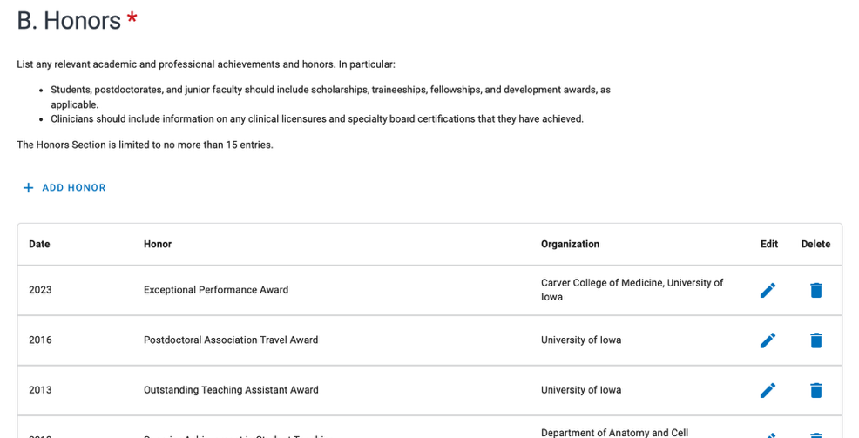
Honors
List academic and professional achievements and awards, including scholarships, fellowships, and development awards
Clinicians should include clinical licensures and specialty board certifications
Limited to 15 entries
Must have at least 1 entry (N/A in fields if no honors)

Slide 41
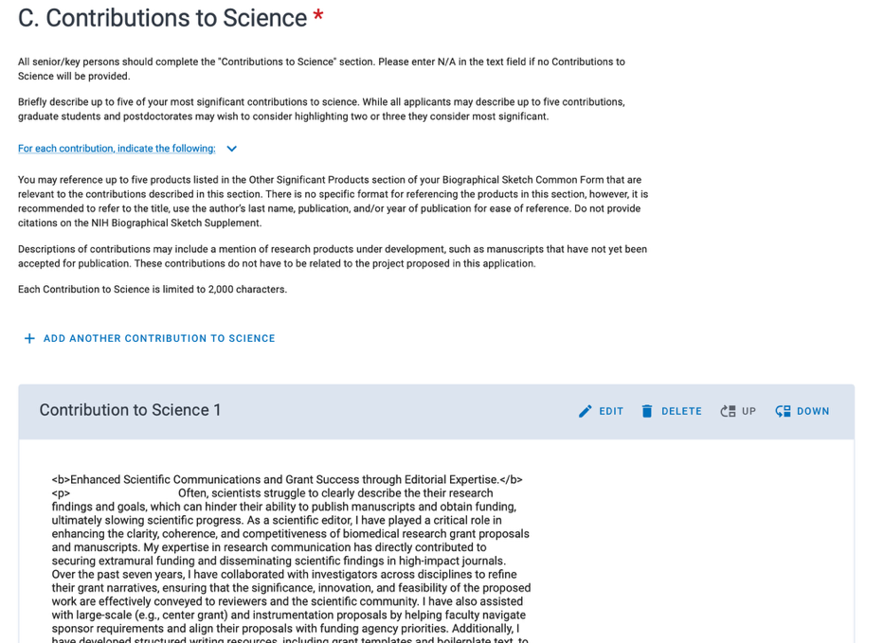
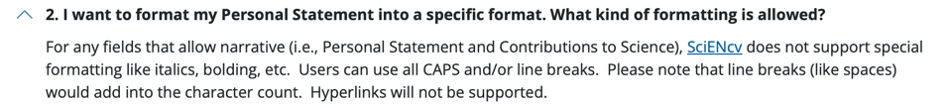
Contributions to Science
Limited to 2000 characters each
Can include up to 5 contributions
Refer to any of the 5 citations in the Other Significant Products section but no others
Some people have used html tagging to format but would caution against for now
Counts towards character limit
Unclear if this is acceptable by NIH
https://grants.nih.gov/faqs#/common-forms-biographical-sketch-current-pending-support.htm?anchor=12020

Slide 42
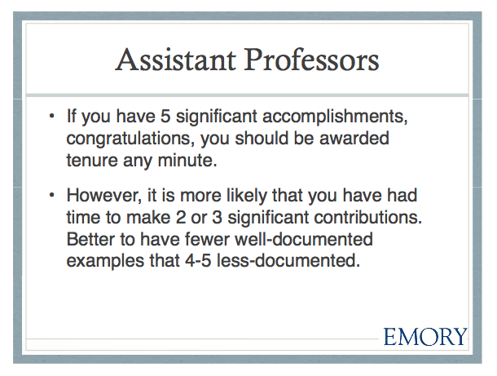
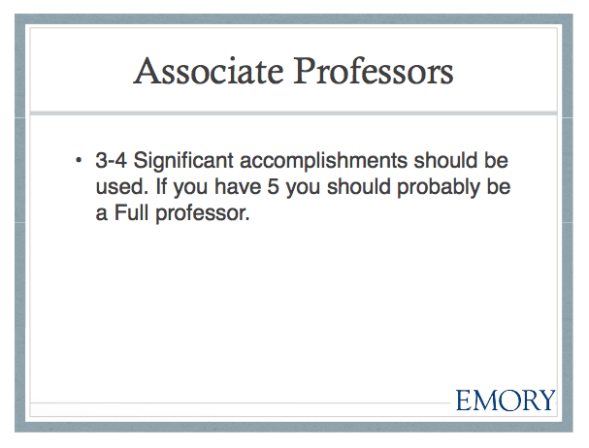
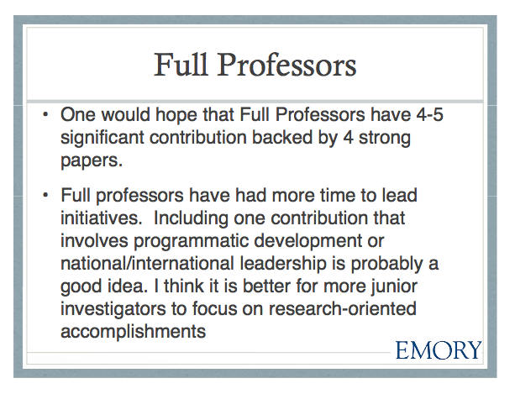
The number of contributions depends on career stage
Considering your level of experience, briefly describe your most significant contributions to science.
While all applicants may describe up to five contributions, graduate students, postdocs, and junior faculty are encouraged to consider highlighting two or three they feel are most meaningful.
Janet Gross, PhD & Gary Miller, PhD
Demystifying the New NIH Biosketch

Slide 43
Content to include in your contributions
Start each contribution with header indicating what it’s about (or what you showed)
e.g., Demonstrated xyz… or Identified abc…
At the very least end this with a period so it does not create a run-on sentence
For each contribution, indicate:
historical background or status quo that frames the scientific problem
the central finding(s)
the influence of the finding(s) on the progress of science or the application of those finding(s) to health or technology
your specific role in the described work.
If referencing a product from the Other Significant Product section, no specified format but you may include the title, author’s last name, publication, year of publication, and PMCID/PMID as part of the short reference
Helps the reviewers appreciate the barriers your study overcomes.
Don’t leave this out!

Slide 44
Write your contributions as a short story
Tell a story to engage the reader and convey your excitement about your science
Provide a logical beginning, middle and ending
Beginning: What was the problem
Middle: What you did
End: What the implications were
Don’t limit yourself to facts and figures; avoid making this just another description of scientific results.
Use “I” and active voice
Cover all aspects that qualify you to study the problem
Expertise/experience
Leadership skills
Cover all aspects of the outcomes
Products and impact on the field
Established collaborations
Skills developed or practiced (data analysis, writing, presentations)

Slide 45
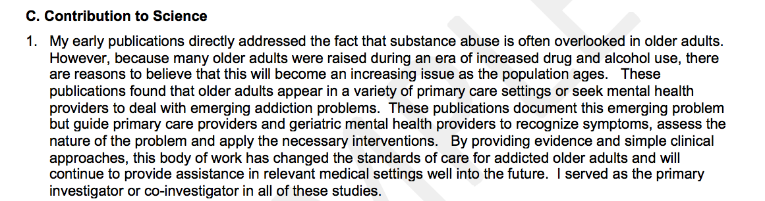
Contributions to Science – Example 1
*Older example before Common Forms were required

Slide 46
Contributions to Science – Example 1 notes
Key issue that was addressed.
Specific research outcomes from publications
Broader impact
Specifies role and uses first person
*Older example before Common Forms were required

Slide 47
Contributions to Science – Example 2
Established Drosophila as a model in which to study lamin biology and disease mechanisms. The nuclear lamina is an extensive protein network that lies underneath the inner membrane of the nuclear envelope. Lamins are the major structural components of the lamina, establishing mechanical support and providing a platform for protein interactions that contribute to gene regulation, DNA replication, and genome stability. Mutations in human lamins are responsible for over seventeen diseases called laminopathies. The phenotypes of these diseases fall into the following major groups: muscle diseases, peripheral neuron diseases, accelerated aging disorders and metabolic disorders. Mechanisms underlying the laminopathies are poorly understood. The Drosophila genome has two lamin genes, a B-type lamin (lamin Dm0) and an A-type lamin (lamin C). Given that the A-type lamin is responsible for most laminopathies, we studied the requirements for its counterpart, lamin C, in Drosophila development. We also compared the properties of Drosophila lamins to those of human A-type lamin and used the Drosophila GAL4-UAS system to express Drosophila mutant lamin C proteins modeled after human-disease causing lamins. Collectively, these studies established Drosophila as an excellent model for studying human lamins. I established a collaboration with investigators in Dr. Lori Wallrath’s laboratory at the University of Iowa and co-led the studies leading to these discoveries.

Slide 48
Contributions to Science – Example 2 notes
Clear header
Established Drosophila as a model in which to study lamin biology and disease mechanisms. The nuclear lamina is an extensive protein network that lies underneath the inner membrane of the nuclear envelope. Lamins are the major structural components of the lamina, establishing mechanical support and providing a platform for protein interactions that contribute to gene regulation, DNA replication, and genome stability. Mutations in human lamins are responsible for over seventeen diseases called laminopathies. The phenotypes of these diseases fall into the following major groups: muscle diseases, peripheral neuron diseases, accelerated aging disorders and metabolic disorders. Mechanisms underlying the laminopathies are poorly understood. The Drosophila genome has two lamin genes, a B-type lamin (lamin Dm0) and an A-type lamin (lamin C). Given that the A-type lamin is responsible for most laminopathies, we studied the requirements for its counterpart, lamin C, in Drosophila development. We also compared the properties of Drosophila lamins to those of human A-type lamin and used the Drosophila GAL4-UAS system to express Drosophila mutant lamin C proteins modeled after human-disease causing lamins. Collectively, these studies established Drosophila as an excellent model for studying human lamins. I established a collaboration with investigators in Dr. Nobel’s laboratory at the University of Iowa and co-led the studies leading to these discoveries.
Context and rationale for studies
Knowledge gap
Explains broader significance of studies.
Specifies additional outcomes (collaboration) and describes their role

Slide 49
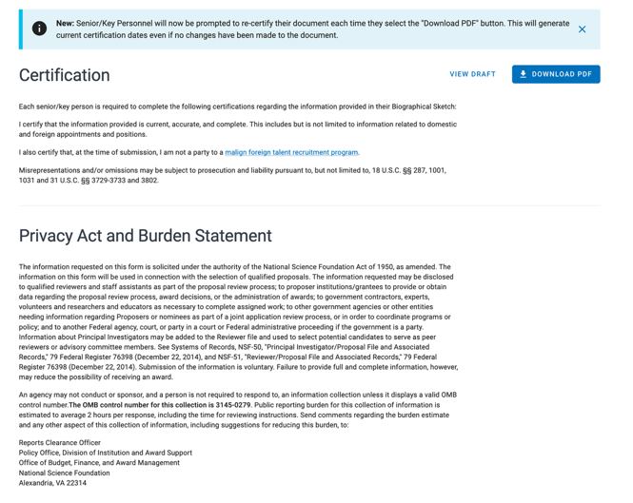
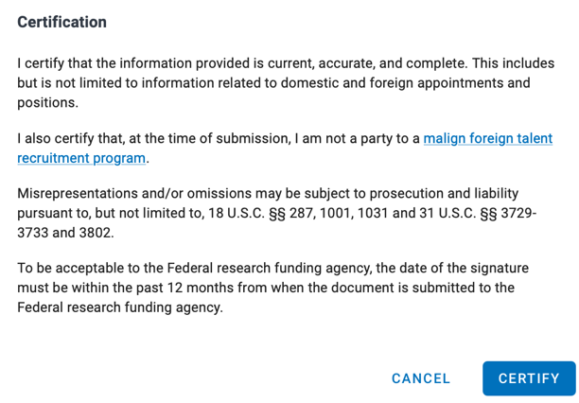
Certifying the biosketch
Final (new) step!
Investigators are required to certify information before the Biosketch can be downloaded as a PDF.
Delegates cannot do this, only the investigator.
When you click the button to download your biosketch as a PDF, a message automatically pops up asking you to certify the information.
Once certified and downloaded, the Biosketch cannot be edited without re-certifying the information.

Slide 50
Other considerations for the biosketch
Keep your ORCiD profile updated
There is no longer a place to link to your My Bibliography; instead, a link to your ORCiD profile will automatically be included
Do not include hyperlinks/URLs
NIH does not allow hyperlinks or URLs to be added outside of those that will be automatically generated (ORCiD; PMCID/PMID)
Janet Gross, PhD & Gary Miller, PhD
Demystifying the New NIH Biosketch

Slide 51

General Tips and Resources

Slide 52
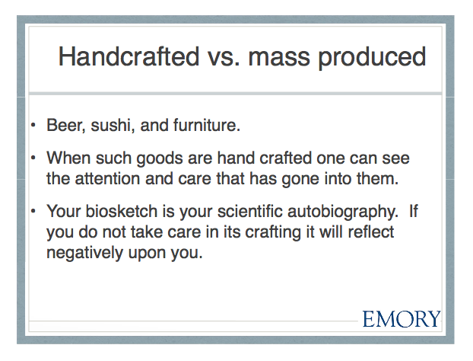
Take time to craft your biosketch
Update your biosketch for each new grant application, especially the Personal Statement, so that it is tailored directly to the specific grant proposal being submitted.
Janet Gross, PhD & Gary Miller, PhD
Demystifying the New NIH Biosketch

Slide 53
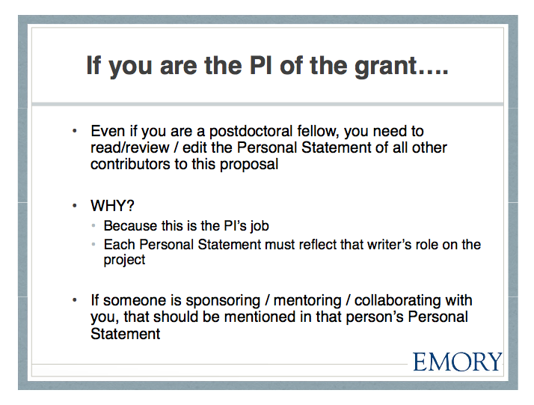
Review all biosketches associated with your grant
This is especially true for career development awards.
Make sure your mentor’s biosketch illustrates their commitment to mentoring and training.
Janet Gross, PhD & Gary Miller, PhD
Demystifying the New NIH Biosketch

Slide 54
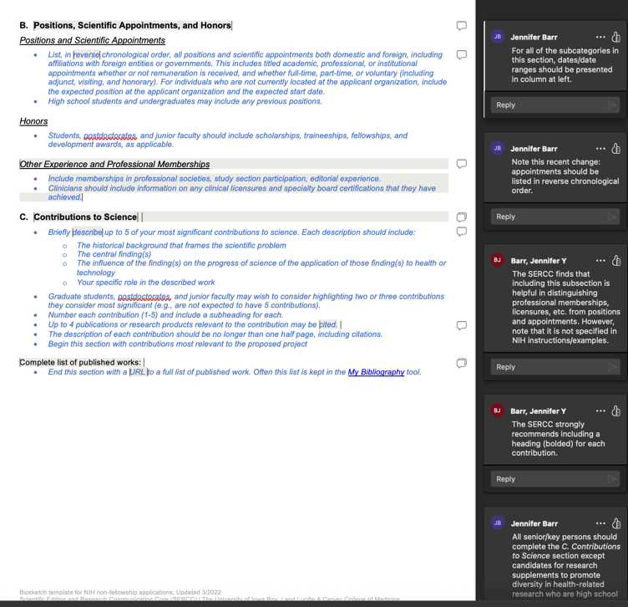
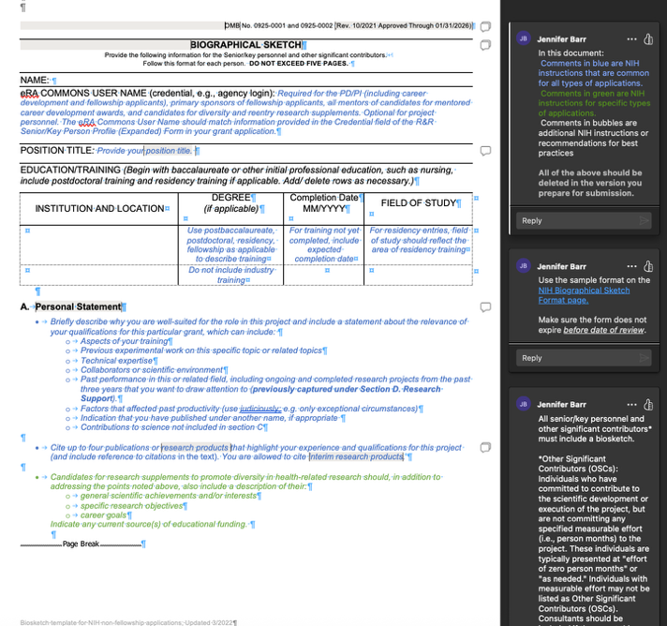
Help for content of biosketch
SERCC template incorporates NIH instructions and has an example (will be updated soon)
Recommend writing the Personal Statement and Contributions to Science is a separate document to edit (and receive feedback on) before uploading to SciENcv
https://sercc.medicine.uiowa.edu/resources/writing-grants - accordion-item-1116-0

Slide 55
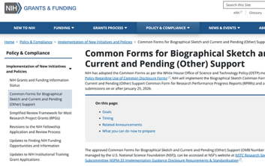
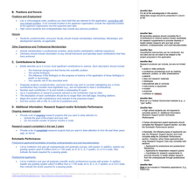
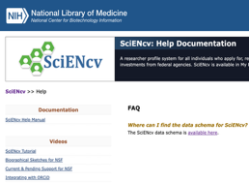
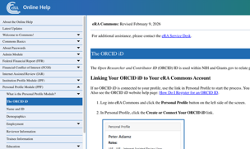
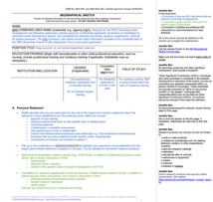

Resources
NIH Common Forms for Biosketch webpage
SERCC templates
SciENcv website
Hardin Library Website
eRA Commons Online Help
https://grants.nih.gov/policy-and-compliance/implementation-of-new-initiatives-and-policies/common-forms-for-biosketch
FAQs: https://grants.nih.gov/faqs#/common-forms-biographical-sketch-current-pending-support.htm
https://sercc.medicine.uiowa.edu/resources/writing-grants#sercc-templates-and-examples
https://www.ncbi.nlm.nih.gov/sciencv/
https://guides.lib.uiowa.edu/ORCID
Contact: Cassie Reed Thureson
https://www.era.nih.gov/erahelp/commons/PPF_Help/8_2_orcid.htm

Slide 56
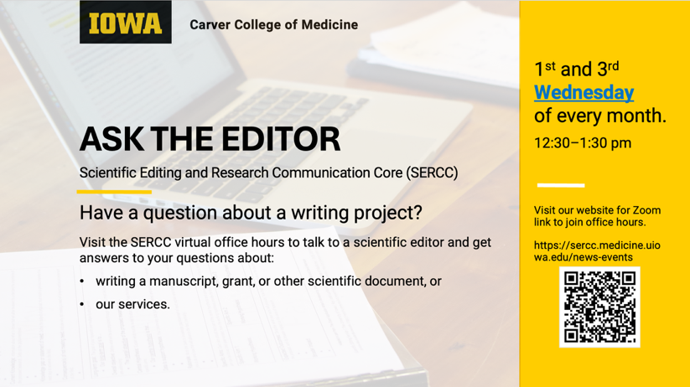
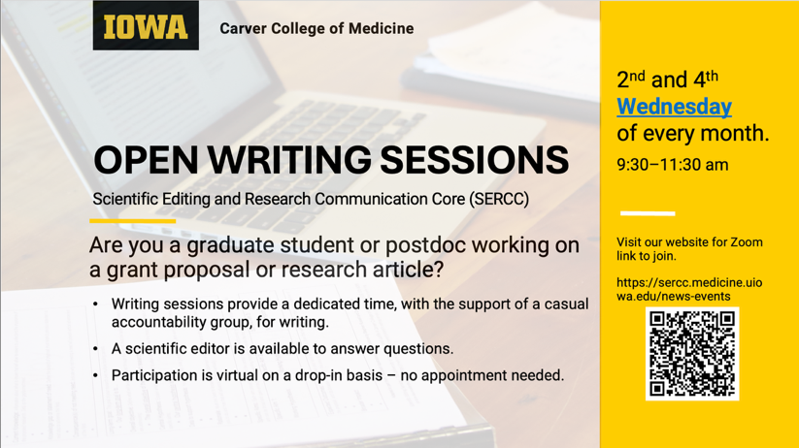
SERCC Drop-in Sessions
Ask the Editor
https://sercc.medicine.uiowa.edu/news/2025/12/ask-editor
Open Writing Sessions*
https://sercc.medicine.uiowa.edu/news/2026/01/open-writing-sessions
* Only for students and postdocs

Slide 57
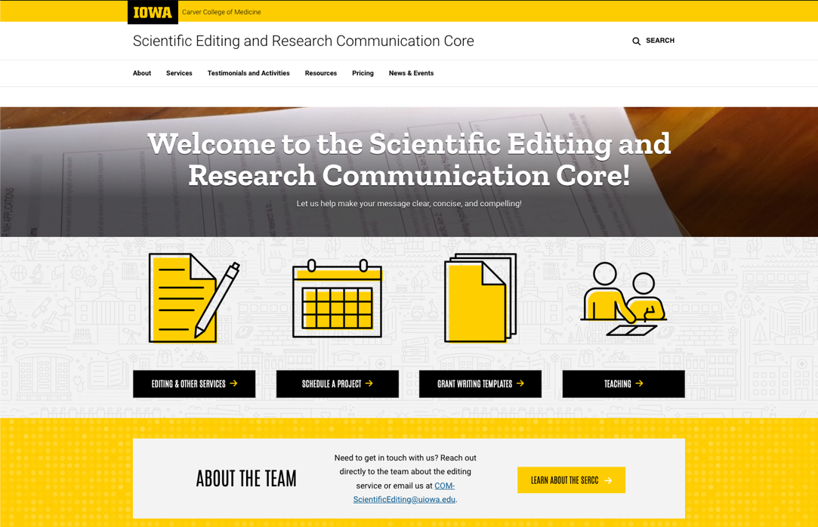
SERCC Website
Resources
Grant-Writing Templates
Pricing
Services
Schedule a Project
Contact us
https://sercc.medicine.uiowa.edu/

Slide 58
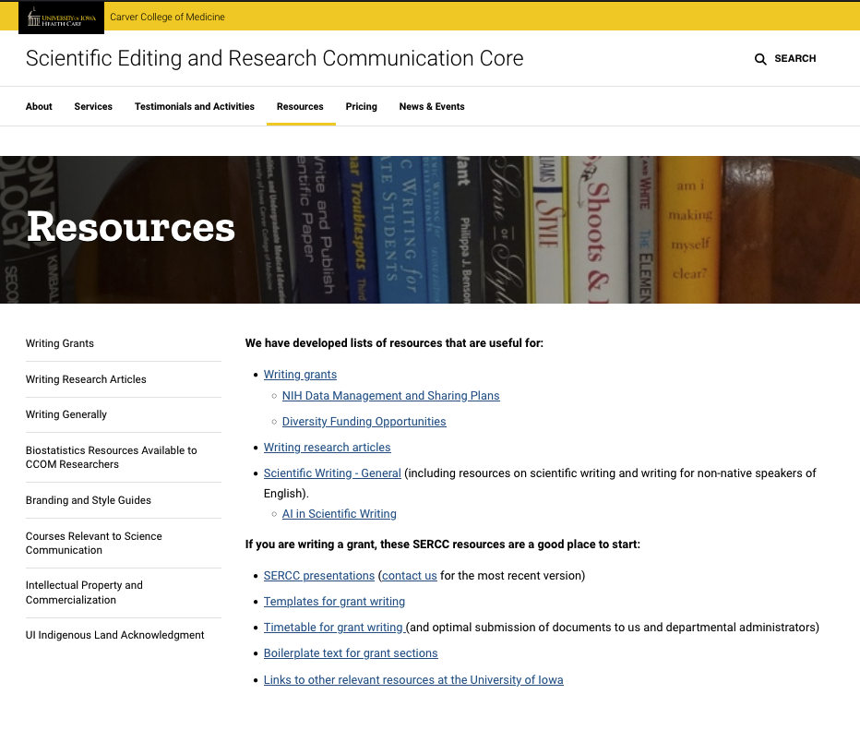
SERCC Resources
Writing Grants:
Templates
Core facilities descriptions
List of available lectures
Links to other resources
Writing Research Articles:
Tips for paper sections
List of available lectures
Suggested books
Writing Generally:
List of available lectures
Suggested articles/books
Resources for non-native speakers

Slide 59
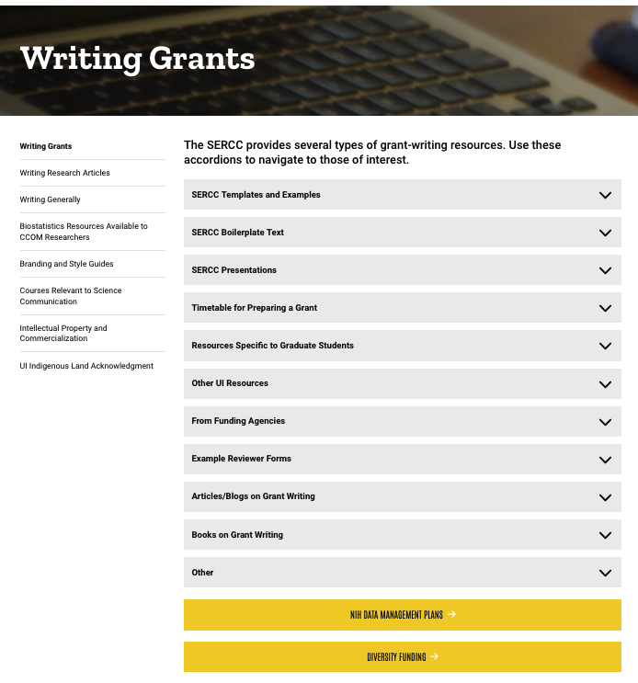
Resources for writing grants
Biosketch templates
Templates and Embedded Examples
Boilerplate Text and Examples
Presentations
Timetables for Preparing Grants
Resources Specific to Graduate Students
Resources from other offices and institutes
Articles/blogs, books, other

Slide 60
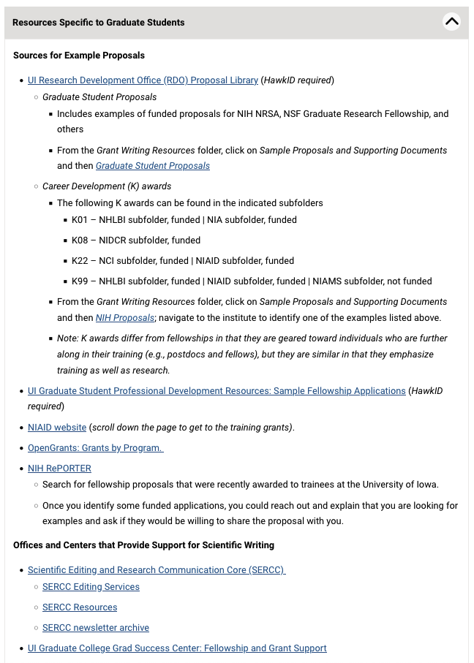
Links to resources from other groups
Sources for example proposals:
OVPR/RDO (e.g., Resource Library)
UI Graduate College
UI Writing Center (CLAS)
Hanson Center for Communication (Eng)
Funding Agencies and other
National Institutes of Health (NIH, NAIAD)
Open Grants

Slide 61

Other resources
Biostatistics Resources
Branding Style Guidelines
Courses Relevant to Science Communication
Intellectual Property and Commercialization
SERCC Newsletter
Open Writing Sessions
Ask the Editor (virtual office hours)

Slide 62


Some past Newsletter topics

Slide 63
Questions?
Email
jennifer-barr@uiowa.edu
COM-ScientificEditing@uiowa.edu
sercc.medicine.uiowa.edu

