Slide 1
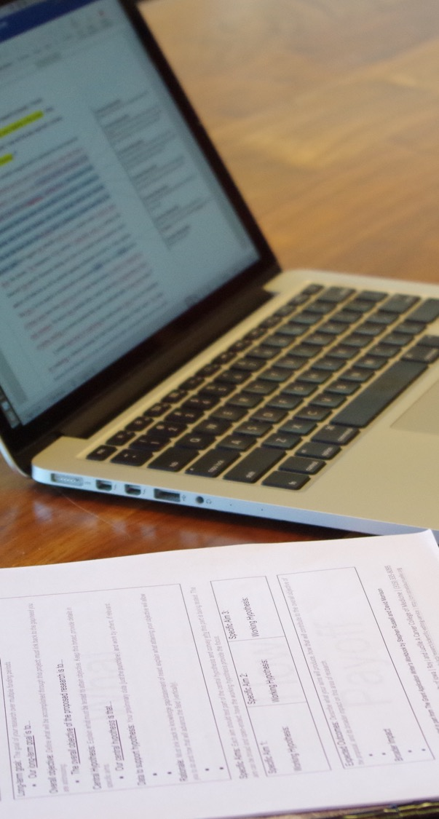
Reference Letters and
Letters of Support for NIH fellowship applications
Jennifer Barr, PhD | SERCC
October 2025
Notes:
Today’s session will reviewing the biosketch, and discuss some upcoming changes to the biosketch format that you can anticipate for next spring.

Slide 2
Reference Letters
General information
Reference letters are required for some grant programs, such as fellowship and career development awards
  They must be submitted by the referee through eRA commons by the application deadline
  They should be no longer than 2 pages
  You will be notified by email when letters are submitted, but they will remain confidential
You must have 3, but no more than 5, reference letters
Resubmission applications require referees to submit updated letters
You must include names of referees in cover letter of the application
https://grants.nih.gov/grants-process/write-application/advice-on-application-sections/reference-letters

Slide 3
Reference Letter Referees
Who to select as Referees
Individuals who can speak to your training, accomplishments, career goals, and potential
  Consider program directors
  Clerkship supervisors
  Thesis Committee members
  Undergraduate research advisor, if you did significant undergraduate research relatively recently
Select one person outside your department to show outside support
Sponsor and any co-sponsor cannot be a referee (they provide statements in the Sponsor/Co-sponsor sections of the application)
Resubmissions do not need to use the same list of referees but do require new reference letter from all referees chosen

Slide 4
Reference Letters: information for referees
What information to provide your referees
The date the application is due
Your eRA commons User ID
Your full name as it appears in eRA commons
Your funding opportunity announcement number
Reference Letter Confirmation Number (only if resubmitting)
Biosketch, project title, and Specific Aims page
Suggested areas that you’d like them to address (background, personal characteristics, areas for development)
Formal instructions with suggested evaluation points are shown on next slide and available through NIH website
  https://grants.nih.gov/grants-process/write-application/advice-on-application-sections/reference-letters
Pairs letter with the application

Slide 5
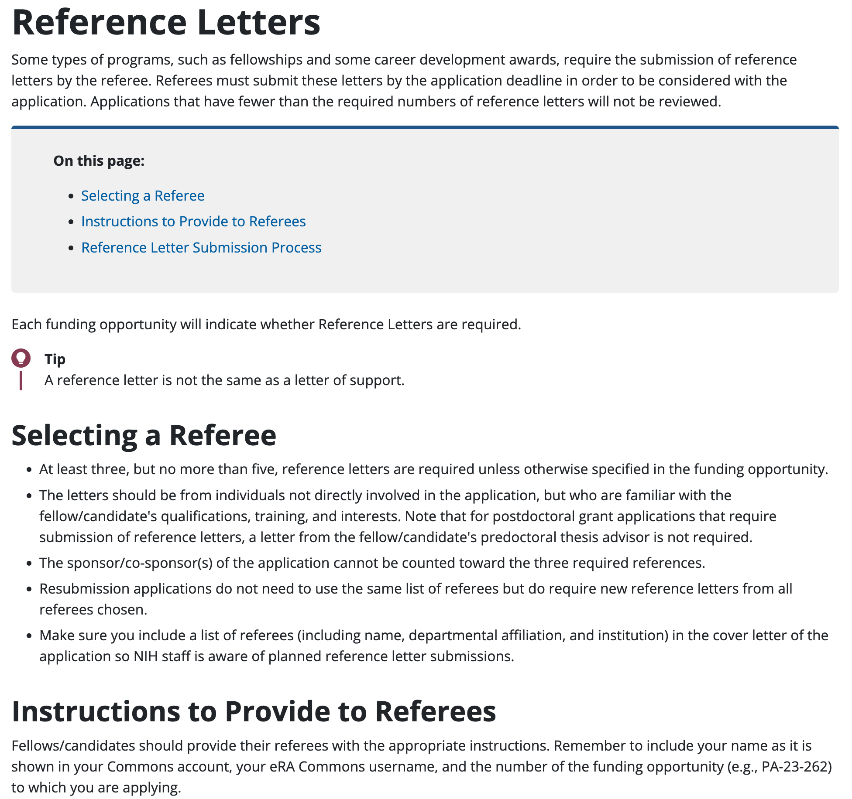
Reference Letters: Updated Instructions
Updated in January 2025
Provides more structure so reviewers can assess
  candidate’s strengths and weaknesses
  potential to pursue a productive career in biomedical science.
https://grants.nih.gov/grants-process/write-application/advice-on-application-sections/reference-letters

Slide 6
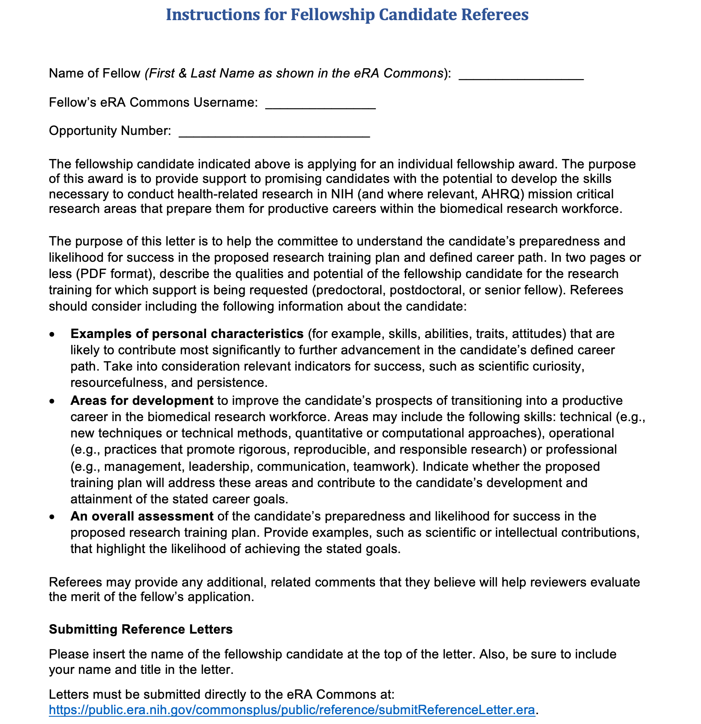
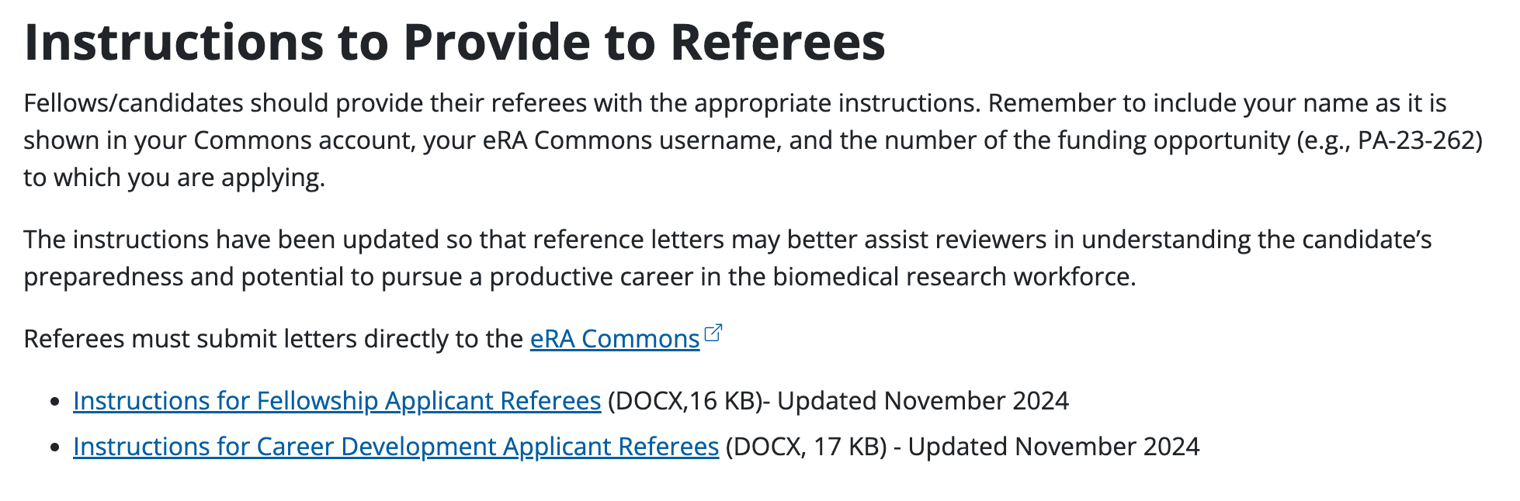
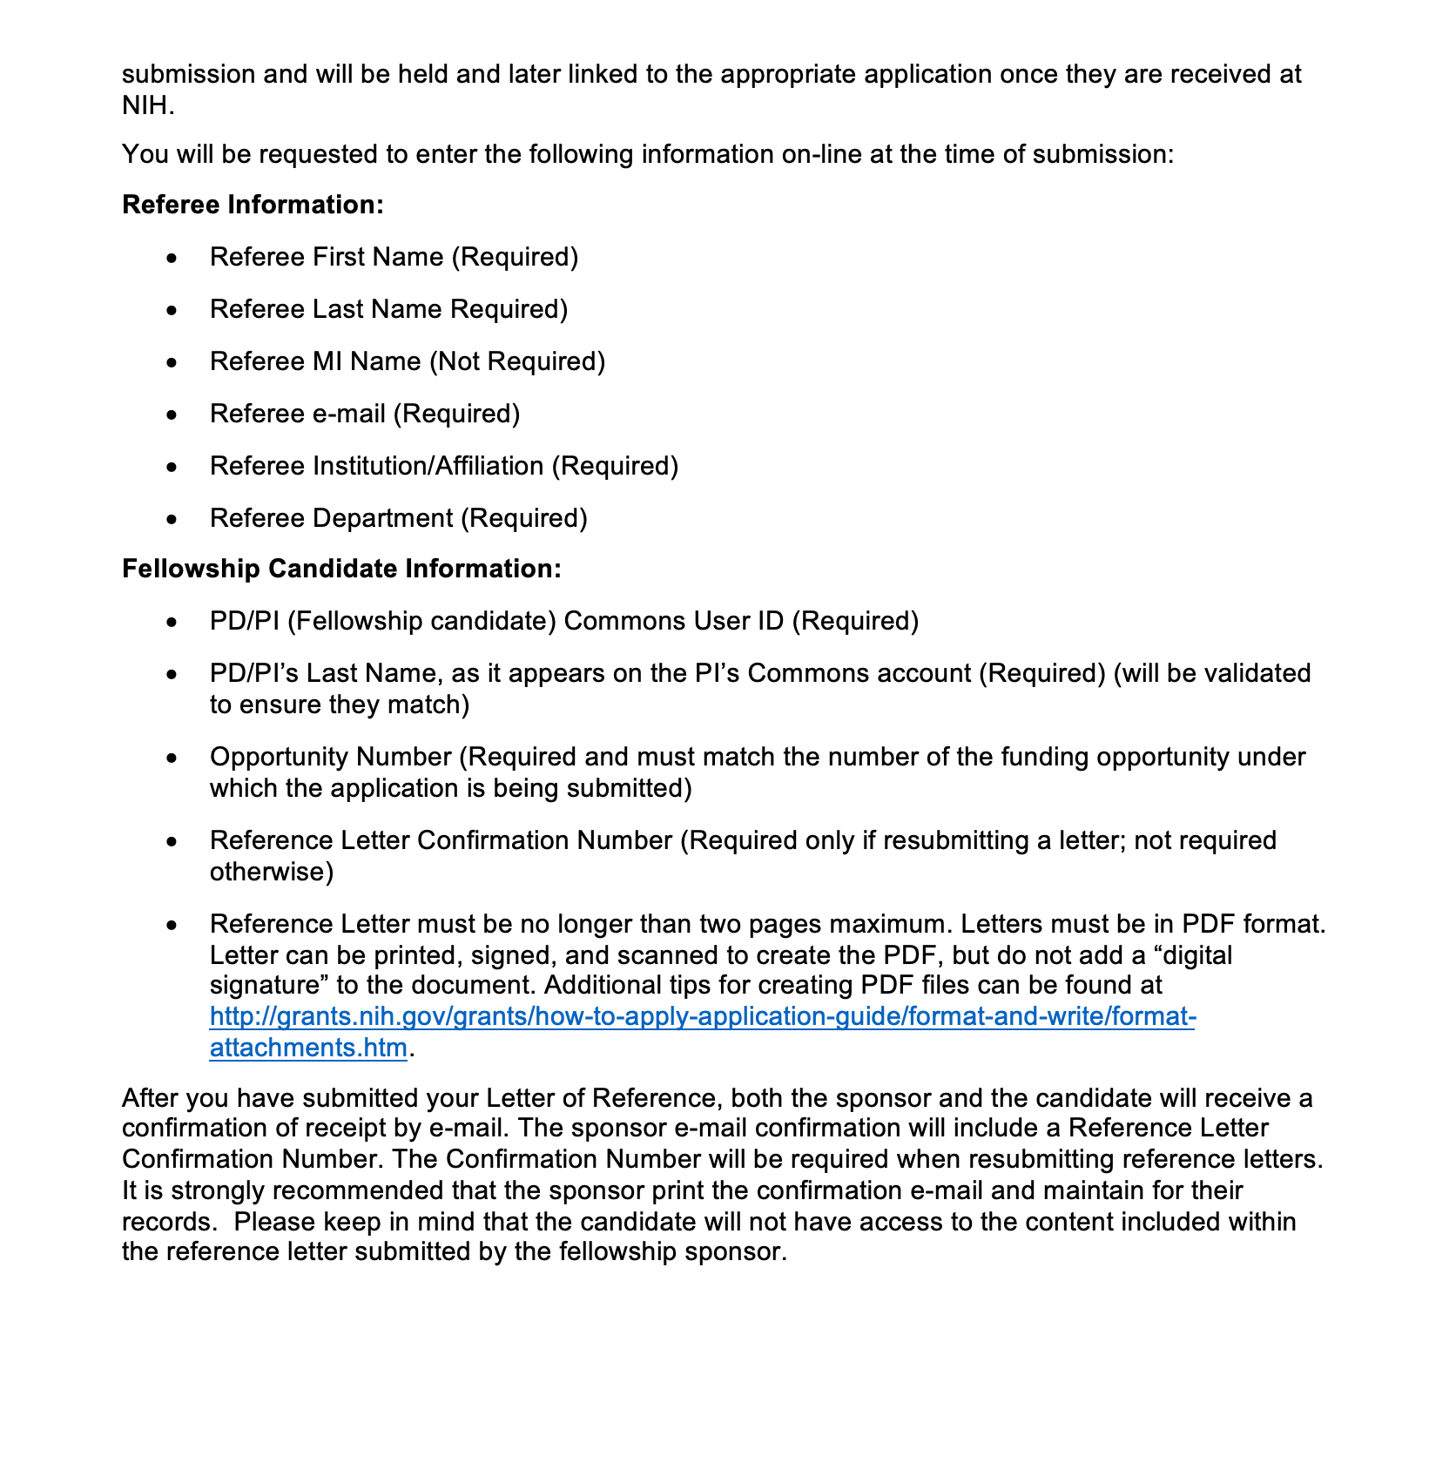
Reference Letter Instructions
Download instructions for Fellowship Applicant Referees
Fill out the top and send to your referees
You must include a list of referees (including name, departmental affiliation, and institution) in the cover letter of the application
https://grants.nih.gov/grants-process/write-application/advice-on-application-sections/reference-letters

Slide 7
Reference Letters: Timeline
Suggested timeline
1 month before submission date -> formally request reference letter
2 weeks before submission date -> follow up with referees
  You can monitor submission status through eRA commons account
  You should receive confirmation when letters are uploaded
YOU are responsible for ensuring the letters are submitted. Follow up with your referees prior to the due date if the letters have not been submitted.

Slide 8
Letters of Support
General information
Letters of support are used to demonstrate
  institutional commitment or resources
  collaboration or role in the project
  Support by a potential or current user of a resource or service proposed in the application
Be sure to indicate the role (how/when) of collaborators, contributors, consultants in your training plan
If an individual will play a larger role in your project, consider obtaining a letter of support and including them as a Key Person (with biosketch)
You are allowed 6 pages for letters of support

Slide 9
Who Should Provide Letters of Support
Who to select
Collaborators/consultants who provide:
Data
Key resources
Instruction on a technique or use of specialized equipment
Analyses
Contributors, such as:
Thesis committee members
Clinical mentors
Advisors

Slide 10
Information to Provide for Letters of Support
What information to provide
Describe the type of support they will provide to the project
Summarize any agreements you have in place that are in support of your project
Suggested timeline:
Ask for letters of support at least 1 month before grant deadline
Consider drafting letters of support and providing them as a template when asking for letter
Letters of support will be uploaded by you/your administrator with the rest of your grant application

Slide 11
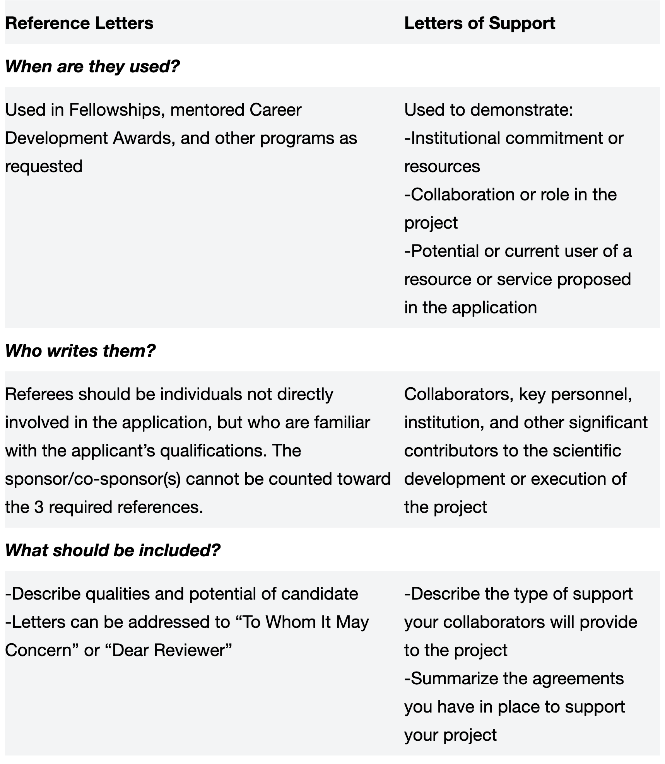

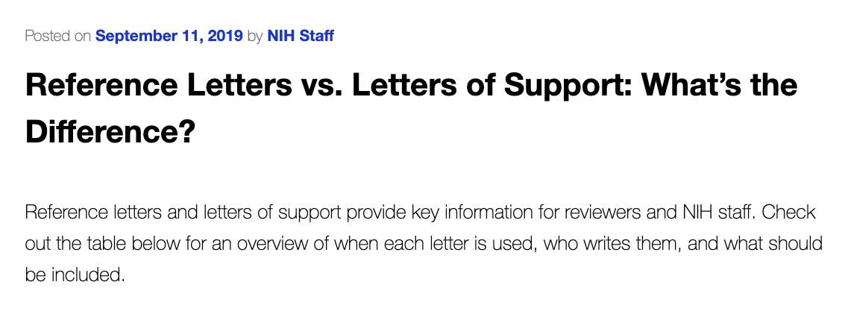
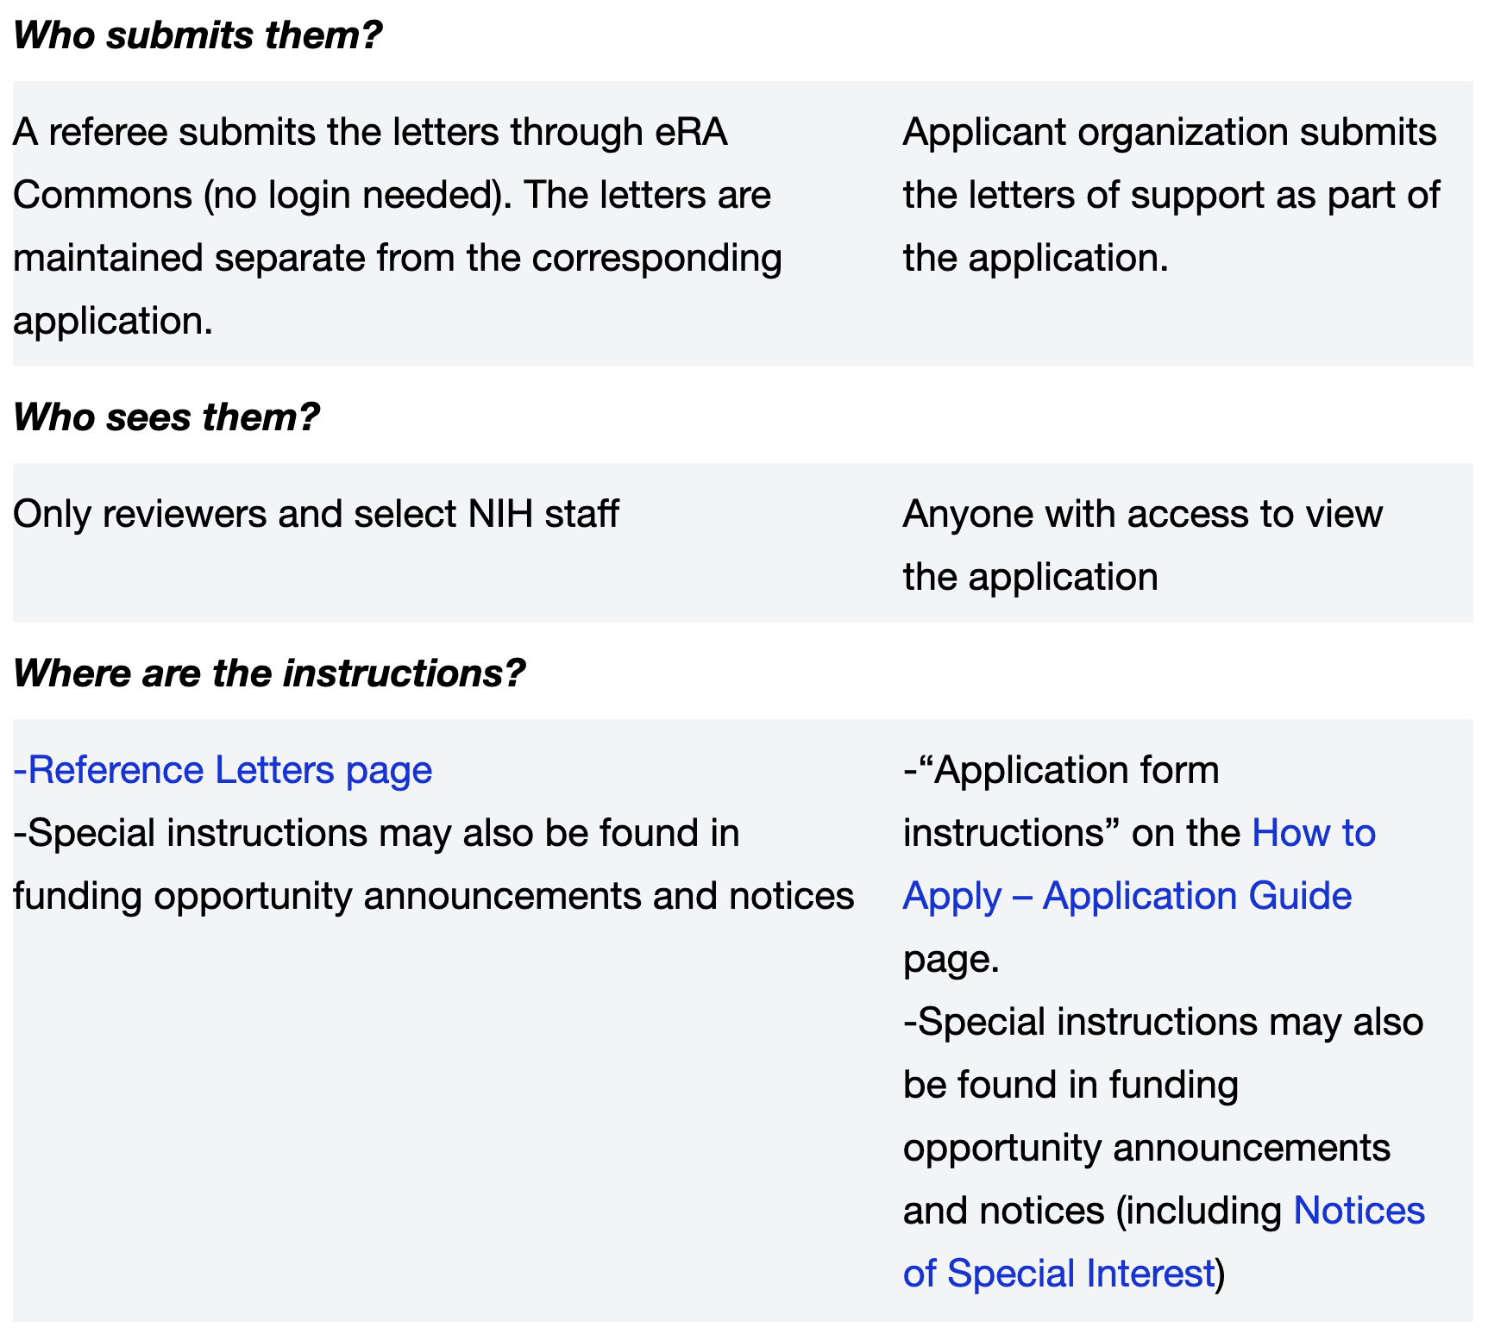
Letters of Support vs. Reference letters

