Slide 1
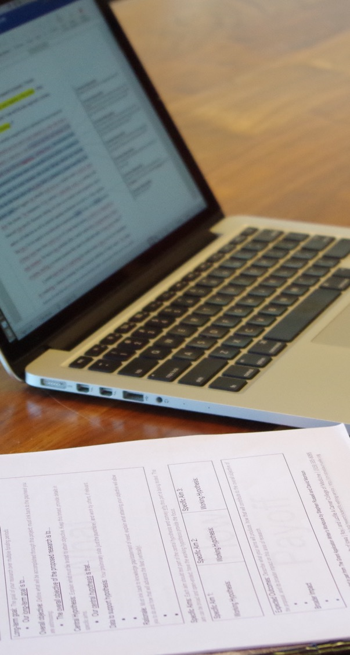
Workshop III:
Achieving Clarity in Scientific Writing
Jennifer Barr, PhD | SERCC
(Lecture)
Grant-Writing Basics
Fall 2025

Slide 2

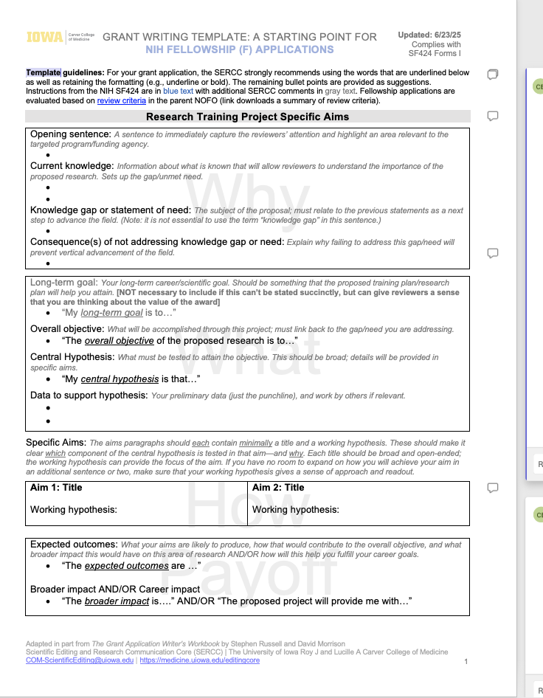
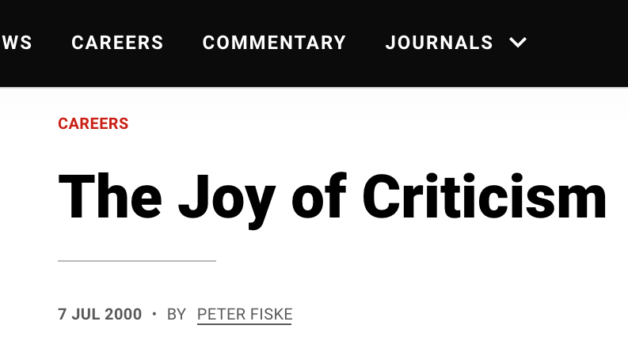
In class
Example paragraphs and iconic story
Writing time: apply principles from this session to your Specific Aims page
Discuss articles on receiving feedback

Slide 3
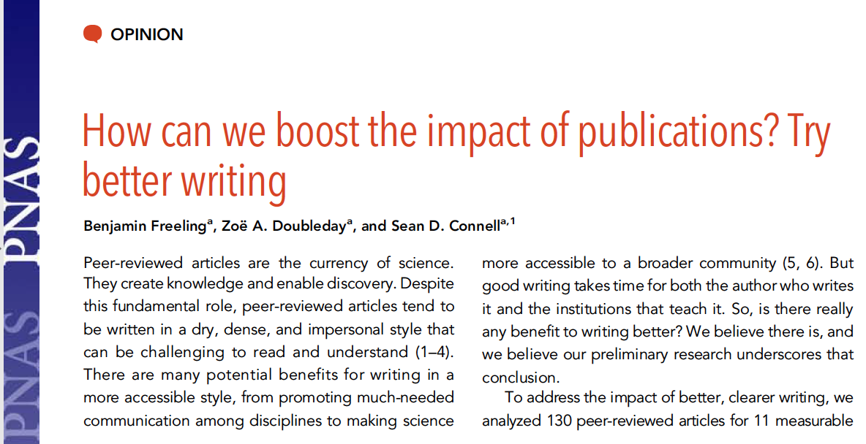

In this lecture
Reasons why clear writing matters
Way to achieve clarity at different levels
  Data presentation
  Paper and grant sections
  Paragraphs
  Sentences

Slide 4
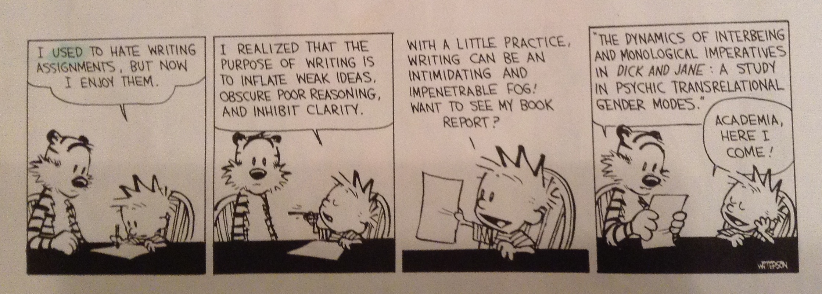

Slide 5
Why does clear writing matter?

Slide 6
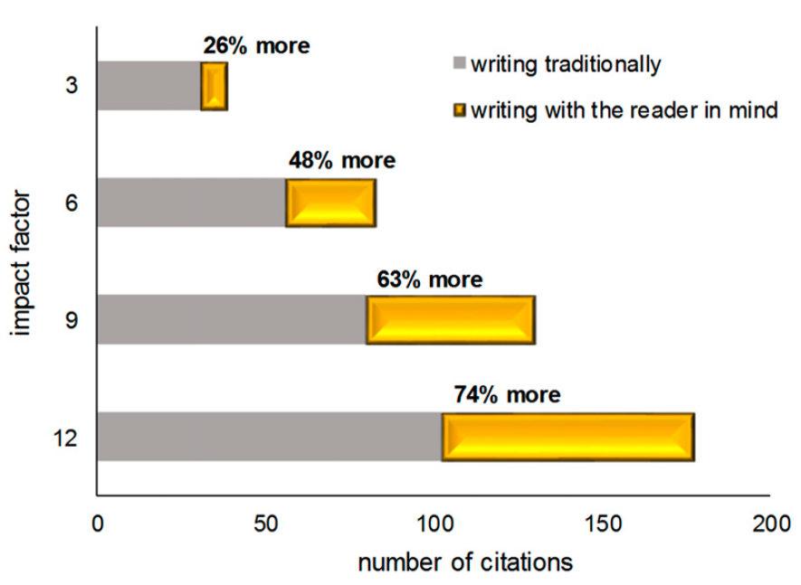
Why does clear writing matter?
Writing with the reader in mind boosts citation rate regardless of where you publish.
The higher the impact factor, the greater the benefit.
Av number of citations per article over 6 yrs.
Our model suggests that increases in clarity, narrative structure, and creativity could translate to a boost in citations.
Benjamin Freeling, Zoë A. Doubleday, and Sean D. Connell
PNAS January 8, 2019 116 (2) 341-343; https://doi.org/10.1073/pnas.1819937116

Slide 7
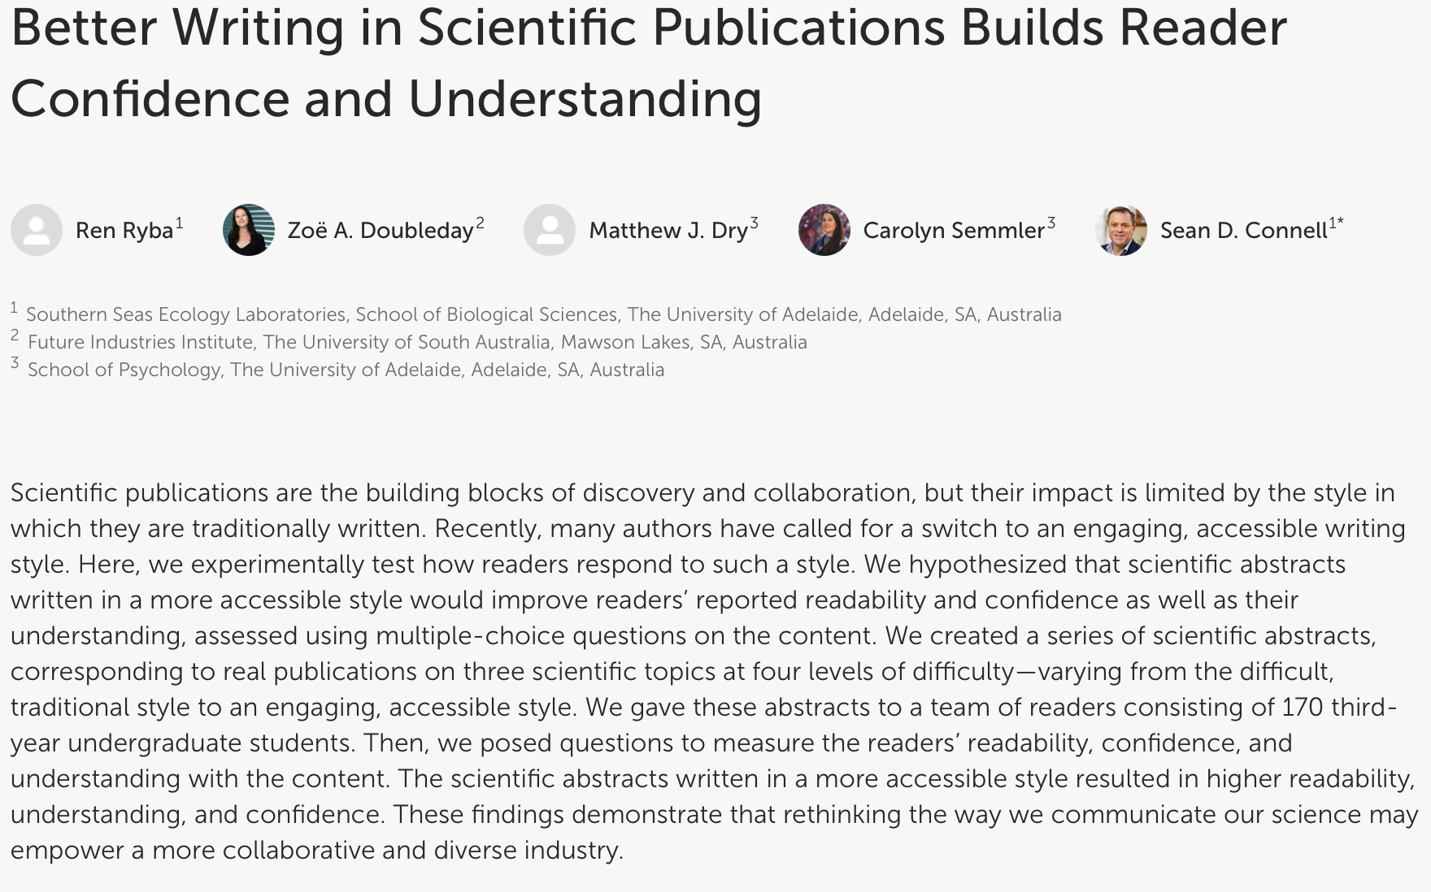
Why does clear writing matter?
Created scientific abstracts written at four levels of difficulty
Gave them to 170 third-year undergraduate students
Asked questions to measure readability, confidence, and understanding of the content.
Ren Ryba, Zoe A Doubleday, Matthew J. Dry, Carolyn Semmler, Sean D. Connell
Frontiers in Psychology August 27, 2021 (12)714321;doi: 10.3389/fpsyg.2021.714321

Slide 8
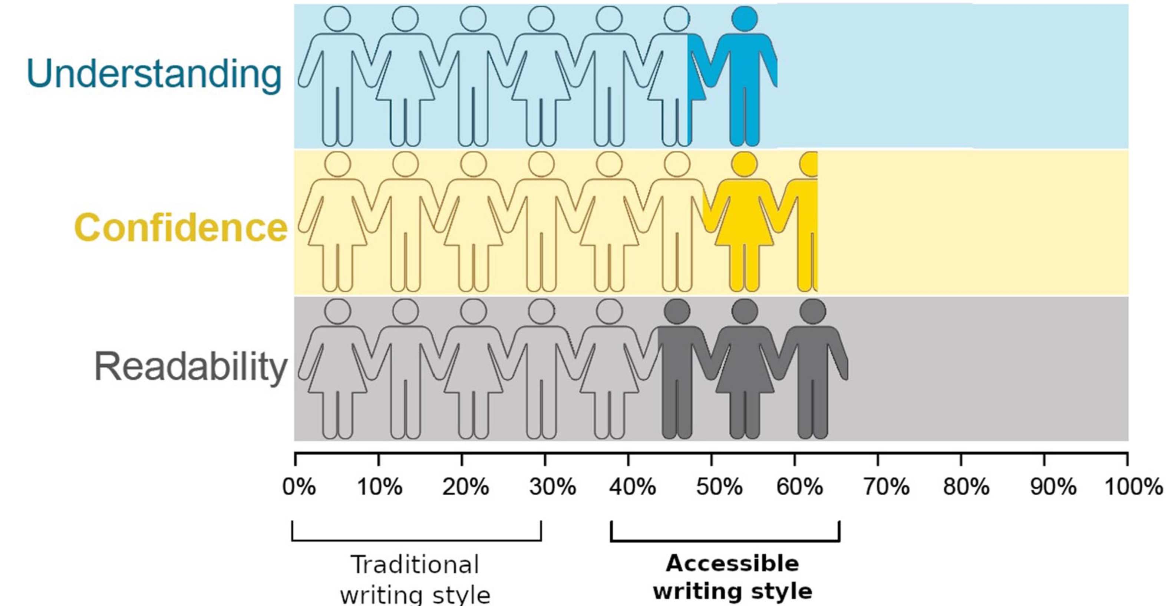
Why does clear writing matter?
The scientific abstracts written in a more accessible style resulted in higher understanding, confidence, and readability.
Ren Ryba, Zoe A Doubleday, Matthew J. Dry, Carolyn Semmler, Sean D. Connell
Frontiers in Psychology August 27, 2021 (12)714321;doi: 10.3389/fpsyg.2021.714321

Slide 9
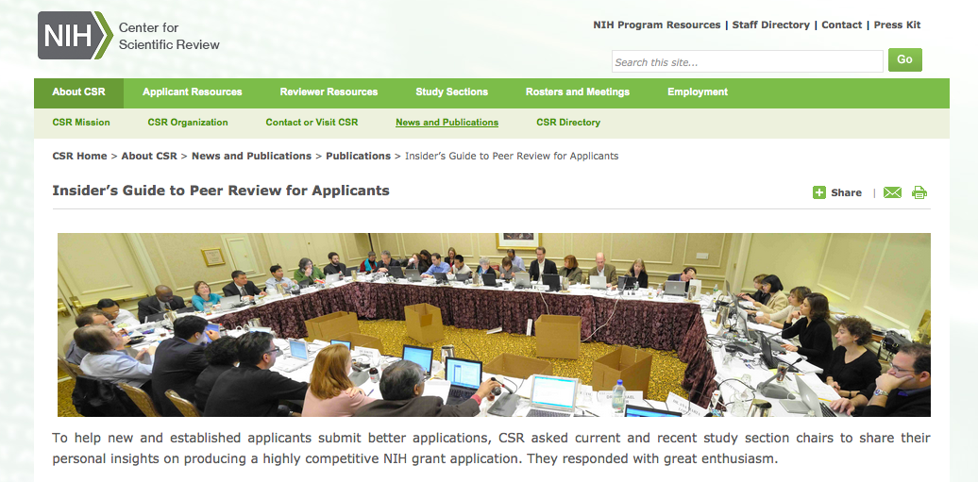
Why does clear writing matter?

Slide 10
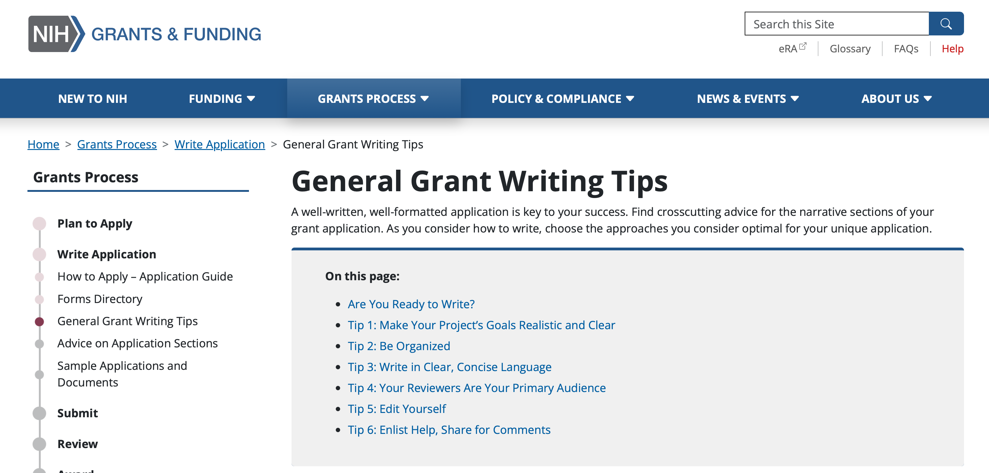
NIH General Grant Writing Tips
Make your application as easy to read as possible
Your application has a better chance of being successful if it is easy to read and well-written.

Slide 11
“If the reader is to grasp what the writer means, the writer must understand what the reader needs.”
The Science of Scientific Writing, George Gopen and Judith Swan
The Science of Scientific Writing, American Scientist
https://www.americanscientist.org/blog/the-long-view/the-science-of-scientific-writing
This article was originally published in the November-December 1990 issue of American Scientist.

Slide 13
Structure in scientific writing
Clarity in scientific writing comes from the use of structural elements at all levels:
  data presentation
  paper and grant sections
  paragraphs
  sentences

Slide 14
Structuring data
Readers interpret substance based (in part) on expectations derived from structure.
  e.g., t (time)=0, T (temperature)=25ºC, t=5, T=29ºC, t=10, T=30ºC, t=15, T=32ºC, t=20, T=27ºC
is more effectively represented as:
Time (min) | Temp (℃)
0 | 25
5 | 29
10 | 30
15 | 32
20 | 27
Temp (℃) | Time (min)
25 | 0
29 | 5
30 | 10
32 | 15
27 | 20
But not as
The Science of Scientific Writing, American Scientist
https://www.americanscientist.org/blog/the-long-view/the-science-of-scientific-writing

Slide 15
Structuring text
Structure for Specific Aims page
Structural clues come from:
  data presentation
  paper and grant sections
  paragraph structure
  sentence structure
}
Opening sentence, hook
Current knowledge
Gap in knowledge
Significance of gap
Why?
What?
}
Long-term goal
Objectives of research
Central hypothesis
Rationale
How?
}
How?
What will you do
Why will you do it
How?
Payoff
}
Expected outcomes of aims
Positive/broad impact of work
Expected contributions to advancement of your career

Slide 16
Structuring text
Research Article
(section as unit)
Structural clues come from:
  data presentation
  paper and grant sections
  paragraph structure
  sentence structure
Introduction
Results and Methods
Discussion

Slide 17
Structuring text
Structural clues come from:
  data presentation
  paper and grant sections
  paragraph structure
  sentence structure

Slide 18
Paragraph structure
MEAL plan
  Main idea: introduce the focus of the paragraph
  Evidence: Support the main idea with source information
  Analysis: Explain and analyze the source information
  Lead out: Conclude the topic
https://academicguides.waldenu.edu/c.php?g=465757&p=5398055

Slide 19
Paragraph structure
Electronic medical records (EMRs) promote patient satisfaction in their ease of access. Certain programs allow patients to view their medical records in a password-protected online environment, print out immunization records, and perform other necessary tasks with an immediacy that paper records do not allow (James, 2011). The convenience of immediacy spans also to healthcare professionals who may need to transfer records to other medical institutions for a patient's procedure. Rather than spending the time and money copying, faxing, or printing records, healthcare professionals can simply transfer information via the EMRs programs (Hunter, 2009). This ease of access for patients and medical personnel creates transparency.
MEAL plan
  Main idea: introduce the focus of the paragraph
  Evidence: Support the main idea with source information
  Analysis: Explain and analyze the source information
  Lead out: Conclude the topic
https://academicguides.waldenu.edu/c.php?g=465757&p=5398055

Slide 20
Paragraph structure
Electronic medical records (EMRs) promote patient satisfaction in their ease of access. Certain programs allow patients to view their medical records in a password-protected online environment, print out immunization records, and perform other necessary tasks with an immediacy that paper records do not allow (James, 2011). The convenience of immediacy spans also to healthcare professionals who may need to transfer records to other medical institutions for a patient's procedure. Rather than spending the time and money copying, faxing, or printing records, healthcare professionals can simply transfer information via the EMRs programs (Hunter, 2009). This ease of access for patients and medical personnel creates transparency.
MEAL plan
  Main idea: introduce the focus of the paragraph
  Evidence: Support the main idea with source information
  Analysis: Explain and analyze the source information
  Lead out: Conclude the topic
https://academicguides.waldenu.edu/c.php?g=465757&p=5398055

Slide 21
Paragraph structure
Electronic medical records (EMRs) promote patient satisfaction in their ease of access. Certain programs allow patients to view their medical records in a password-protected online environment, print out immunization records, and perform other necessary tasks with an immediacy that paper records do not allow (James, 2011). The convenience of immediacy spans also to healthcare professionals who may need to transfer records to other medical institutions for a patient's procedure. Rather than spending the time and money copying, faxing, or printing records, healthcare professionals can simply transfer information via the EMRs programs (Hunter, 2009). This ease of access for patients and medical personnel creates transparency.
MEAL plan
  Main idea: introduce the focus of the paragraph
  Evidence: Support the main idea with source information
  Analysis: Explain and analyze the source information
  Lead out: Conclude the topic
https://academicguides.waldenu.edu/c.php?g=465757&p=5398055

Slide 22
Paragraph structure
Electronic medical records (EMRs) promote patient satisfaction in their ease of access. Certain programs allow patients to view their medical records in a password-protected online environment, print out immunization records, and perform other necessary tasks with an immediacy that paper records do not allow (James, 2011). The convenience of immediacy spans also to healthcare professionals who may need to transfer records to other medical institutions for a patient's procedure. Rather than spending the time and money copying, faxing, or printing records, healthcare professionals can simply transfer information via the EMRs programs (Hunter, 2009). This ease of access for patients and medical personnel creates transparency.
MEAL plan
  Main idea: introduce the focus of the paragraph
  Evidence: Support the main idea with source information
  Analysis: Explain and analyze the source information
  Lead out: Conclude the topic
https://academicguides.waldenu.edu/c.php?g=465757&p=5398055

Slide 23
Paragraph structure
Good writing requires that you clearly spell out your interpretations/conclusions.
Without this, you may leave the reader
  wondering which of two (or more) possible interpretations is meant, or
  completely in the dark, especially if they are unfamiliar with the topic.

Slide 24
Paragraph structure
Linkers help readers follow the logical flow of ideas
Understanding the role of gut microbiota in human health has become a central focus in biomedical research. For instance, recent studies show that specific bacterial strains can influence immune responses and metabolic pathways. Moreover, alterations in microbial composition have been linked to conditions such as obesity, diabetes, and inflammatory bowel disease. However, despite these associations, the mechanisms underlying these effects remain poorly understood. Therefore, researchers are now employing multi-omics approaches—such as metagenomics, transcriptomics, and metabolomics—to gain deeper insights. In addition, longitudinal studies are being conducted to determine causality rather than mere correlation. Ultimately, the goal is to develop targeted microbiome-based therapies that can be personalized to individual patients.

Slide 25
Achieving clarity: paragraph level
Summary
Limit each paragraph to one major idea
Describe this idea in logical manner
Use linker phrases to smooth flow
Spell out interpretations or conclusions
Pay attention to sentence structure
MEAL plan
  Main idea: introduce the focus of the paragraph
  Evidence: Support the main idea with source information
  Analysis: Explain and analyze the source information
  Lead out: Conclude the topic
Will work through examples in class to help illustrate these points

Slide 26
Structuring text
Structural clues come from:
  data presentation
  paper and grant sections
  paragraph structure
  sentence structure

Slide 27
5 strategies for clear sentence structure
Use the topic and stress positions wisely.
Place the verb near its grammatical subject.
Articulate the action of every clause and sentence in its verb.
Use parallel structure
Keep terms consistent and concise

Slide 28
1. Use the topic and stress positions to create flow
  e.g., t (time)=0, T (temperature)=25ºC, t=5, T=29ºC, t=10, T=30ºC, t=15, T=32ºC, t=20, T=27ºC
is more effectively represented as:
Time (min) | Temp (℃)
0 | 25
5 | 29
10 | 30
15 | 32
20 | 27
Temp (℃) | Time (min)
25 | 0
29 | 5
30 | 10
32 | 15
27 | 20
But not as
The Science of Scientific Writing, American Scientist
https://www.americanscientist.org/blog/the-long-view/the-science-of-scientific-writing

Slide 29
1. Use the topic and stress positions to create flow
Accommodates reader’s propensity to remember material at the end
Prevents a hunt for the point of emphasis
Sentence
Clarifies the logic
Prevents misinterpretation
Topic
Stress
“Old” information that links back
(perspective and context)
New information to emphasize
(closure and fulfillment)

Slide 30
1. Use the topic and stress positions to create flow
Topic
sentence
Concluding sentence
Old
New
Old
New
Old
New
Periodontal disease is a common condition affecting a significant portion of the adult population. A first sign of periodontal disease is inflammation of the gums, which can lead to more severe issues if left untreated. Unchecked gum inflammation results in the destruction of connective tissues and bone that support the teeth. As a consequence, tooth mobility and eventual tooth loss are common outcomes in advanced stages of the disease.
Topic
sentence
Supporting statement
Supporting statement
Supporting statement
Concluding sentence
(Context)

Slide 31
1. Use the topic and stress positions to create flow
Active vs. passive voice
In general, we encourage the use of active voice in scientific writing (the subject performs the action)
However, sometimes you may need to use passive voice to help maintain flow, e.g., when it is more important to highlight the result rather than who performed the action.
We developed a novel gene-editing technique to correct mutations associated with cystic fibrosis. We tested this method in cultured epithelial cells and observed that normal protein function was restored. The results were validated through multiple independent assays and blinded replication studies.

Slide 32
5 strategies for clear sentence structure
Use the topic and stress positions wisely (provide context).
Place the verb near its grammatical subject.
Articulate the action of every clause and sentence in its verb.
Use Parallel structure
Avoid sentences that are overly complicated

Slide 33
2. Place the verb near its grammatical subject
Two primary pieces of information that the reader is looking for in a sentence:
Subject (person, place, thing the sentence is about)
Verb (action of the subject)
Keep them close together!

Slide 34
2. Place the verb near its grammatical subject
The clinical trial investigators, after months of patient recruitment, extensive protocol development, coordination with multiple international research centers, and repeated revisions to meet regulatory standards, determined that the new immunotherapy significantly improved survival rates in patients with advanced melanoma.

Slide 35
2. Place the verb near its grammatical subject
The clinical trial investigators, after months of patient recruitment, extensive protocol development, coordination with multiple international research centers, and repeated revisions to meet regulatory standards, determined that the new immunotherapy significantly improved survival rates in patients with advanced melanoma.
Solution 1: move intervening information to end of sentence for smoother flow.
The clinical trial investigators determined that the new immunotherapy significantly improved survival rates in patients with advanced melanoma, which was realized after months of patient recruitment, protocol development, coordination with international research centers, and regulatory revisions.
Solution 2: Move intervening information to a new sentence.
The clinical trial investigators determined that the new immunotherapy significantly improved survival rates in patients with advanced melanoma. This determination followed months of patient recruitment, extensive protocol development, coordination with international research centers, and multiple revisions to meet regulatory standards.

Slide 36
5 strategies for clear sentence structure
Use the topic and stress positions wisely (provide context).
Place the verb near its grammatical subject.
Articulate the action of every clause and sentence in its verb.
Use parallel structure
Avoid sentences that are overly complicated

Slide 37
3. Articulate the action with a verb
Use verbs that convey the action – avoid any that don’t add to the story
…diffusible factors are involved in mediating interactions.
…diffusible factors mediate interactions.
We performed an analysis on the data.
We analyzed the data.

Slide 38
3. Articulate the action with a verb
State what the action is rather than just implying it exists.
Here, we show the effects of the Notch mutation on
on gene expression in progenitor B cells.
Here, we show that the Notch mutation represses
gene expression in progenitor B cells.

Slide 39
3. Articulate the action with a verb
Avoid nominalizing useful verbs
There was a reduction in inflammation following treatment.
The treatment reduced inflammation.
In this study, we performed an an analysis of the water problem.
verb
In this study, we analyzed the water problem.
noun

Slide 40
3. Articulate the action with a verb
Avoid nominalizing useful verbs
Action | Nominalization
to regulate | regulation
to occur | occurrence
to prepare | preparation
to investigate | investigation
to delineate | delineation
to perform | performance

Slide 41
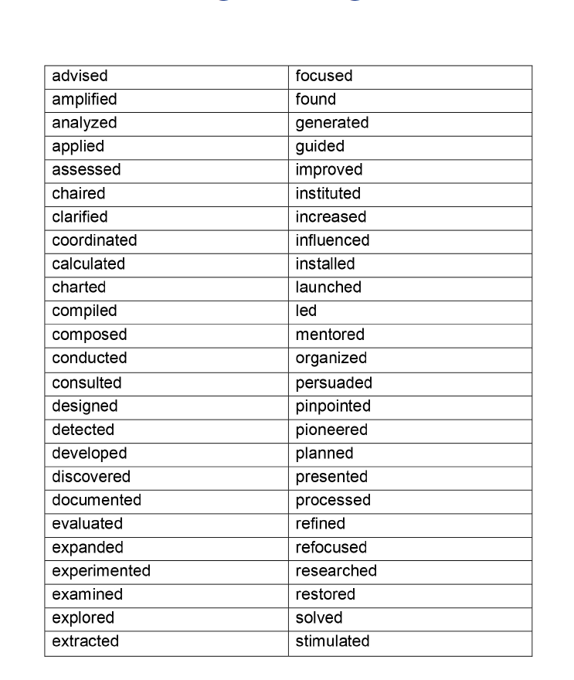
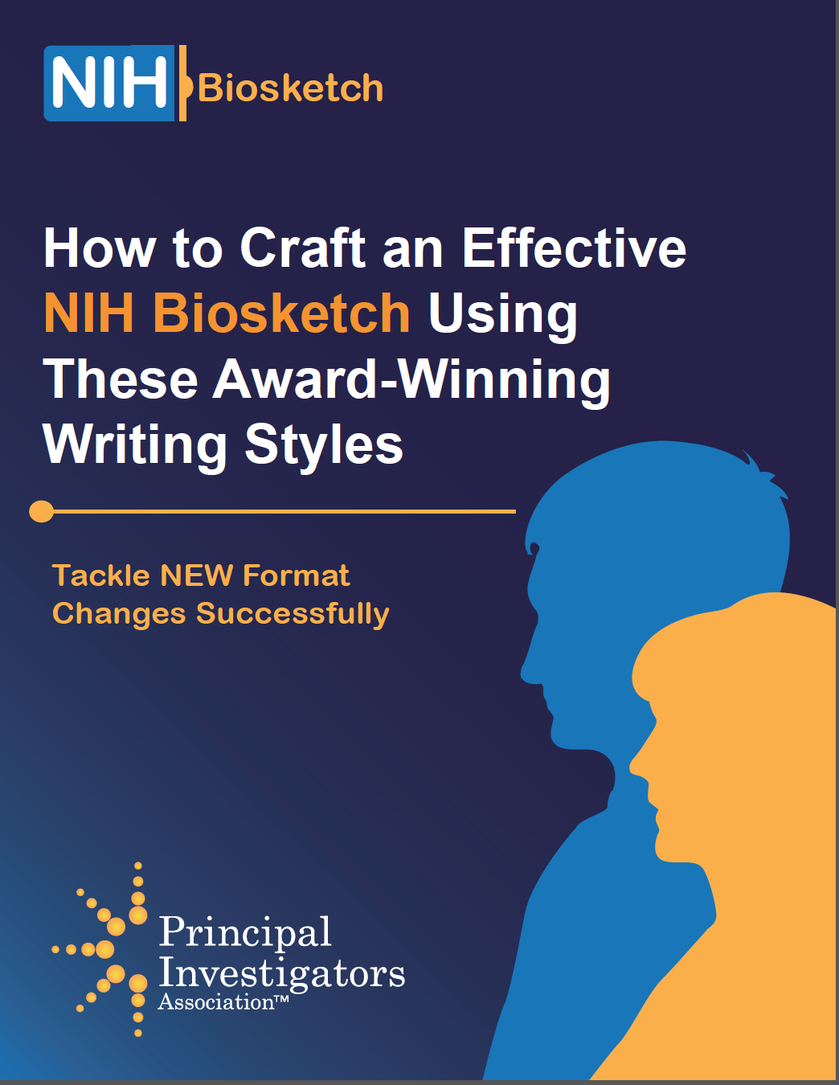
3. Articulate the action with a verb
Appendix A:
50 Research and Analysis Power Verbs
for Writing Strong Sentences

Slide 42
5 strategies for clear sentence structure
Use the topic and stress positions wisely (provide context).
Place the verb near its grammatical subject.
Articulate the action of every clause and sentence in its verb.
Use parallel structure
Avoid sentences that are overly complicated

Slide 43
4. Use parallel structure
The study demonstrated that the drug reduces blood pressure, improving cardiovascular function, and that the quality of life for patients was enhanced.

Slide 44
4. Use parallel construction
The study demonstrated that the drug reduces blood pressure, improving cardiovascular function, and that the quality of life for patients was enhanced.
reduces (simple present tense)
improving (present participle/gerund form)
was enhanced (passive voice)

Slide 45
4. Use parallel construction
The study demonstrated that the drug reduces blood pressure, improves cardiovascular function, and enhances patient quality of life.
reduces (simple present tense)
improves (simple present tense)
enhances (simple present tense)
*Can also be applied for other major elements (structure of aims in a grant proposal)

Slide 46
4. Use parallel construction
The human cartilaginous airway is a pseudostratified
columnar epithelium composed of
ciliated, goblet, non-ciliated columnar cells,
intermediate cells, and basal cells.
adjective
noun
Not all nouns are modifying an adjective!

Slide 47
4. Use parallel construction
Solution 1. All adjectives modify a noun
The human cartilaginous airway is a pseudostratified
columnar epithelium composed of
ciliated cells, goblet cells, non-ciliated columnar cells,
intermediate cells, and basal cells.
Solution 2. All adjectives modify one noun
The human cartilaginous airway is a pseudostratified
columnar epithelium composed of
ciliated, goblet, non-ciliated columnar,
intermediate, and basal cells.
adjective
noun

Slide 48
5 strategies for clear sentence structure
Use the topic and stress positions wisely (provide context).
Place the verb near its grammatical subject.
Articulate the action of every clause and sentence in its verb.
Use parallel structure
Avoid sentences that are overly complicated
  Noun/adjective strings
  Dangling modifiers

Slide 49
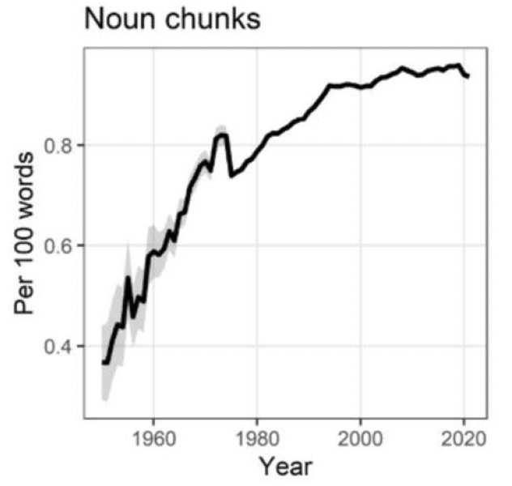
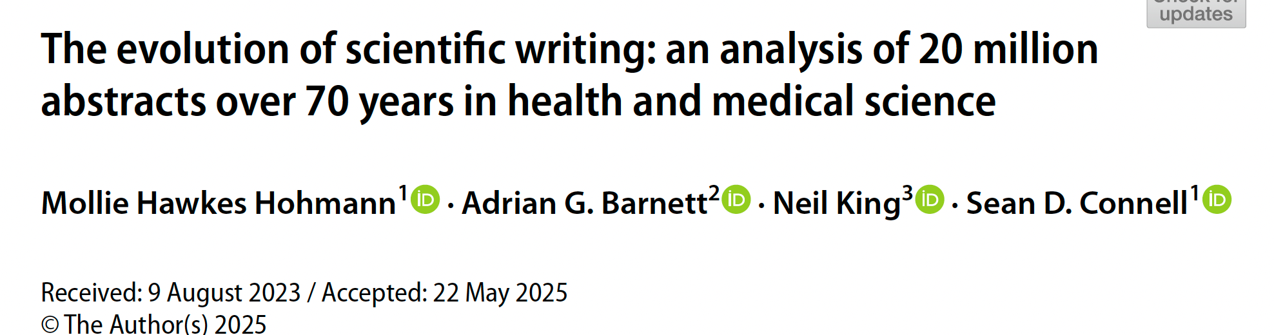
5. Avoid sentences that are overly complicated
”’Noun chunks are where three or more nouns are used in a row. Noun chunks are though to have a negative effect on cognitive load experienced by the reader.”

Slide 50
5. Avoid sentences that are overly complicated
Noun/adjective strings
The evaluation of synaptic transmission efficiency alterations in hippocampal neurons following chronic exposure to stress-inducing environmental stimuli was performed using electrophysiological recordings.
We evaluated alterations in the efficiency of synaptic transmission in hippocampal neurons following chronic exposure to stress-inducing environmental stimuli using electrophysiological recordings.

Slide 51
5. Avoid sentences that are overly complicated
Noun/adjective strings
Nox1-containing NADPH oxidase-induced O₂^{•-}-mediated EGFR transactivation plays a critical role in cellular signaling.
O₂^{•-}-mediated EGFR transactivation induced by Nox-1 containing NADPH oxidases plays a critical role in cellular signaling.

Slide 52
5. Avoid sentences that are overly complicated
Dangling modifier
In the signaling pathway, the researchers showed the importance of inadequate regulation.
The researchers showed the importance of inadequate regulation of the signaling pathway.

Slide 53
5. Avoid sentences that are overly complicated
Dangling modifier
We examined neurexin deposition at E15, at which point neurons normally sprout dendrites by whole-mount immunostaining.
We examined neurexin deposition at E15, at which point neurons normally sprout dendrites, by whole-mount immunostaining.
We used whole-mount immunostaining to examine neurexin deposition at E15, at which point neurons normally sprout dendrites.

Slide 54
Additional considerations
Keep terms consistent
Avoid jargon and colloquialisms
Avoid unnecessary complexity
Avoid redundant wording
Use tense correctly
Subject-verb agreement
Use punctuation correctly
Avoid misspelling words

Slide 55
Additional considerations
Keep terms consistent
Avoid jargon, colloquialisms, contractions
Avoid unnecessary complexity
Avoid redundant wording
Use tense correctly
Subject-verb agreement
Use punctuation correctly
Avoid misspelling words
Do not use multiple versions of a term that means the same thing
CD4+ Tregs
CD4+ regulatory T cells
CD4 T cells
Pick one and use that throughout to avoid confusing the reader.

Slide 56
Additional considerations
Keep terms consistent
Avoid jargon, colloquialisms, contractions
Avoid unnecessary complexity
Avoid redundant wording
Use tense correctly
Subject-verb agreement
Use punctuation correctly
Avoid misspelling words
If you have to use jargon make sure to define it
Avoid “touch base,” “bring up to speed”
Don’t use contractions

Slide 57
Additional considerations
Keep terms consistent
Avoid jargon, colloquialisms, contractions
Avoid unnecessary complexity and unnecessary words
Avoid redundant wording
Use tense correctly
Subject-verb agreement
Use punctuation correctly
Avoid misspelling words
use vs. utilize,
close vs. proximal
There have been studies that show….
Over the last five years, we have had 10 institutions participated…

Slide 58
Additional considerations
Instead of this | …use this
a majority of | most
a number of | many
on the basis of | because
due to the fact that | because
are of the same opinion | agree
by means of | by
despite the fact that | although
during the course of | during
has the capability | can
in close proximity to | near
in order to | to
prior to/previous to | before
all of/both of | all/both
Keep terms consistent
Avoid jargon, colloquialisms, contractions
Avoid unnecessary complexity and unnecessary words
Avoid redundant wording
Use tense correctly
Subject-verb agreement
Use punctuation correctly
Avoid misspelling words

Slide 59
Additional considerations
Keep terms consistent
Avoid jargon, colloquialisms, contractions
Avoid unnecessary complexity
Avoid redundant wording
Use tense correctly
Subject-verb agreement
Use punctuation correctly
Avoid misspelling words
Already existing
In addition, we also showed
Period of time

Slide 60
Additional considerations
Keep terms consistent
Avoid jargon, colloquialisms, contractions
Avoid unnecessary complexity
Avoid redundant wording
Use correct terms
Subject-verb agreement
Use punctuation correctly
Avoid misspelling words
Imply vs. infer
Insert vs. inset
Alternately vs. alternatively
Complement vs. compliment
Principle vs. principal
Whereas vs. while

Slide 61
Additional considerations
Affect vs. Effect (verbs)
Affect: to have an effect on, make a difference to, influence
“The receptor affects the efficiency of pathogen binding…”
Effect: cause something to happen, bring about
“Metalloproteases effect protein cleaveage by catalyzing the hydrolysis of peptide bonds.’
Keep terms consistent
Avoid jargon, colloquialisms, contractions
Avoid unnecessary complexity
Avoid redundant wording
Use correct terms
Subject-verb agreement
Use punctuation correctly
Avoid misspelling words

Slide 62
Additional considerations
Keep terms consistent
Avoid jargon, colloquialisms, contractions
Avoid unnecessary complexity
Avoid redundant wording
Use correct terms
Subject-verb agreement
Use punctuation correctly
Avoid misspelling words
Affect vs. Effect (nouns)
Affect: emotion that influences behavior
“He spoke without affect.”
Effect: a result, consequence, or impression
“The effect on binding is minimal.”

Slide 63
Additional considerations
Keep terms consistent
Avoid jargon, colloquialisms, contractions
Avoid unnecessary complexity
Avoid redundant wording
Use correct terms
Subject-verb agreement
Use punctuation correctly
Avoid misspelling words
Singular subjects take singular verbs
“The enzyme catalyzes the reaction efficiently.” (NOT the enzyme catalyze)
Plural subjects take plural verbs
“The enzymes catalyze various reactions in the cell.” (NOT the enzymes catalyzes)

Slide 64
Additional considerations
Keep terms consistent
Avoid jargon, colloquialisms, contractions
Avoid unnecessary complexity
Avoid redundant wording
Use correct terms
Subject-verb agreement
Use punctuation correctly
Avoid misspelling words

Slide 65
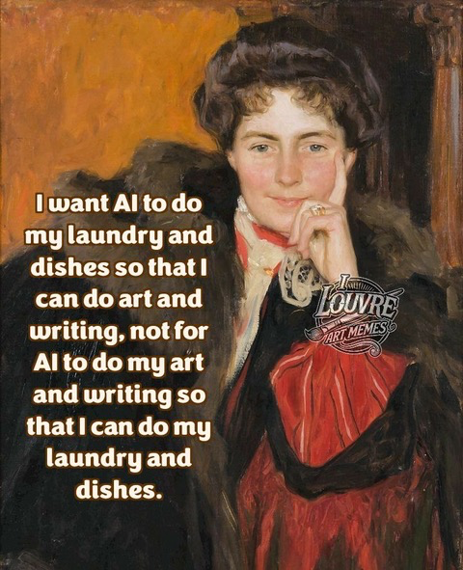
Additional considerations
Keep terms consistent
Avoid jargon, colloquialisms, contractions
Avoid unnecessary complexity
Avoid redundant wording
Use correct terms
Subject-verb agreement
Use punctuation correctly
Avoid misspelling words
Jacob Levin, NORDP listserv

Slide 66
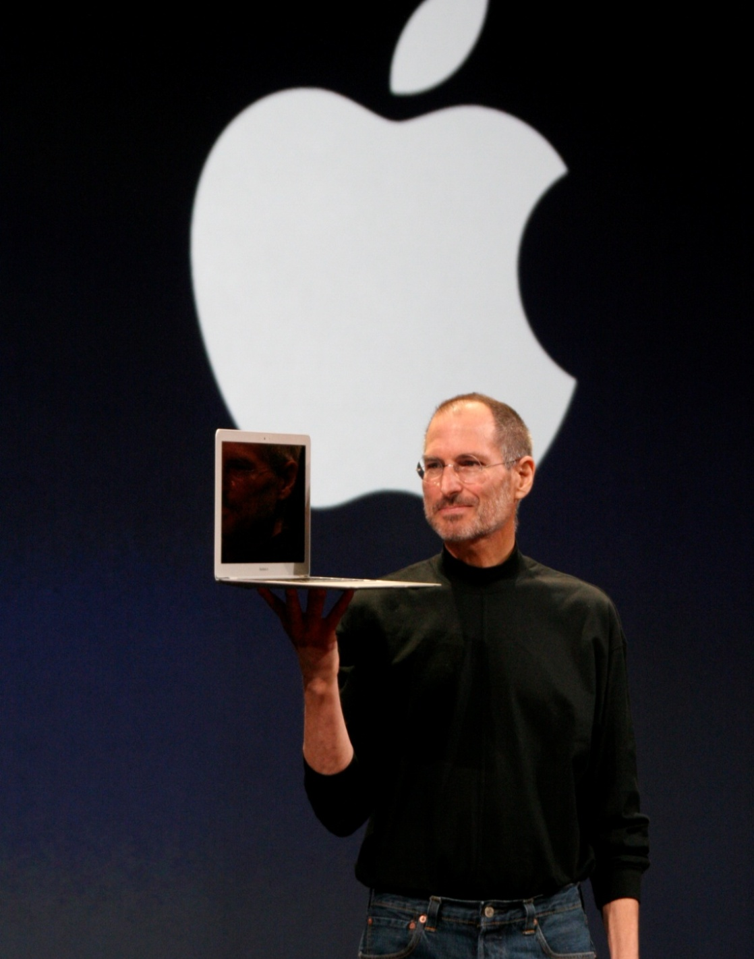

"Simple can be harder than complex. You have to work hard to get your thinking clean to make it simple. But it's worth it in the end, because once you get there, you can move mountains."
GRANT WRITING FOR SUCCESS
LeShawndra N. Price, Ph.D., NIMH, NIH
Dana Plude, CSR, NIH
Henry Khachaturian, Ph.D., OEP/NIH

Slide 67
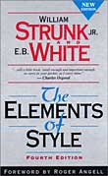
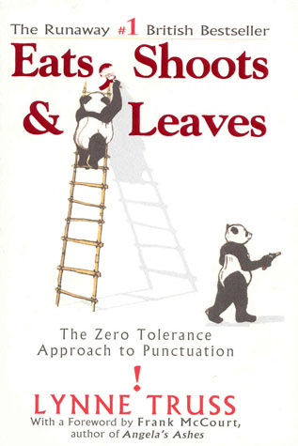
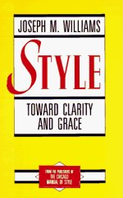
Resources
William Strunk Jr. & E.B. White
The elements of style
(Fourth Edition)
Allyn and Bacon, 1999
Lynne Truss
Eats, shoots & leaves:
the zero tolerance approach to punctuation
Gotham Books, 2004
Joseph M. Williams
Style: Toward Clarity & Grace
Chicago Guides to Writing, Editing, and Publishing
The University of Chicago Press, 1995
Writing tips by Gary Westbrook & Linda Cooper
Society for Neuroscience and The Journal of Neuroscience websites
http://www.jneurosci.org/site/misc/publishingpointers.xhtml
http://www.jneurosci.org/site/misc/writingtips.xhtml
George Gopen & Judith Swan
The Science of Scientific Writing, American Scientist 78, 550-558, 1990
http://www.americanscientist.org/issues/pub/the-science-of-scientific-writing

Slide 68

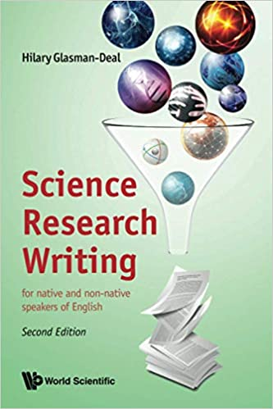
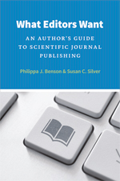
Resources
Academic Writing for Graduate Students, 3rd Edition
John Swales & Christine Feak
Science Research Writing
Hilary Glasman-Deal
Writing Science: How to Write Papers That Get Cited and Proposals that Get Funded
Joshua Schimel
What Editors Want: An Author’s Guide to Scientific Journal Publishing
Phillipa Benson & Susan Silver

Slide 69
2. Use the topic and stress positions wisely
Frequency of passive voice in specific research article sections:
 | Introduction | Methods | Results | Discussion
Present tense | +++ | + | + | +++
Past tense | ++ | +++ | +++ | ++
Passive voice | + | +++ | variable | variable
Reproduced from Table 21, Swales & Feak, 2004, Academic Writing for Graduate Students: Essential Tasks and Skills (second edition). University of Michigan Press.

Slide 70
Key elements of a good story: parallel construction
WT early pro-B cells downregulated genes that promote alternative lineage potential, whereas these factors remained highly overexpressed in Justy early pro-B cells
WT early pro-B cells downregulated genes that promote alternative lineage potential, whereas Justy early pro-B cells retained high expression of these factors.

