Slide 1
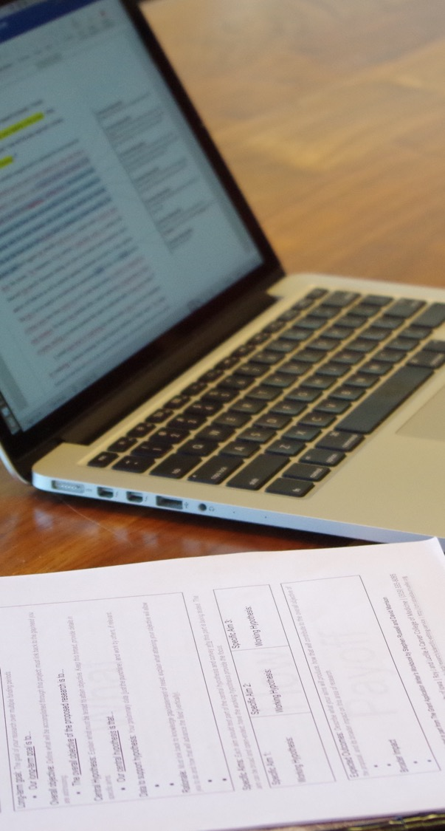
Giving and Receiving Feedback: Strategies for Clear Scientific Writing
Jennifer Barr, PhD | SERCC
Writing Initiative in Neuroscience
Interdisciplinary Graduate Program in Neuroscience
April 14, 2026
Notes:
Thank you for having me
My name is Jennifer Barr
I am in the SERCC
I’m hnappy to be with you to talk about feedback

Slide 2



My career path
BS
Dept. of Biology
PhD
Anatomy and Cell Biology
Post-doc
Pediatrics
Scientific Editing Internship
Scientific Editing Service,
Chris Blaumueller
Research Asst.
Life Sciences Institute
Scientific Editor and Writing Consultant
SERCC
Carver College of Medicine
Grant Writer
SERCC
Carver College of Medicine
Notes:
To start, wanted to give you a sense of my background

Slide 3




SERCC Editors
Advanced degrees in science | Laboratory experience | A love of clear writing!
Christine M Blaumueller, PhD
Director, Senior Scientific Editor and Writing Consultant
Over 14 years as a laboratory researcher | 6 years as a journal editor (EMBO) | Editor in CCOM since 2006 | Established SERCC in 2017
PhD from Yale University | Postdoctoral training at the European Molecular Biology Laboratory (EMBL).
Jennifer Y Barr, PhD
Assistant Director, Grant Writer
Over 12 years of experience as a laboratory researcher | SERCC editing internship 2015–2017 | SERCC editor since 2017
PhD and Postdoctoral training at UI | Has developed many of our author resources and directs our Scientific Editing Internship Program
Michael R Rebagliati, PhD
Scientific Editor and Writing Consultant
Ove 30 years of experience as a laboratory researcher.
PhD in biology from Harvard University | Postdoctoral training at the NICHD | Primary editor for the Stead Family Department of Pediatrics
Emily Huber, PhD
Scientific Editor and Writing Consultant
Over 10 years of research experience in cell biology, genomics, and virology | Has edited for both academic and industry laboratories
PhD in human and statistical genetics from Washington University in St. Louis
https://sercc.medicine.uiowa.edu/about
Notes:
Passion for helping scientists clearly communicate their work

Slide 4
What editing staff do
The Science
Clear Writing
Strategic
Writing
Provide input on drafts of writing projects
Provide one-on-one consultation on writing strategy
Brainstorm with authors and faculty on Specific Aims
Teach scientific writing
Collect and generate resources
Changes in funding agency requirements
Grant writing templates (NIH “R”/“K/“F” grants)
Liaise with other RD professionals
National Organization of Research Development Professionals (NORDP)
Scientific Editors Network (ScENe)
American Medical Writers Association (AMWA)
Notes:
When we provide feedback, what we are looking for is to make sure the science is rigorous and conveyed clearly; that the writing is strategic, and that all of it is clear to the intended audience

Slide 5
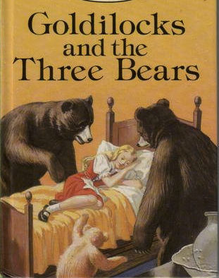



In this session
Elements of storytelling from a classic story
Providing feedback using elements of storytelling
How to approach feedback you receive
Resources
Notes:
Focus today is on giving and receiving feedback
Thought it might help to tell you a little bit about what I look for when I review granst and manuscripts
Want to review four key elements of storytelling Using a classic children’s story goldilocks,
Explain how thinking about these elements can help you when providing feedback to someone (or in your own writing)
Decribe some ways you can approach the feedback you receive
Some resources for your writing

Slide 6
Elements of storytelling
Notes:
Let’s talk about storytelling, you may have heard some people say you should tell a story with your research, and I would agree, but why is that?

Slide 7
Scientific writing requires persuasion
Problem
Solution
Plan
Impact
Notes:
It’s because scientific writing requires persuasion. You have several goals:
You need to convince someone there is a problem and it is important
Propose a viable solution (hypothesis)
Present a plan to achieve that solution (or describe what you did to identify a solution
Explain why the outcomes are important or their impact
Need to figure out how these pieces go together…helpful to think about how this is done using stories
And telling is a story is a good way to captivate someone’s attention and try to persuade them to at least listen to what you want to do.

Slide 8
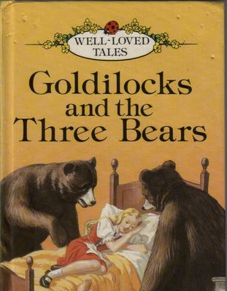
Storytelling is a way to be persuasive
Notes:
I’m going to briefly discuss some fundamental elements of storytelling using the story Goldilocks and the three bears, which many of you may have heard of
Keeping some of these elements in mind is important for your writing, but it can help you provide feedback by looking for these elements in other people’s writing

Slide 9
Goldilocks and the Three Bears
Once upon a time, there was a young girl named Goldilocks. One day Goldilocks was skipping through the forest when she came upon a cottage that belonged to the Three Bears. She knocked, and upon receiving no answer, she went right in.
Once inside, she discovered bowls of porridge and realized she was hungry. She tried one bowl – this porridge was too hot. She tried another bowl – this porridge was too cold. She tried the third bowl – this porridge was just right – and she ate it all up.
She then decided to rest her feet and she sat down in a chair – this chair was too big. She tried another chair – this chair was too small. She tried the third chair – this chair was just right. But no sooner had she settled into the chair than it splintered into a thousand pieces.
Now very tired, Goldilocks went into the next room, where she saw three beds. She tried one bed – this bed was too hard. She tried another bed – this bed was too soft. She tried the third bed – this bed was just right. Goldilocks snuggled into the bed and fell asleep.
While she slept, the Three Bears returned. “Someone’s been eating my porridge,” said the Papa Bear. “Someone’s been eating my porridge,” said the Mama Bear. “Someone’s been eating my porridge,” said the baby bear, “and it’s all gone!”
In the next room, Papa Bear said, “Someone’s been sitting in my chair.” And Mama Bear said, “Someone’s been sitting in my chair.” And Baby Bear said, “Someone’s been sitting in my chair, and they’ve broken it all to pieces!”
They entered the sleeping room, and Papa Bear said, “Someone’s been lying in my bed.” And Mama Bear said, “Someone’s been lying in my bed.” And Baby Bear said, “Someone’s been lying in my bed, and they’re still there!”
At this, Goldilocks awoke with a start, leapt out of bed, and ran out of the house, never to return again.
Notes:
Many of you have heard the story of goldilocks and the three bears, but for those who need a refresher

Slide 10
Elements of storytelling can help you be persuasive (and provide feedback)
Notes:
So, not that you’ve all had a refresher on the story, let’s talk about some specific elements of it that are applicable to science writing or reviewing.

Slide 11
Elements of a good story: logical order
Beginning
(sets the stage)
Middle
(describes what happens)
End
(resolution)
Notes:
The story uses an overall structure to provide a logical flow of information: there is a clear beginning (goldilocks is in the forest and comes upon the bears cottage) middle (she tries the porridge, chairs, and beds and falls asleep), end (she wakes up to the three bears and runs away).
Each of these pieces is really important for the reader to fully understand the whole story. Without context it would be difficult to understand and appreciate what happened. With outh knowing what happened it would be difficult to understand the conclusion (why she ran away).

Slide 12
Key elements of a good story: Guideposts
Once upon a time
Once inside
Now very tired
Cues and transitions help keep the reader oriented
While she slept
Notes:
In addition, throughout the story, the reader is given Guideposts (cues to help keep you oriented)
Once upon a time, once inside, now very tired,
These help give you context and perspective to understand the sequence of events that follow

Slide 13

Key elements of a good story: parallel structure
Papa bear, mama bear, baby bear
Too much, too little, just right
Notes:
Another element of good storytelling is the use of parallel structure. Goldlilocks is one of the best examples of parallel structure
Like the other two elements, which set the stage to help the reader understand the information that comes, parallel structure does this too.
Use of the same structure throughout the story allows you as the reader to anticipate what is coming next. (less cognitive work to figure that out and can focus on other aspects of the story.

Slide 14
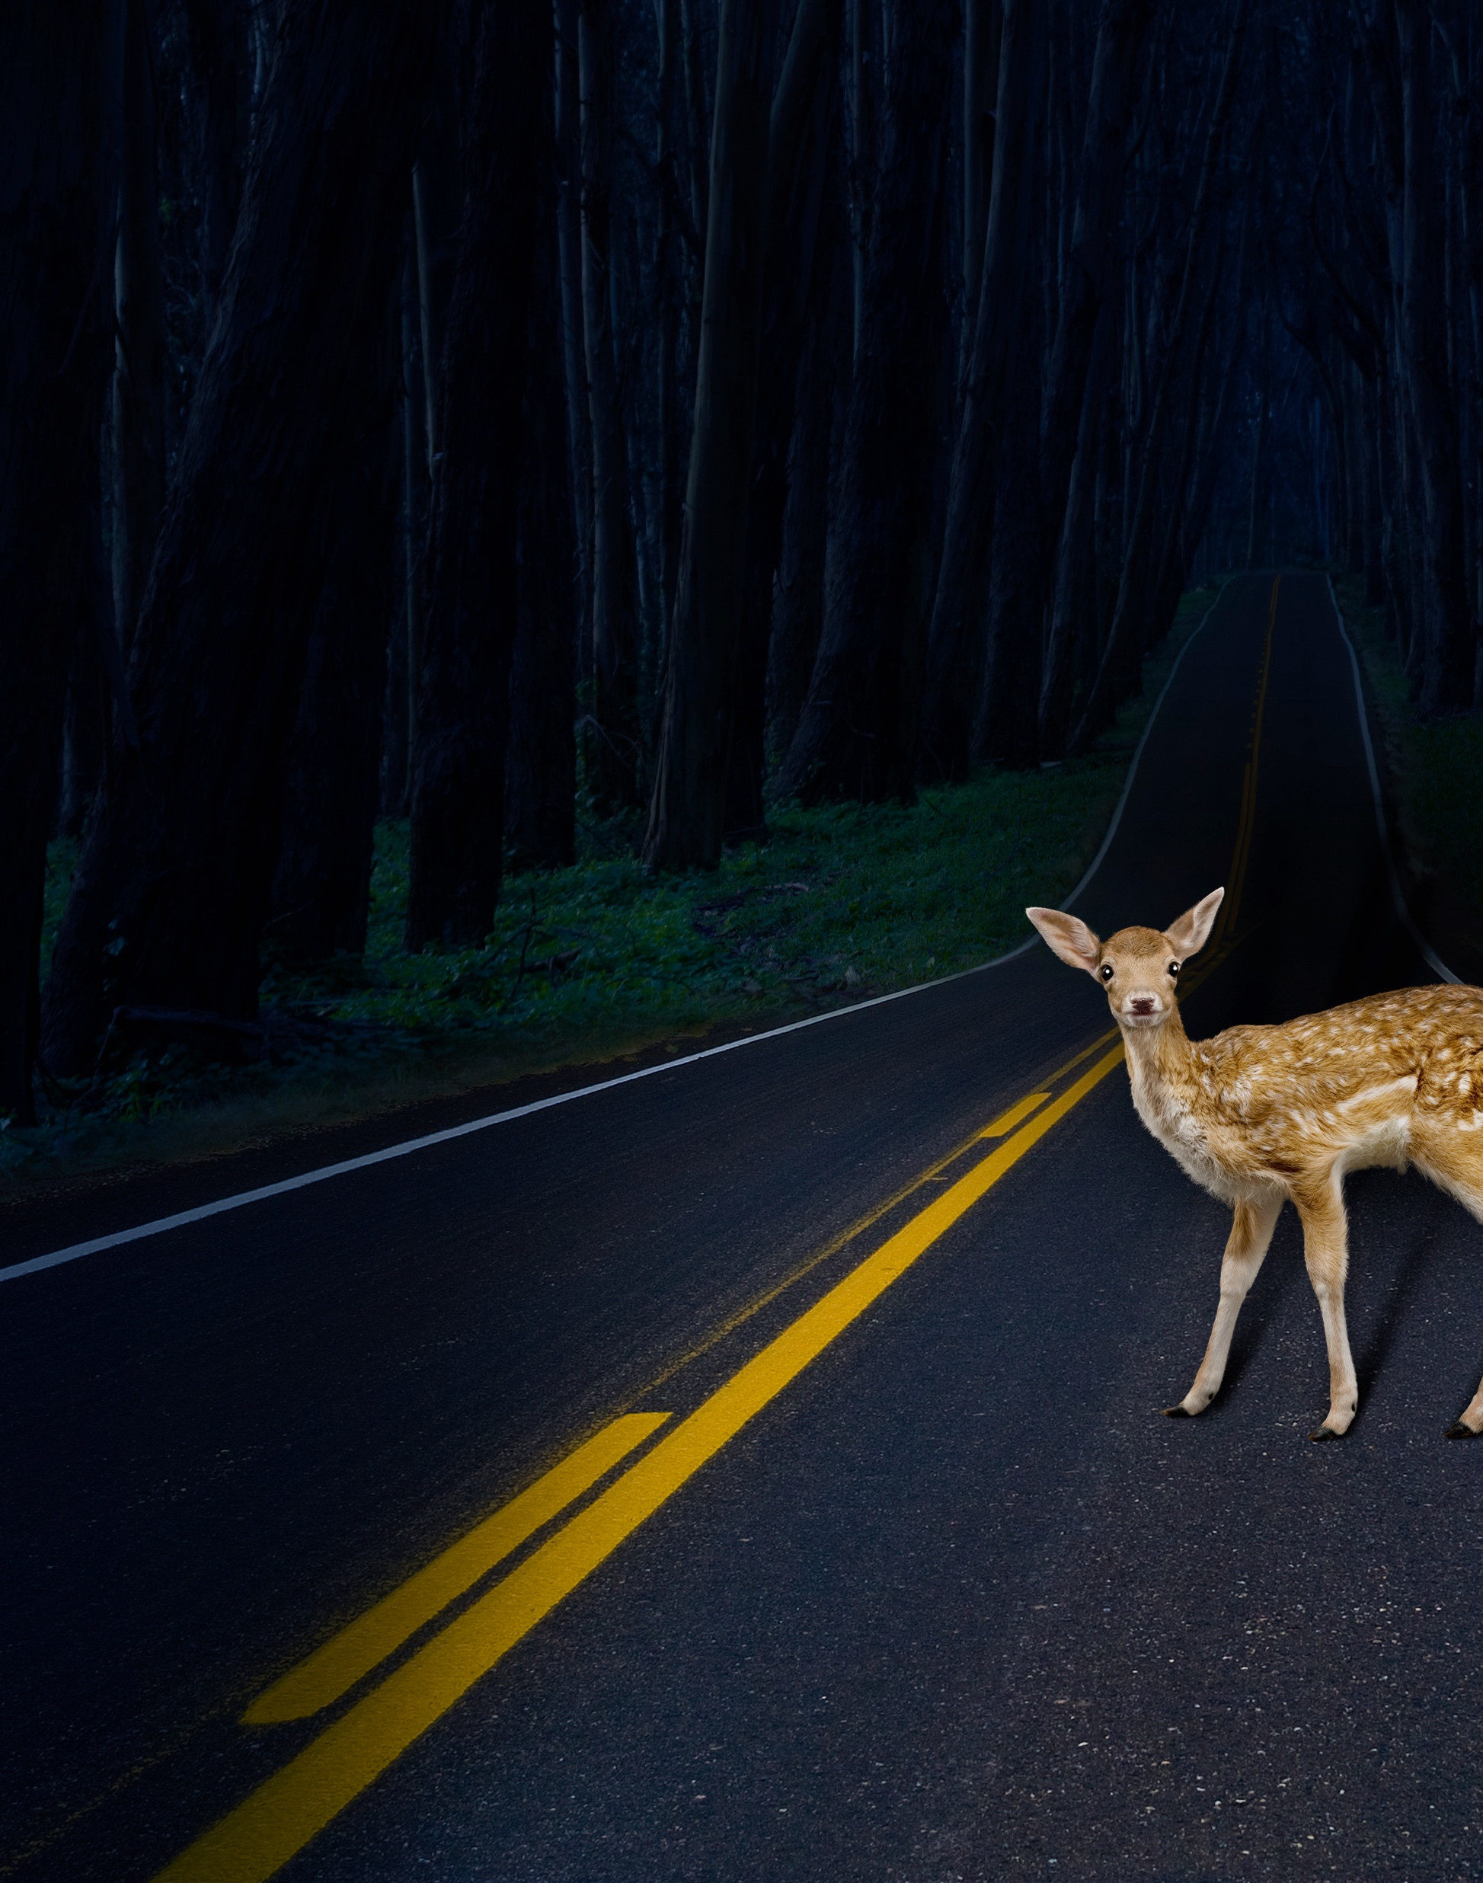
Key elements of a good story: No suprises or distractions
No new information without some context
No major tangents or extraneous detail
Notes:
Building on these three elements, the final aspect that is represented by the Goldlilocks story, is that there aren’t any major surprises for the reader or distractions
No major tangents – doesn’t stop and smell the flowers, wash the dishes
No descriptsion of the bears bowls or silverwear, what the wallpaper looked like.

Slide 15
Providing feedback using elements of storytelling
Notes:
We can think about these elements when we are providing feedback

Slide 16


Elements of a classic story
: Order
Order
Guideposts
Parallel structure
Red herrings
J. Downer and R. Dresbeck
Writing and Editing for Impact
NORDP Conference, 2019
Notes:
Let’s look at how each of these aspects apply to scientific writing and therefore, can be considered when you provide feedback.
And we’ll go into a bit of detail about how each of these elements applies to scientific writing, starting with the order
Goldlocks story follows a logical order, at many levels, that provides context for the reader. Similarly [CLICK]

Slide 17
Giving feedback: Order of information
Beginning
Why
(sets the stage)
Middle
What and How
(Describes what happens, How it is done)
End
Payoff
(Resolution)
Why?
Why?
How?
What?
What?
How?
What?
How?
What?
How?
Payoff
Payoff
Notes:
Your scientific documents should also follow a logical order
You can think about this when you are reviewing someone’s writing (or your own): check to see if the order is logical and makes sense.
Look at the overall order/structure of the document– do you get a sense of a beginning, middle and end?
In scientific writing, this might look like the writer first telling you why they are doing a study. Then what they propose to do (or what they did) and then how they will do it; and then the payoff of that work (broader implications of that work – how it advances the field).

Slide 18
Order of information in research articles
Abstract
Research Article
Introduction
Background knowledge
Gap in knowledge
Significance of gap
Brief description of research findings
General Introduction
More detailed background
Gap in knowledge
Why?
How?
What?
Methods
How you performed experiments
How you analyzed the data
Your overall finding
Method/Finding
Method/Finding
Method/Finding
What?
Results
What you did
What you found
What?
Discussion
Summary of outcomes
Integration with existing knowledge
Significance and impact of work
Significance/general context
Broader perspective
Payoff
Notes:
This is how the structure maps onto a manuscript./research article
Start out broad to provide context for the study (background and overarching question or knowledge gap being addressed)
Narrow in to describe how you did the study and what results you found
Then summarize your outcomes and integrate this with the literature; describe the significance and impact of the work
This is also true for grant writing

Slide 19
Order of information in grant applications
}
Broad problem, hook
Background knowledge
Gap in knowledge
Significance of gap
Why?
}
What?
Long-term goal
Objectives of research
Central hypothesis
Rationale
How?
}
How?
What will you do
Why will you do it
How?
}
Payoff
Expected outcomes of aims
Positive/broad impact of work
Expected contributions to advancement of your career
Notes:
As an example, here is a recommended structure of the Specific Aims page.
The information should start out describing a broad problem or need, and flow into the knowledge gap and the significance of that.
Once that is established, the document should discuss what will be done (e.g., long-term goal; objective; hypothesis, and support for that hypothesis)
Then get more specific and describe how it is you will achieve that goal
And then finally the expected outcomes and the broader impact of those outcomes.
The template that we’ve put together provides a guide for putting together your story in the form of a Specific Aims page. Allows the information to flow in a logical order.
In Goldilocks, not just overall order that makes it an effective story. Also see order at the sentence and paragraph level

Slide 20
Order of information at the sentence level
Topic and stress positions
Topic
Stress
Contextual (old) information
New information (emphasis)
Notes:
The order information is presented within sentences can impact clarity writing.
Some of you may have heard of the topic and stress position of a sentence.
The topic position is the beginning of the sentence – you want to put contextual or old information here
The end of the sentence is the stress position because readers naturally emphasize this part of the sentence. Here is where you want to put new information.
Use of topic and stress position within a sentence allows you to present your information to the reader in a logical order that facilitates understanding.

Slide 21
Order of information within paragraphs
Topic
Stress
Once upon a time, there was a young girl named Goldilocks.
One day Goldilocks was skipping through the forest when she came upon a cottage that belonged to the Three Bears. She knocked but upon receiving no answer went right in.
Topic sentence
Concluding sentence
Old
New
Old
New
Old
New
Notes:
Logical use of the Topic and Stress positions allows for sequential progression of information that builds on itself.
Providing contextual information first makes it easy to link new information together in a paragraphs because you slowly introduce the reader to new information and giving them the necessary context they need to understand why that information is important. .

Slide 22
Topic and stress positions smooth the flow of information
Topic sentence
Concluding sentence
Old
New
Old
New
Old
New
Multiple sclerosis (MS) is a chronic, inflammatory, neurodegenerative disease of the central nervous system (CNS) with unknown etiology.
Mouse models of MS are characterized by high expression of the Nix-a cytokine.
Nix-a is a signature cytokine of the Nix subset and is known to play a crucial role in controlling extracellular bacterial and fungal infections.
High levels of the Nix-a cytokine can lead to unresolved inflammation and tissue pathology.
Although Nix-a is considered a major cytokine in the pathogenesis of multiple autoimmune diseases, its role in the pathobiology of MS is still being explored.
Notes:
You can use this old-new old-new structure to build paragraphs that flow in a logical order for the reader

Slide 23
Order of information in paragraphs: context is key
Topic sentence
Supporting statement
Supporting statement
Supporting statement
Concluding sentence
(Context)
Once inside, she discovered bowls of porridge and realized she’s hungry.
She tried one bowl and thought, “This porridge is too hot.”
She tried another bowl and thought “This porridge is too cold.”
She tried the third bowl and thought “This porridge is just right.”
And she ate it all up.
Notes:
You aren’t limited to just using the ping-pong structure (old new, old new, old new). You can also connect sentences in a paragraph to one main topic sentence and have each sentence build on that.
In this case, the topic is the bowl of porridge, and each of the sentences in the paragraph refer back to the initial sentence.

Slide 24
Use the topic sentence to provide context for new info
Topic sentence
Concluding sentence
New
New
New
(Context)
Major depressive disorder is a prominent mental health issue in the United States that affects about twice as many women as men.
For women, depression during pregnancy may increase the risk of neurodevelopmental disorders in the child.
Although conventional antidepressants may effectively treat depression in some mothers, about half do not respond to treatment.
Furthermore, antidepressant use during pregnancy often presents an additional risk for adverse neurodevelopment of the child.
Therefore, current treatments for depression during pregnancy are insufficient, and there is an urgent need to develop new, more effective treatments.
Rachel Schroder
UI Grad Success Center Professional Development Resources
Notes:
Can use information from topic sentence for each subsequent sentence to introduce new information
Don't always have to use the topic/stress position or generate paragraphs in this format, but if you are having trouble seeing how the information is linked together within a paragraph, see if the topic and stress positions in a sentence can be modified to smooth the flow of information.

Slide 25
Use the concluding sentence to emphasize the main point
Topic sentence
Concluding sentence
New
New
New
(Context)
Major depressive disorder is a prominent mental health issue in the United States that affects about twice as many women as men.
For women, depression during pregnancy may increase the risk of neurodevelopmental disorders in the child.
Although conventional antidepressants may effectively treat depression in some mothers, about half do not respond to treatment.
Furthermore, antidepressant use during pregnancy often presents an additional risk for adverse neurodevelopment of the child.
Therefore, current treatments for depression during pregnancy are insufficient, and there is an urgent need to develop new, more effective treatments.
Rachel Schroder
UI Grad Success Center Professional Development Resources
Notes:
One other note, I mentioned stories have a logical order – beginning, middle, and end – Making sure there is a concluding sentence at the end of the paragraph is often critical. It should summarize for the reader the main point of the paragraph (or section). If a paragraph or section feels like it ends abruptly, suggest adding a concluding sentence to provide the reader with the main point is that ending (conclusion) needed to tie the information together.

Slide 26
Elements of a classic story: Guideposts
Order
Guideposts
Parallel structure
Red herrings
J. Downer and R. Dresbeck
Writing and Editing for Impact
NORDP Conference, 2019
Notes:
Another element of storytelling that you can use when reviewing scientific writing projects is to look for guideposts.
In the goldilocks story these were words that gave clues to the reader to help orient them. In scientific writing, can use words and also also use structural elements (such as headers, formatting) to provide guideposts.
4 points I want to make.
Goldlocks story really has a structure, at many levels, that provides context for the reader.
In addition, it uses parallel construction throughout to make it easy for the reader to anticipate what might be coming next
There are no surprises or red herrings, nothing out of the blue
And it uses relevant guideposts to provide orientation throughout the story
I’m going to briefly touch on each of these points and how they can be translated to scientific writing

Slide 27
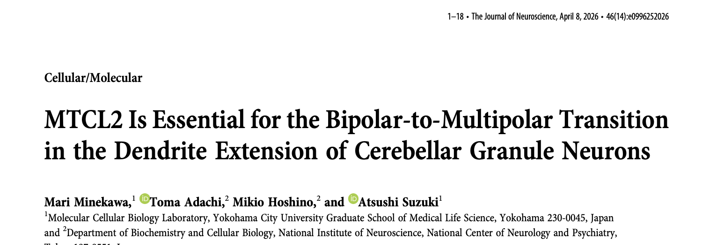
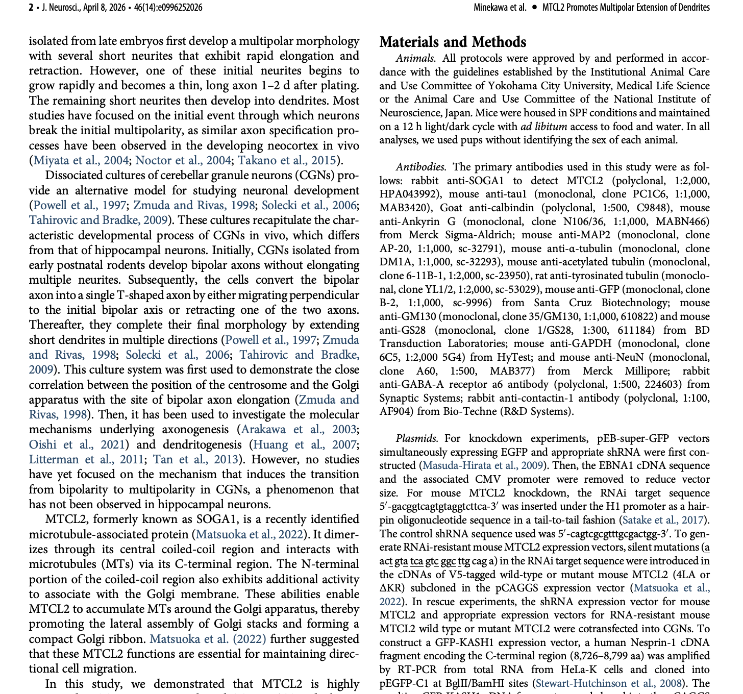
Guideposts can also be used in the Methods section of a manuscript
Introduction
Methods
For major sections
Discussion
Results
and subsections
Notes:
Section headers can be critical for keeping the reader oriented

Slide 28
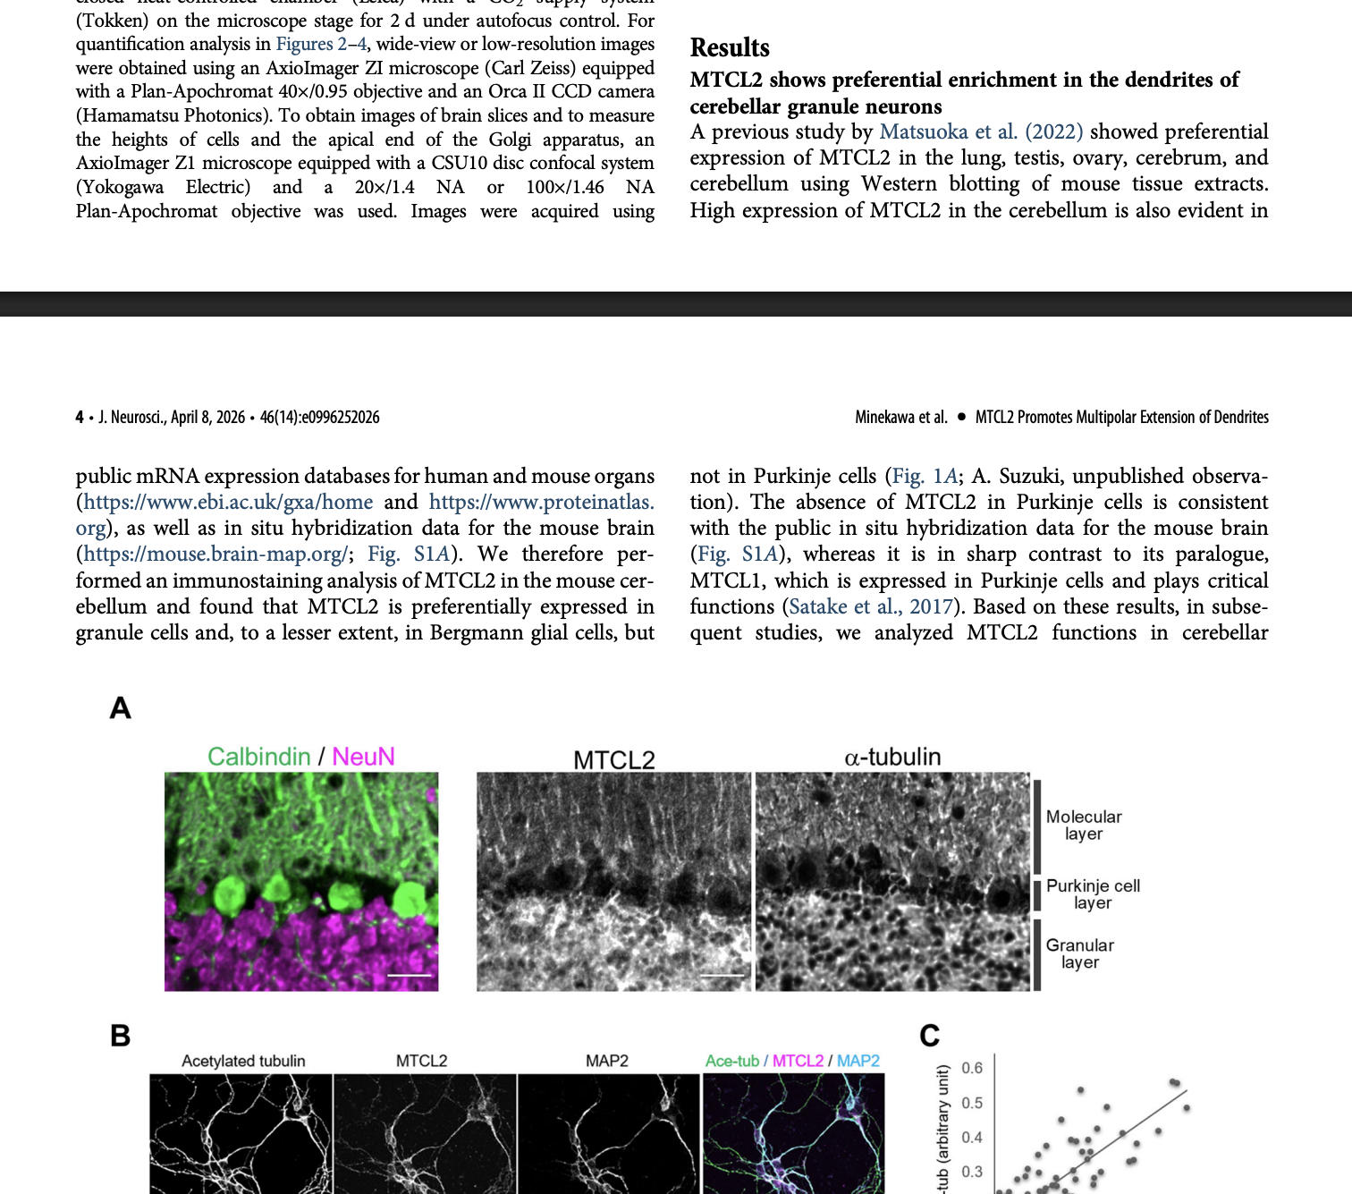
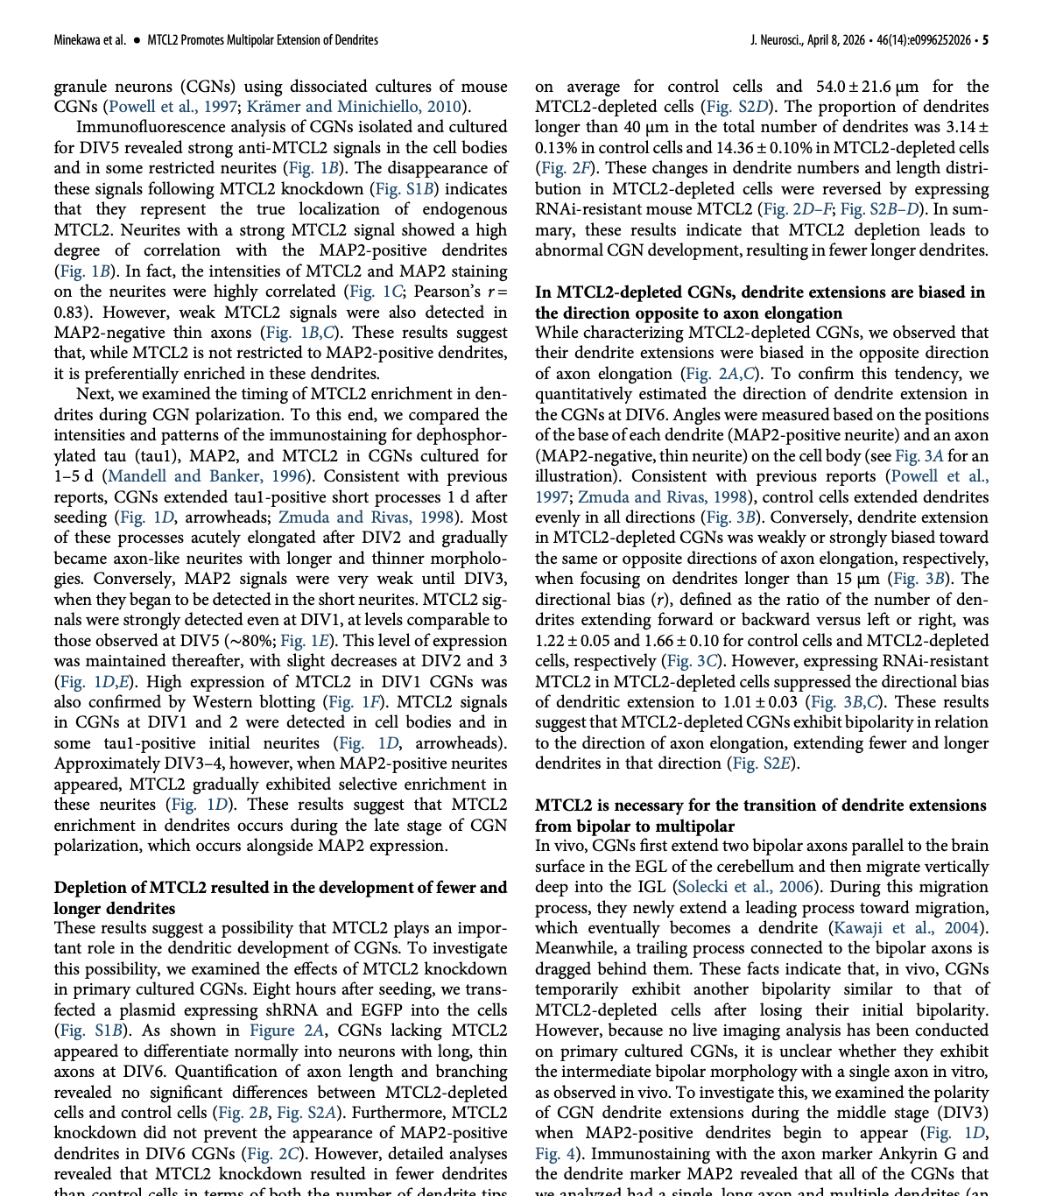
Guideposts can also be used in the Results section of a manuscript:
Introduction
Methods
For major sections
Discussion
Results
and subsections
Notes:
Section headers can be critical for keeping the reader oriented

Slide 29
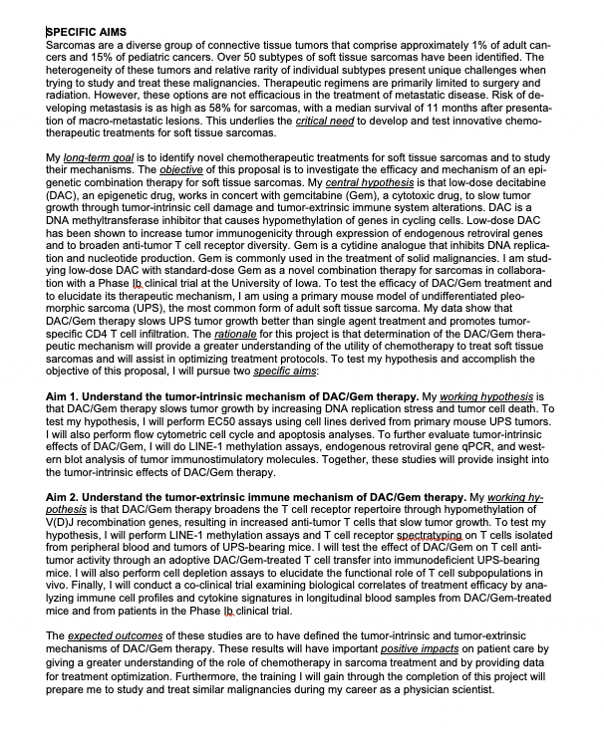
Giving feedback: Guideposts
Guideposts highlight important information
Critical need
Objective
Example from an
NIH Specific Aims page
Expected outcomes
Central hypothesis
Highlighting of
critical need
long-term goal
objective (of the proposed research)
central hypothesis (overall)
rationale
specific aims
working hypothesis (by aim)
expected outcomes
positive impact
Notes:
Suggest changes to formatting to highlight these points (instead of entire sentences)
Neatness counts! make it very obvious which terms are meant to be higlighted
I just reviewed some pilot grants for another project I was working on and the ones that used sign posting (and not too much, because there were some where there was a lot of highlighting and it was distracting), but it was extremely helpful in finding the relevant information, particularly after I had read through the entire proposal once and wanted to refresh my memory on some key points.

Slide 30
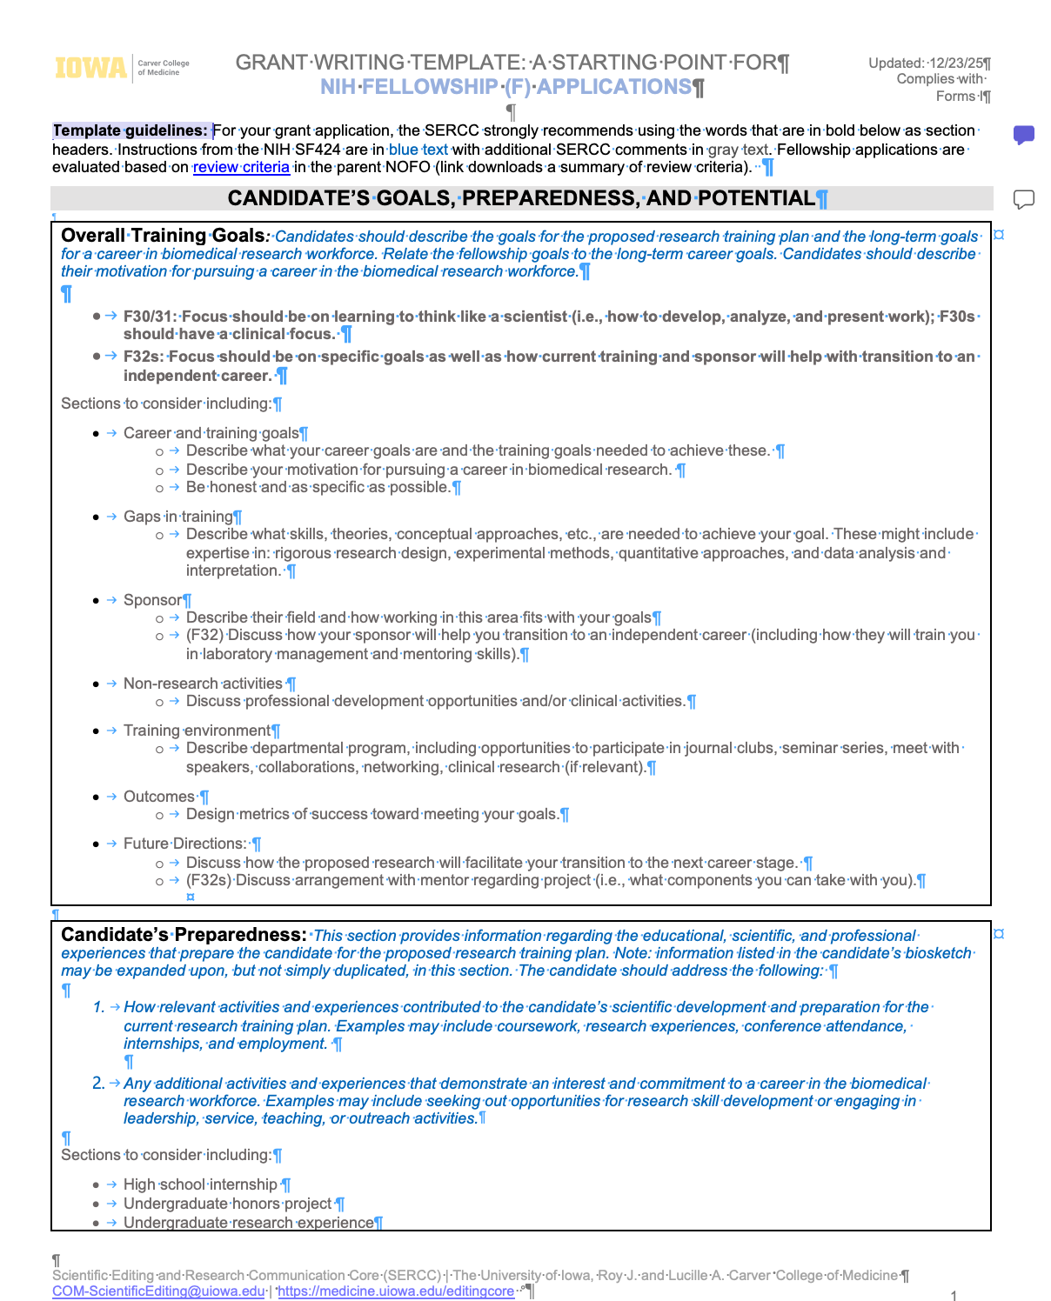
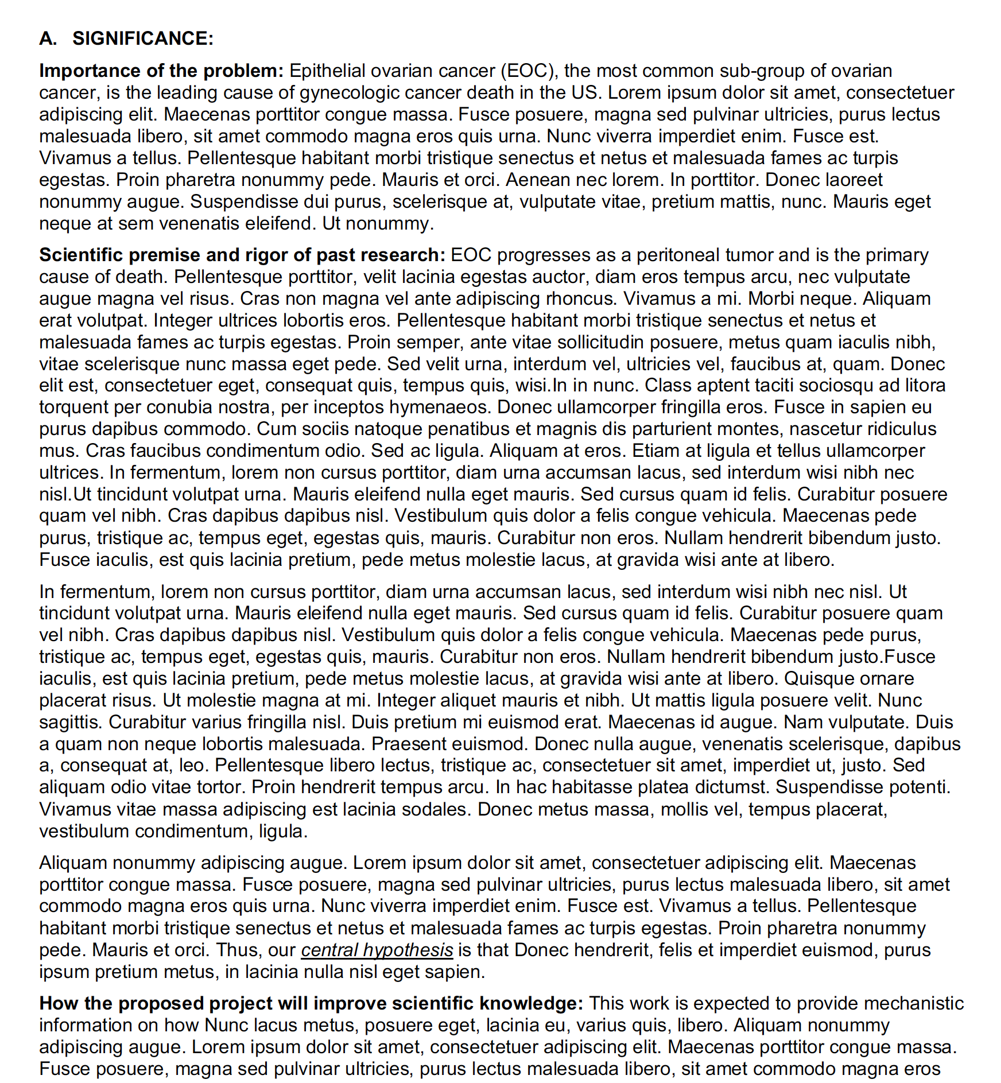
Guideposts keep the reader oriented
Significance
Problem
Suggested headers in our templates
Example from an
NIH Significance Section
Value
Premise
Highlighting of
Importance of the problem
Scientific premise and rigor of prior research
How work will improve scientific knowledge
= reviewer prompts
Notes:
Section headers can be critical for keeping the reader oriented

Slide 31

Elements of a classic story: Parallel structure
Order
Guideposts
Parallel structure
Red herrings
J. Downer and R. Dresbeck
Writing and Editing for Impact
NORDP Conference, 2019
Notes:
Another element from storytelling to highlight is the use of parallel structure
we saw the goldilocks story provides great examples of this
In addition, it uses parallel construction throughout to make it easy for the reader to anticipate what might be coming next - anything you can do to reduce cognitive load of the reader is helpful and to your benefit

Slide 32
Parallel structure in a sentence
Sentence
Specific Aims
Approach (Research Strategy)
The study demonstrated that the drug reduces blood pressure, improving cardiovascular function, and that the quality of life for patients was enhanced.
reduces (simple present tense)
improving (present participle/gerund form)
was enhanced (passive voice)
Notes:
We can all understand this sentence, but as I read, my mind gets distracted because the information isn’t all presented in the same way (different verb tenses are used and I have to figure out what that means).

Slide 33
Parallel structure improves clarity
Sentence
Specific Aims
Approach (Research Strategy)
The study demonstrated that the drug reduces blood pressure, improves cardiovascular function, and enhances the quality of life for patients.
reduces (simple present tense)
improves (simple present tense)
enhances (simple present tense)
Notes:
Writing the sentence with the same verb t3enses in parallel structure makes this easier to follow.

Slide 34
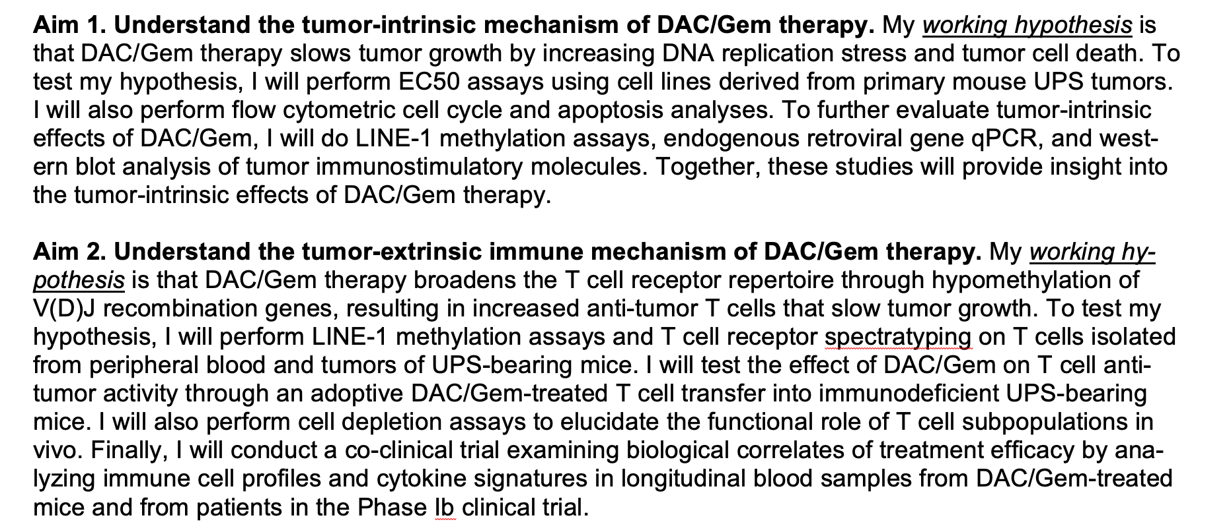
Parallel structure in Aims
Sentence
Specific Aims
Approach (Research Strategy
Aim 1:
Working hypothesis
Experimental approach
Aim 2:
Working hypothesis
Experimental approach
Notes:
Parallel structure also comes into play at the paragraph level – one example is on the Specific Aims page. Very helpful to structure these the same.

Slide 35
Parallel structure maintains organization
Sentence
Specific Aims
Approach (Research Strategy)
Aim 1
Aim 2
Title of Specific Aim
Introduction/rationale paragraph
Justification and Feasibility paragraph
(including background and preliminary data)
Research Design paragraphs
Expected Outcomes paragraph
Potential Problems and Alternative Strategies
Title of Specific Aim
Introduction/rationale paragraph
Justification and Feasibility paragraph
(including background and preliminary data)
Research Design paragraphs
Expected Outcomes paragraph
Potential Problems and Alternative Strategies

Slide 36

Elements of a classic story: Red herrings
Order
Guideposts
Parallel structure
Red herrings
J. Downer and R. Dresbeck
Writing and Editing for Impact
NORDP Conference, 2019
Notes:
4 points I want to make.
Goldlocks story really has a structure, at many levels, that provides context for the reader.
In addition, it uses parallel construction throughout to make it easy for the reader to anticipate what might be coming next
There are no surprises or red herrings, nothing out of the blue
And it uses relevant guideposts to provide orientation throughout the story
I’m going to briefly touch on each of these points and how they can be translated to scientific writing

Slide 37
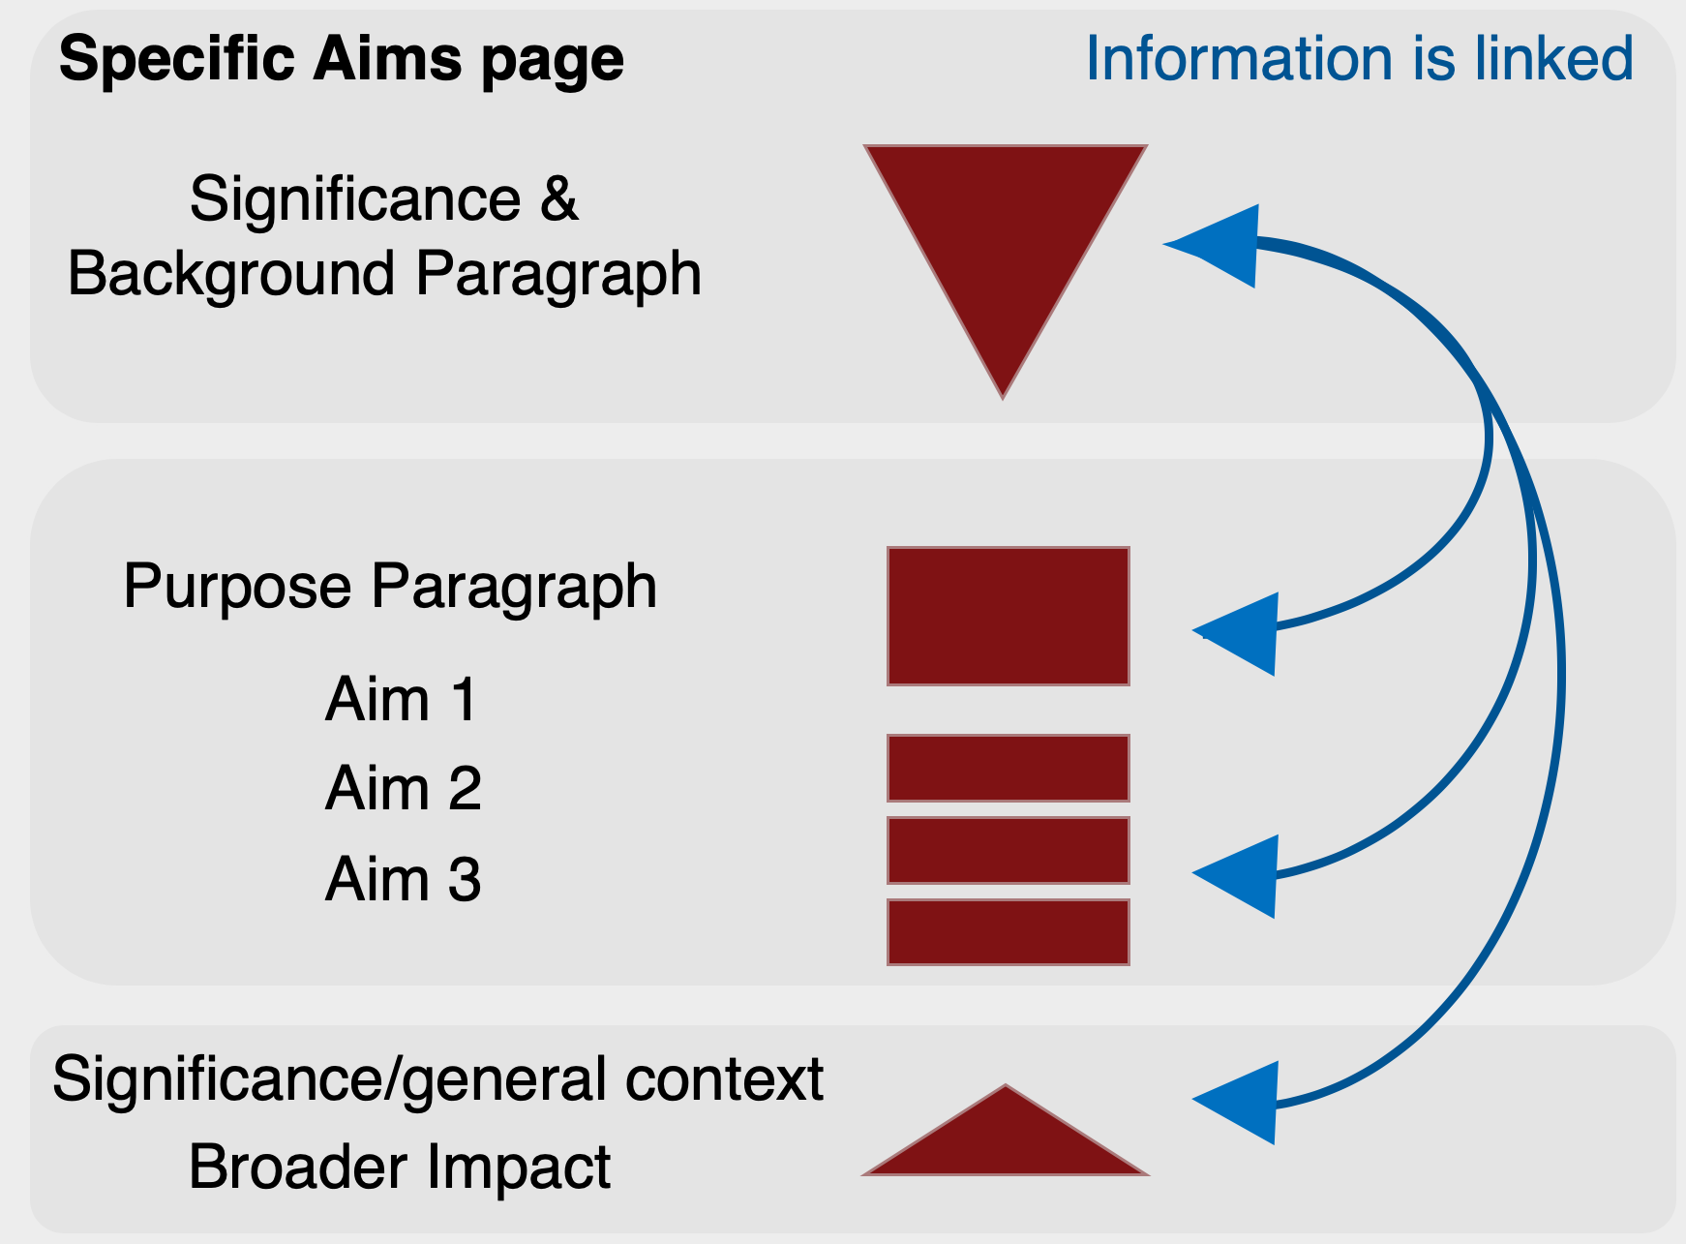
Key elements of a good story: no surprises or red herrings
Make sure context is provided
Avoid unnecessary details
Make sure information is linked
Flag inconsistent labels and abbreviations
Flag field-specific jargon
Make sure formatting is used consistently
Notes:
Goldilocks – once upon a time girl named goldilocks (always called by same name; don't add too much detail)
- don’t provide last name or parents names, etc.
Skipping through forest when she came upon a cottage (not how many bedrooms, square feet, what neighborhood its in)
Provides context – once inside, now very tired,
(not all reviewers are experts)

Slide 38
Other feedback
Identify ambiguous statements
Ideally provide alternative wording
Explain problem in comment
Point out if they are missing key statements
Knowledge gap
Objective or hypothesis
Main conclusion/takeaway
Suggest a schematic figure
To clarify key process or relationship among aims

Slide 39
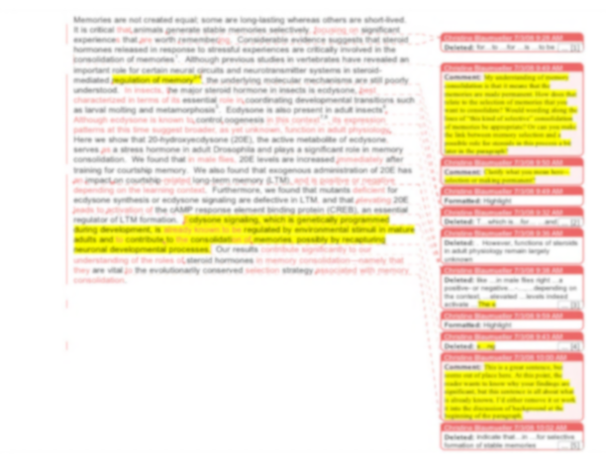
How to approach giving feedback
Point out what was done well
Use track changes to make it easy to see changes
Provide honest, constructive criticism
Use ”Comments” to ask questions
Notes:
Point out what was done well
Scientific writing is not easy and it is a process
The final products you see take time to develop

Slide 40
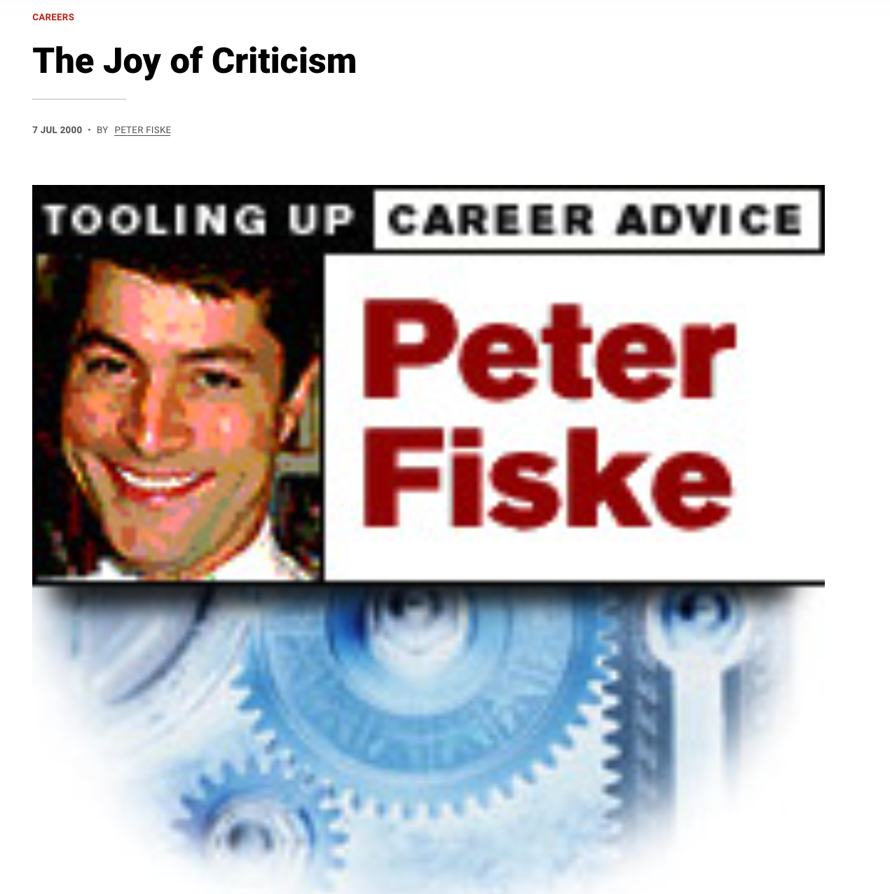
The Joy of Criticism
How to be a positive critic
Be humble
Ask “How could I be doing this better?”
Become aware of the emotions, actions, and feelings of the people you are criticizing
Acknowledge that your criticisms are necessarily subjective
Provide suggestions for how to address a challenge
Lead through actions, set a good example, follow up with questions
By Peter Fiske
https://www.science.org/content/article/joy-criticism#:~:text=Much%20of%20the%20criticism%20we,improve%20and%20strengthen%20the%20work.

Slide 41
What does this look like?
Avoiding ”I” statements
“I think you should…”
“I didn’t like the way…”
Frame the concern from the perspective of a reviewer
“Is this something a broad panel of reviewers will understand?”
“Reviewers may be concerned that…”
Provide examples of alternative ways to structure or phrase something instead of just focusing on what is wrong.
“Consider wording this as …”
“This section describes the impact of the work and may fit better in the Significance section.”

Slide 42

How to approach the feedback you receive

Slide 43
Why is it difficult for us to accept feedback or criticism?
Can feel like an attack on your self esteem (especially if it is not supported with evidence or fair comparisons)
Can trigger fears of judgement or rejection
Feels non-strategic: non-specific about goals or solutions
Lack of trust in the person providing the feedback
By Peter Fiske
https://www.science.org/content/article/joy-criticism
doi: 10.1126/article.65156
Notes:
For some people, especially at first, it can be difficult to accept feedback or criticism.
This is all reasonable, but, feedback is necessary in science, and it can help if we reframe how we think about it

Slide 44
Objective ways to think about criticism or feedback
Criticism as information (data) that can help you improve
As a recipient: can be beneficial and positive
As a giver: intended to improve and strengthen the recipient
Keep an open mind
Welcome the criticism, assume that critic has your best interests at heart
Listen carefully and ask questions to clarify; ask for suggestions
Allow critic to deliver all criticisms before responding (don’t rebut point-by-point)
Maintain your cool
Stay cool: try to be relaxed
Take time to think about it or come back to it later
By Peter Fiske
https://www.science.org/content/article/joy-criticism
doi: 10.1126/article.65156
Notes:
I think it is human nature to react somewhat defensively when we get feedback; first response; I think it is good to just keep that in mind.
If that is your initial reaction, that's ok, (your like me), but being aware of this reaction is important because then we can take a step back and think, maybe I need to think about this more objectively.

Slide 45
How to know if the criticism (feedback) is “right”?
The criticism jives with your own gut feeling
Multiple people flag the issue
The critique makes a good passage better
Keep in mind: for clarity issues, the audience is always right

Slide 46

Actionable strategies for receiving feedback
Ask for specific areas you’d like feedback on
Provide your reviewers with the necessary information
Instructions or review criteria
Once you receive feedback, read through it and make a plan to address it
Go through and clean up typos, grammar, etc.
Address bigger issues
“The only kind of writing is rewriting.”
- Ernest Hemingway, A Moveable Feast

Slide 47

Resources

Slide 48
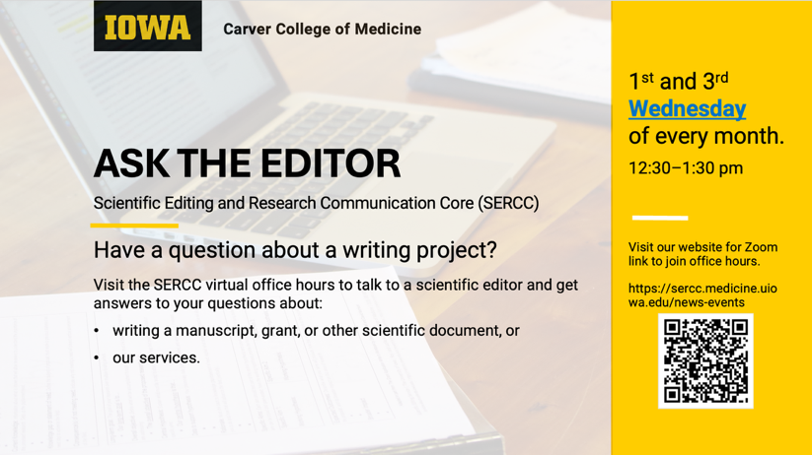
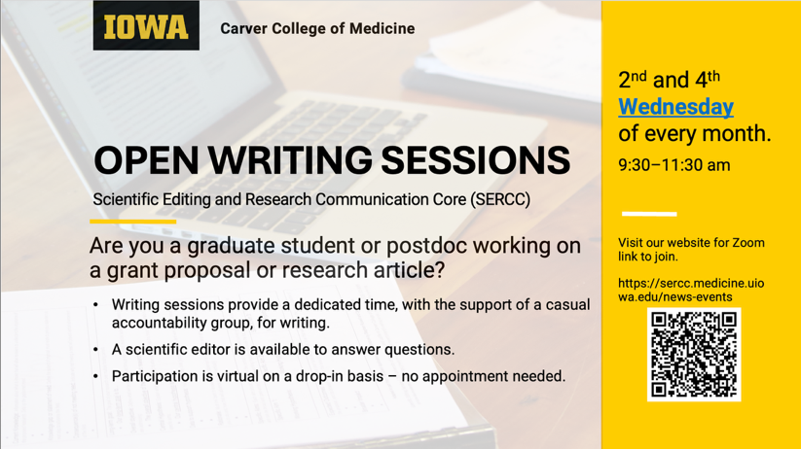
SERCC Drop-in Sessions
Ask the Editor
https://sercc.medicine.uiowa.edu/news/2025/12/ask-editor
Open Writing Sessions*
https://sercc.medicine.uiowa.edu/news/2026/01/open-writing-sessions
* Only for students and postdocs

Slide 49

SERCC Website
Resources
Grant-Writing Templates
Pricing
Services
Schedule a Project
Contact us
https://sercc.medicine.uiowa.edu/

Slide 50
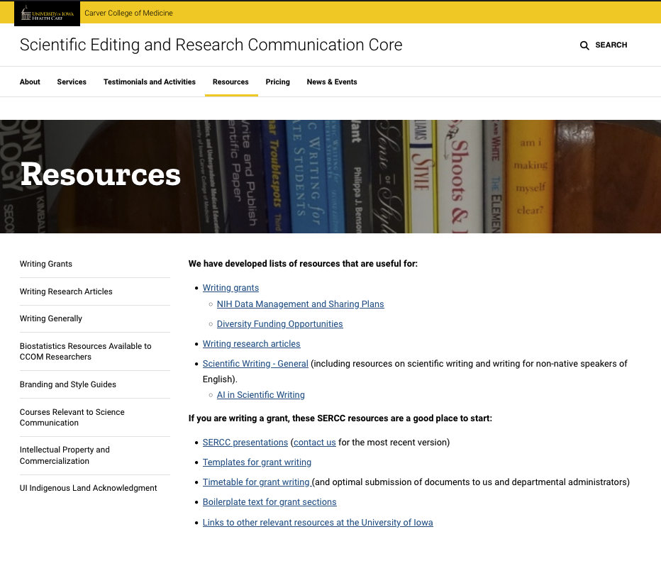
SERCC Resources
Writing Grants:
Templates
Core facilities descriptions
List of available lectures
Links to other resources
Writing Research Articles:
Tips for paper sections
List of available lectures
Suggested books
Writing Generally:
List of available lectures
Suggested articles/books
Resources for non-native speakers

Slide 51

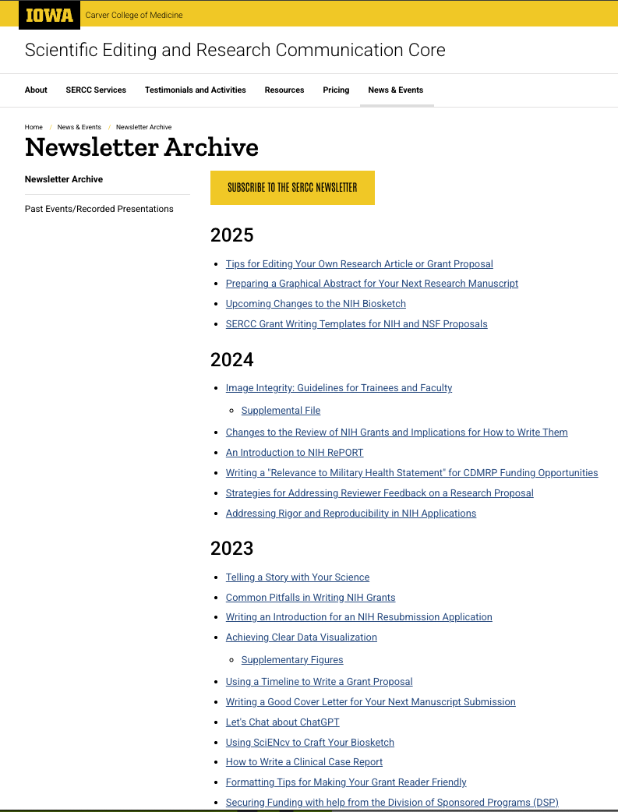
Some past Newsletter topics

Slide 52
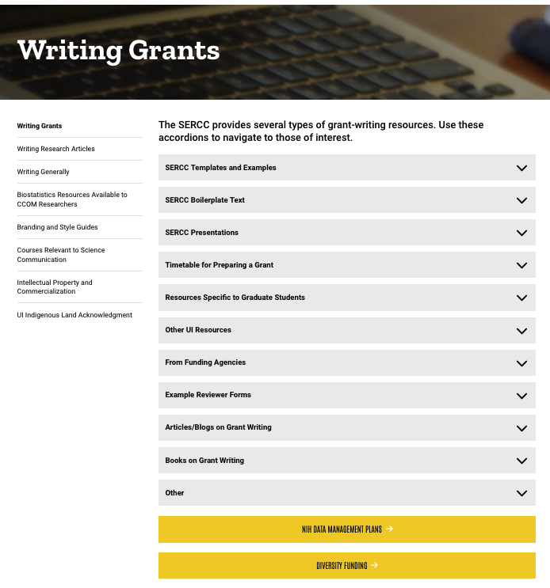
Resources for writing grants
Biosketch templates
Templates and Embedded Examples
Boilerplate Text and Examples
Presentations
Timetables for Preparing Grants
Resources Specific to Graduate Students
Resources from other offices and institutes
Articles/blogs, books, other

Slide 53
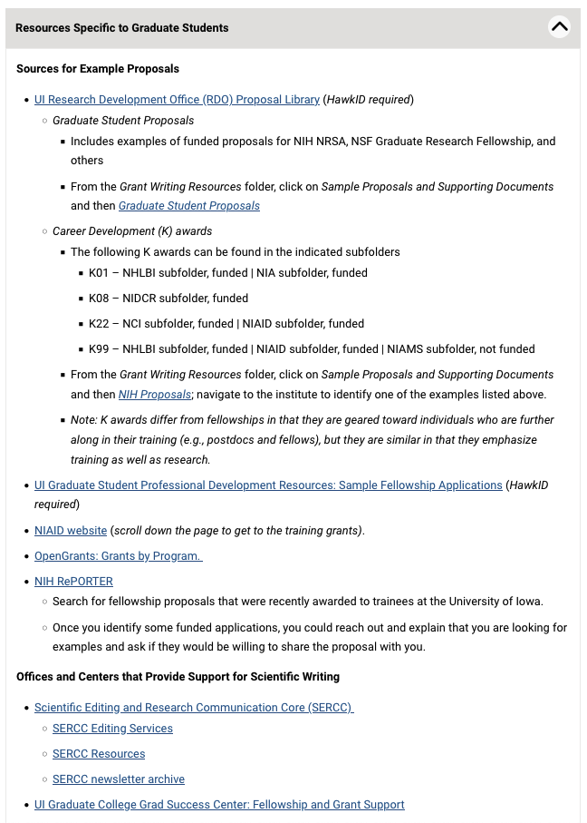
Links to resources from other groups
Sources for example proposals:
OVPR/RDO (e.g., Resource Library)
UI Graduate College
UI Writing Center (CLAS)
Hanson Center for Communication (Eng)
Funding Agencies and other
National Institutes of Health (NIH, NAIAD)
Open Grants

Slide 54
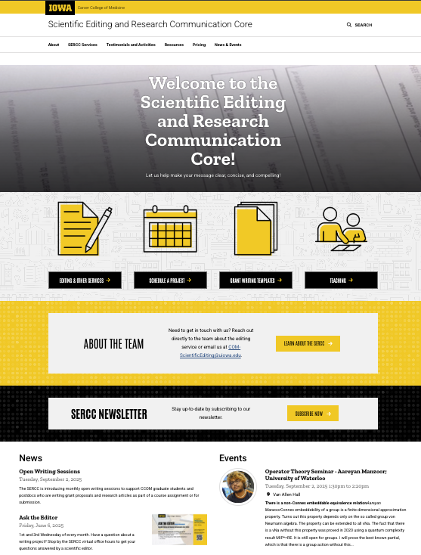
Other resources
Biostatistics Resources
Branding Style Guidelines
Courses Relevant to Science Communication
Intellectual Property and Commercialization
SERCC Newsletter
Open Writing Sessions
Ask the Editor (virtual office hours)

Slide 55
Questions?
Email
jennifer-barr@uiowa.edu
COM-ScientificEditing@uiowa.edu
sercc.medicine.uiowa.edu

Slide 56
Giving feedback: order of information in sentences
Check if the order is logical
For the document as a whole
Within sentences
Topic
Stress
Contextual (old) information
New information (emphasis)
Angiogenesis is the formation of new blood vessels from pre-existing vasculature and plays an important role in health and disease. Endothelial cell dynamics controlled by membrane trafficking is central to the process of angiogenesis.
Angiogenesis is the formation of new blood vessels from pre-existing vasculature and plays an important role in health and disease. This process is dependent on dynamic changes in endothelial cells, which are in turn controlled by membrane trafficking.

