Slide 1

Changes in NIH Review For Research Project Grant (RPG) applications submitted on or after January 25, 2025
HCCC PRSPR Group
April 29, 2026
Notes:
Thank you for inviting me to talk to you about recent changes in review at NIH.

Slide 2




Who I am
EMBL
European Molecular
Biology Laboratory
EMBO
European Molecular
Biology Organization
Yale
University
Northwestern University
PhD
Department
of Biology
Director
Scientific Editing and
Research Communication Core (SERCC)
BA
Biochemistry, Molecular Biology and Cell Biology
Editor
Reviews
Research Articles
Postdoc
Developmental Biology Programme
Notes:
Wanted to tell you a bit about my background so that you get a sense of what I look for in grants (and manuscripts).
I’m a scientist by training..
Have worked on the composition of hnRNP complexes, Notch signal transduction, tissue growth during development
transitioned from the lab in 2000, serving first as the reviews editor and then scientific editor at EMBO reports; among other things
did line editing of reviews/meeting reports
shepherded research articles though the review process
I’ve seen a lot of science communicated
Some very well
Some not so well
What do I care about in the writing projects I work on with clients?

Slide 3
What I care about in writing projects
The Science
Clear Writing
Strategic
Writing
Director
Scientific Editing and
Research Communication Core (SERCC)
Are the instructions followed?
Are the review criteria addressed?
Notes:
The Science
Can I follow it?
Strategic Communication of the Science
Did they follow instructions and address review criteria?
Can I follow
WHY they did what they did and/or
WHY they've proposed what they're proposing?
Clear Communication
Can I follow the story on a first read? (i.e., no need for backtracking or jumping ahead)

Slide 4




Who the SERCC editors are
The Science
Clear Writing
Strategic
Writing
What we have in common:
Advanced degrees in the sciences
Laboratory experience
A love of clear writing
Christine M Blaumueller, PhD
Director, Senior Scientific Editor and Writing Consultant
Over 14 years as a laboratory researcher | 6 years as a journal editor (EMBO) | Editor in CCOM since 2006 | Est SERCC in 2017
PhD from Yale University | Postdoctoral training at the European Molecular Biology Laboratory (EMBL)
Jennifer Y Barr, PhD
Assistant Director of SERCC, Grant Writer in Large-Scale Proposal Development Service (LSPDS)
Over 12 years of experience as a laboratory researcher | SERCC editing internship 2015–2017 | SERCC editor since 2017
PhD and Postdoctoral training at UI | Has developed many of author resources and directs Scientific Editing Internship Program
Michael R Rebagliati, PhD
Scientific Editor and Writing Consultant
Ove 30 years of experience as a laboratory researcher.
PhD from Harvard University | Postdoctoral training at the NICHD | Primary editor for the Stead Family Department of Pediatrics
Emily Huber, PhD
Scientific Editor and Writing Consultant
Over 10 years of research experience in cell biology, genomics, and virology | Has edited for academic and industry laboratories
PhD in human and statistical genetics from Washington University in St. Louis
Notes:
The same is true for all the editors in the SERCC
We are all scientists
Although the details of our path to editing vary, we all have…
Advanced degrees in the sciences
Laboratory experience
A love of clear writing
We all look for the same things in writing projects

Slide 5
What the SERCC editors do
Provide input on drafts of writing projects
Provide one-on-one consultation on writing strategy
Brainstorm with groups of authors and faculty on Specific Aims
Teach scientific writing
Collect and generate resources
Changes in funding agency requirements
Grant writing templates (NIH “R”/“K/“F” grants)
Liaise with other RD professionals
National Organization of Research Development Professionals (NORDP)
Scientific Editors Network (ScENe)
American Medical Writers Association (AMWA)
Will introduce you to one of these today
Notes:
Complementary activities go into training good writers
We provide direct feedback on and input into writing – helps us with our teaching
Teach scientific writing (courses, seminars, workshops)
To help our clients, we collect and generate resources – helps us with our teaching

Slide 6
NIH Simplified Review Framework
The instructions for writing grants have not changed.
As it applies to Research Project Grants (RPGs):
“The same research strategy – reviewed in a new way”
Applies to:
R01, R03, R15, R16, R21, R33, R34, R36, R61, RC1, RC2, RC4, RF1, RL1, RL2
U01, U34, U3R, UA5, UC1, UC2, UC4, UF1, UG3, UH2, UH3, UH5,
And phased awards: R21/R33, UH2/UH3, UG3/UH3, R61/R33
https://grants.nih.gov/policy-and-compliance/policy-topics/peer-review/simplifying-review/framework
Notes:
NIH introduced a "Simplified Review Framework” (SRF) in January 2025
Will discuss what the SRF is (how it compares to past review), and
How it impacts grant structure – note that instructions haven't changed

Slide 7
Goals of the Simplified Review Framework (SRF):
Enable improved review by
Focusing reviewer attention on three key questions:
Factor 1: Importance of the Research
Factor 2: Rigor and Feasibility
Factor 3: Expertise and Resources
Simplifying and strengthening review by:
Shifting from extensive sets of complex questions
Encouraging thoughtful integration of concepts
Discouraging “yes-no” thinking for Factors 1 and 2
Should it be done?
Can it be done?
Will it be done?
https://grants.nih.gov/policy-and-compliance/policy-topics/peer-review/simplifying-review/framework
Notes:
Why did NIH do this?

Slide 8
Goals of the SRF:
…with explanation of what more is required
In Factor 3, modify criterion definitions for Investigator and Environment to reduce reputational bias
Assess the adequacy of investigator expertise and institutional resources as a binary choice:
Appropriate
Additional Resources or Expertise Needed
Investigator and Environment are evaluated with respect to the work proposed – to reduce the potential for general scientific reputation to have an undue influence.
For “Additional Considerations,” reduce reviewer burden
Shift review of considerations not directly related to scientific merit to NIH administrative staff.
https://grants.nih.gov/policy-and-compliance/policy-topics/peer-review/simplifying-review/framework

Slide 9
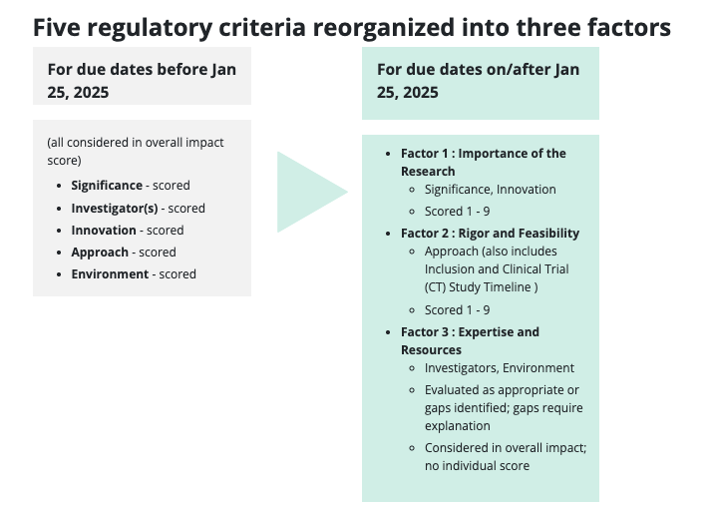
Reorganization of Scored Review Criteria
Factor 1: Importance of the Research
(Considers the Significance and Innovation)
Scored 1-9
Factor 2: Rigor and Feasibility
(Considers the Approach)
Scored 1-9
Factor 3: Expertise and Resources
(Considers the Investigator and Environment)
Scored as “Appropriate” or “Gaps identified” (with explanation of gaps)
Inconsistent wording for this:
e.g., NIH also uses “Sufficient”
https://grants.nih.gov/policy-and-compliance/policy-topics/peer-review/simplifying-review/framework
Notes:
What this looks like in comparison to previous scoring scheme at the level of the scored review criteria
NIH provides nice before and after tables

Slide 10
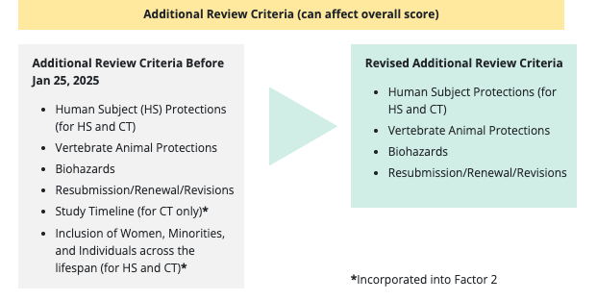
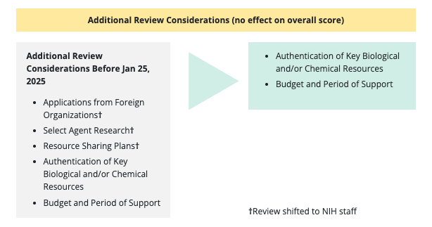
Reorganization of Additional Review Criteria and Considerations
First-Level Review
By scientific peers in a standing or
special emphasis panel
Second-Level Review
By Advisory Council
(funding institute/center)
Additional Review Considerations
Most were removed from first-level peer review
To shift responsibility for review of these considerations to the institute/center
https://grants.nih.gov/policy-and-compliance/policy-topics/peer-review/simplifying-review/framework
Notes:
Changes were also made to:
Additional Review Criteria and
Additional Review Considerations

Slide 11
Review criteria according to the SRF
Overall Impact
Reviewers provide an overall impact score
To reflect their assessment of the likelihood for the project to exert a sustained, powerful influence on the research field(s) involved,
In consideration of the review criteria and additional review criteria (as applicable for the project proposed).
An application does not need to be strong in all categories to be judged likely to have major scientific impact.
Review Criteria
Factors 1, 2, 3 are considered in determining scientific merit and providing an overall impact score.
Each factor receives a separate criterion score.
https://grants.nih.gov/policy-and-compliance/policy-topics/peer-review/simplifying-review/framework
Notes:
Principles of the overall impact score and how it's derived have not changed

Slide 12
Factor 1. Importance of the Research (Score of 1–9)
Considerations for Significance
The importance of the proposed research in the context of current scientific challenges and opportunities, either for advancing knowledge within the field, or more broadly.
Whether the application addresses an important gap in knowledge in the field, would solve a critical problem, or create a valuable conceptual or technical advance.
The rationale for undertaking the study, the rigor of the scientific background for the work (e.g., prior literature and/or preliminary data), and whether the scientific background justifies the proposed study.
Considerations for Innovation
The extent to which innovation influences the importance of undertaking the proposed research.
Although technical or conceptual innovation can influence the importance of the proposed research…
…a project that is not applying novel concepts or approaches may be of critical importance for the field.
Whether the proposed work applies novel concepts, methods or technologies or uses existing concepts, methods, technologies in novel ways, to enhance the overall impact of the project.
https://grants.nih.gov/policy-and-compliance/policy-topics/peer-review/simplifying-review/framework
Notes:
Let's look at what they want for each factor in a bit greater depth
In the case of Factor 1
Either Significance or Innovation must be strong
They may both be strong
They are now reviewed together so that their complementarity can be evaluated.

Slide 13
Factor 2. Rigor and Feasibility (Score of 1–9)
Approach
The scientific quality of the proposed work: the likelihood that compelling, reproducible findings will result (rigor) and whether the proposed studies can be done well and within the timeframes proposed (feasibility).
Considerations for Rigor
The potential to produce unbiased, reproducible, robust data.
The rigor of experimental design and whether appropriate controls are in place.
Whether the sample size is sufficient and well-justified.
The quality of the plans for analysis, interpretation, and reporting of results.
Whether the investigators presented adequate plans to address relevant biological variables, such as sex or age, in the design, analysis, and reporting.
For applications involving human subjects or vertebrate animals, also evaluate…
For applications involving human subjects, including clinical trials, assess the adequacy of inclusion plans as appropriate for the scientific goals of the research...
https://grants.nih.gov/policy-and-compliance/policy-topics/peer-review/simplifying-review/framework
Notes:
Approach has two components
Rigor: Will it produce compelling, reproducible (and interpretable) findings?

Slide 14
Factor 2. Rigor and Feasibility
Approach
The scientific quality of the proposed work: the likelihood that compelling, reproducible findings will result (rigor) and whether the proposed studies can be done well and within the timeframes proposed (feasibility).
Considerations for Feasibility
Whether the proposed approach is sound and achievable,
including plans to address problems or new challenges that emerge in the work
If feasibility is less certain, whether the uncertainty is balanced by the potential for major advances
For applications involving human subjects, including clinical trials,
the adequacy and feasibility of the plan to recruit and retain an appropriately diverse population of participants
the likelihood of successfully achieving the proposed enrollment based on age, racial, ethnic, and sex categories
For clinical trial applications, whether the study timeline and milestones are feasible.
https://grants.nih.gov/policy-and-compliance/policy-topics/peer-review/simplifying-review/framework
Notes:
...and Feasibility:
Can the studies be done well?
Can they be done within the proposed period of funding?

Slide 15
Factor 3. Expertise and Resources (Scored as Yes/No)
Investigator(s)
Whether the investigator(s) have demonstrated background, training, and expertise, as appropriate for their career stage, to conduct the proposed work.
For Multiple Principal Investigator (MPI) applications, the quality of the leadership plan to facilitate coordination and collaboration.
Environment
Whether the institutional resources are appropriate to ensure the successful execution of the proposed work.
https://grants.nih.gov/policy-and-compliance/policy-topics/peer-review/simplifying-review/framework
Notes:
This is now a yes/no question:
Are both the Investigator(s) and the Environment suitable for performing the proposed studies?

Slide 16
Instructions have not changed – keep major sections the same
Research Strategy
Significance and Innovation
Approach
Research Strategy
Significance
Approach
Innovation
Research Strategy
Importance of the Research
Rigor and Feasibility
Notes:
Reviewers will likely get confused if you use:
different headings and/or
additional higher-level headings (e.g., Importance of the Research section subdivided into Significance in Innovation subsections).

Slide 17
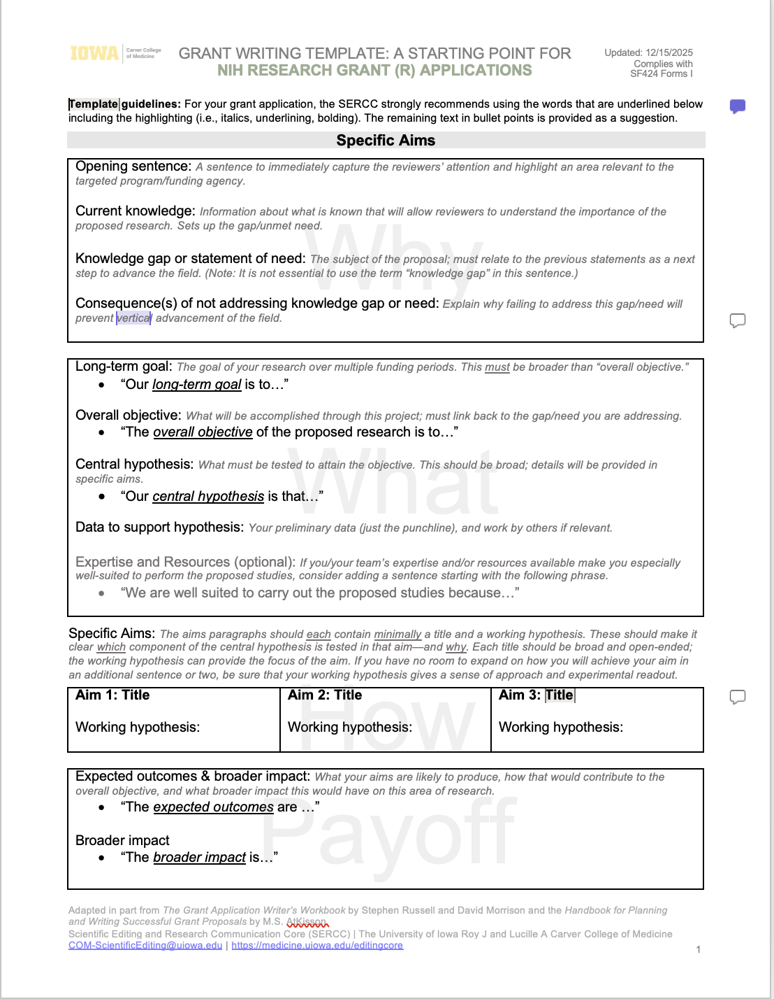
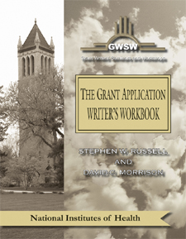
Key resources
SERCC templates based on the workbook, our experience, other sources (for R, K, and F mechanisms; updated as requirements change)
https://sercc.medicine.uiowa.edu/resources/writing-grants#accordion-item-1116-0
http://www.grantcentral.com
Notes:
Our advice for writing Research grants is based in part on this workbook
By a group that comes to UI to teach grant writing annually
We find their suggestions for the Specific Aims page especially helpful
The SERCC developed a template based in part on the workbook by Grant Writers’
It should be helpful in getting you started on an outline
Our advice for writing the Significance and Approach sections of an NIH grant diverge slightly from the Grant Writers’ recommendations

Slide 18
For Approach, we still recommend
Issues related to rigor and reproducibility
Addressing weaknesses in rigor of prior research
Strategies to ensure rigor of proposed research
Consideration of biological variables including sex
Aim x (for each aim)
Title of Specific Aim
Introduction/rationale paragraph
Justification and Feasibility paragraph
(including background and preliminary data)
Research Design paragraphs, including
Addressing weaknesses in rigor of prior research
Strategies to ensure robust and unbiased approach
Consideration of biological variables
Expected Outcomes paragraph
Potential Problems and Alternative Strategies par
Timeline and Benchmarks for success
Future Directions
Research Strategy
Significance
Approach
Innovation
https://sercc.medicine.uiowa.edu/resources/writing-grants#accordion-item-1116-0
Notes:
Suggestions for incorporating rigor in Approach are based largely on
our experience (and that of other grant editors/writers) and
recommendations from faculty who have served on study sections.

Slide 19
For Significance and Innovation, we still recommend…
Importance of the problem
Scientific context and rigor of prior research
Significance of expected research contribution
impact on scientific knowledge
impact on the field
Research Strategy
Significance
Approach
Innovation
Explain what makes the proposed approach a substantially different way to address an important problem
For each aspect of innovation discussed (ideally, limit to 1–3), explain:
Current strategies and their limitations
What makes the proposed research innovative:
New approach/use of unconventional technology?
Non-traditional concept/challenge of dogma?
What advances are only possible because of this new approach
https://sercc.medicine.uiowa.edu/resources/writing-grants#accordion-item-1116-0
Notes:
Suggestions for incorporating rigor in the Significance are based largely on:
effective submissions from our clients and
recommendations from faculty who have served on study sections.
Suggestions for writing the Innovation section come largely from the Grant Writers' workbook.

Slide 20
What Reviewers and NIH Staff are Saying

Slide 21
NIH Videos on Impact of Change: Reviewer impressions
Excerpts from conversations with study section chairs about their impressions of peer review under the Simplified Review Framework.
Implementing SRF With a Focus on Importance of Research September 17, 2025
Encouraging the Evaluation of Risk September 17, 2025
Impact of SRF on Review Meeting Discussions September 9, 2025
How SRF Changed Reviewers’ Approach September 9, 2025
https://grants.nih.gov/news-events/nih-extramural-nexus-news/2026/01/learn-what-reviewers-say-about-implementing-the-simplified-review-framework
Notes:
These interviews were done with a small group of reviewers (some of whom were study section chairs)
As always, takeaways for other study sections may be slightly different
It may be worth watching these videos (they are short), but on the next slides, we provide a summary of key messages...

Slide 22
NIH Videos on Impact of Change: Reviewer Impressions Summer 2025 (1)
Summary compiled by
Jen Barr
Culture shift to focus more on Factor 1:
Importance of problem to be addressed (Should the research be done?)
Are the questions being asked going to move the field forward and if so, how?
Factor 1 now sets the ceiling for Overall Impact score
Focus of review previously and now:
Was more about the health outcome (why study of disease x is important)
Was less about the specific contribution of the application.
Now focuses on why this project needs to be done.
Importance of the proposed research needs to be specific
It’s not sufficient to mention the disease that the work is relevant to, or its importance
It’s critical to explain how the proposed research specifically will move the field forward
https://grants.nih.gov/news-events/nih-extramural-nexus-news/2026/01/learn-what-reviewers-say-about-implementing-the-simplified-review-framework
Notes:
Factor 1 takeaway:
You can't have good Overall Impact score without good Factor 1 score
There is now more emphasis on clearly explaining how you envision your research moving the field forward (vs. the message that the problem you're addressing is important)

Slide 23
NIH Videos on Impact of Change: Reviewer Impressions Summer 2025 (2)
Summary compiled by
Jen Barr
Thoughts on the system:
Requires emphasis on this from SRO and Study Section Chair
The new system is more efficient: discussions have shifted from technical minutia to the importance of the research
It’s helpful that Significance and Innovation are considered together (Factor 1) – less work than having to separate these criteria
Less focused on the PI and institution – this component is reviewed after the science, so there is much less bias toward senior investigators
Because primary reviewers had less to cover, more time was left for overall discussion
_____
Additional comments from other researchers
Reiterated many points in the videos, and said it’s nice to not review Innovation separately
Panelists were not allowed to talk about Factor 3: Investigator

Slide 24
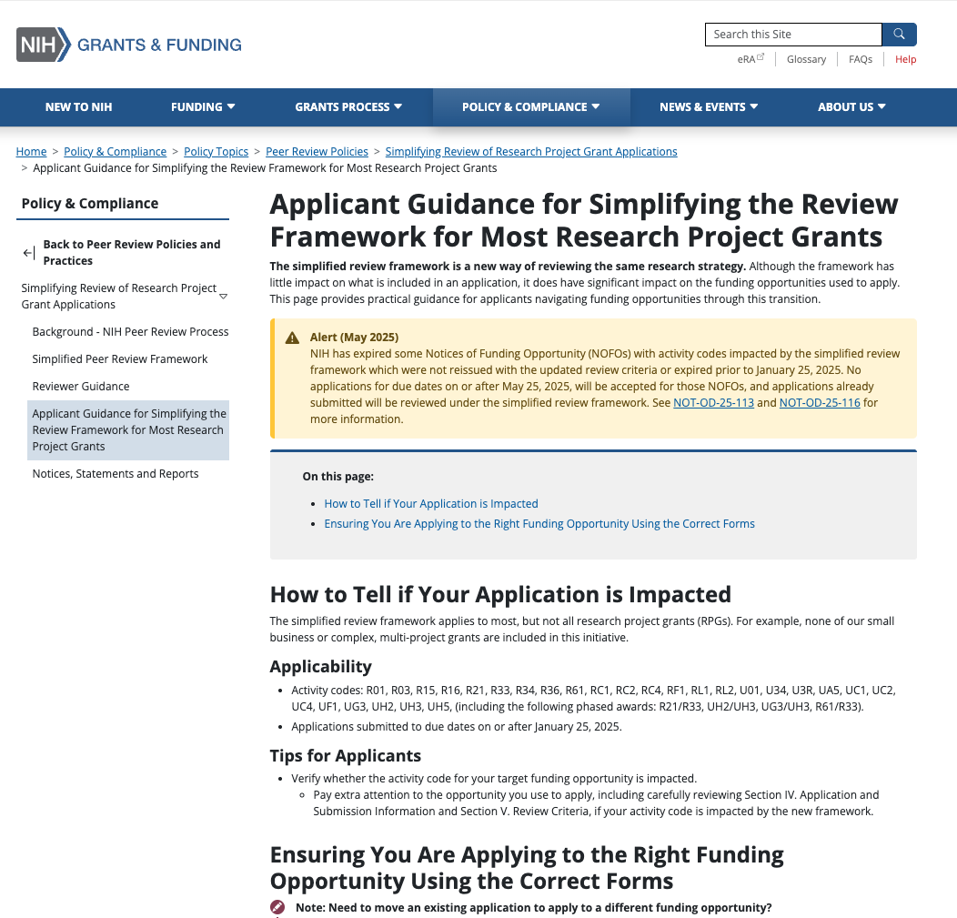
Applicant Guidance from NIH
As always, be sure to be responsive to the application requirements in:
Section IV. Application and Submission Information
Section V. Application Review Information of the funding opportunity
Learn more about how the simplified review framework impacts application review.
You must apply to a funding opportunity that includes the simplified review framework in
Section V. Application Review Information of the funding opportunity (i.e., review criteria are organized into three factors).
Make sure you are preparing your application using forms with the competition id “FORMS-I” and associated application instructions. See:
Do I Have the Right Forms for My Application? (PDF) for help identifying the competition id.
FORMS-I application guide instructions are available
Applicants are encouraged to contact a NIH Program Official if they still have questions or need additional clarification.
FAQs
https://grants.nih.gov/policy-and-compliance/policy-topics/peer-review/simplifying-review/applicant-guidance
Notes:
NIH resources for applicants.

Slide 25
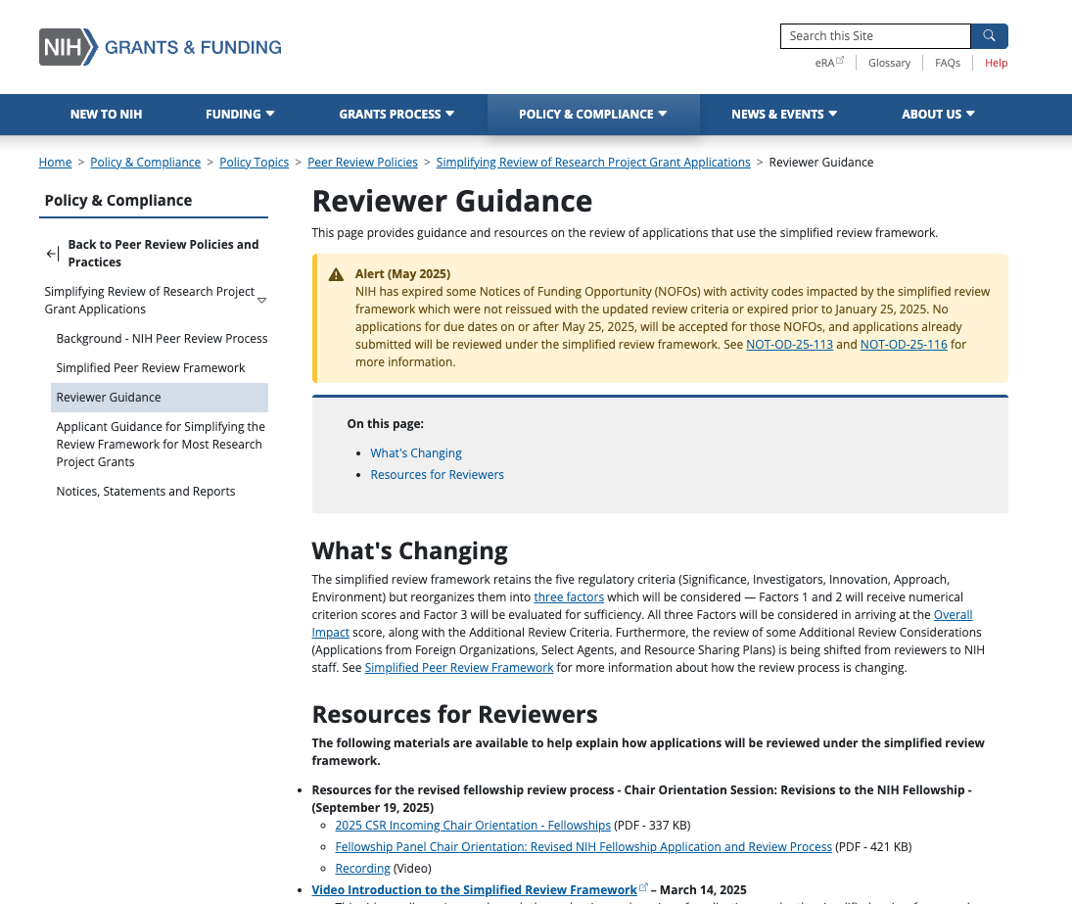
Reviewer Guidance
For reviewers and NIH staff:
Learn what they’re looking for!
Chair Orientation Session: Revisions to the NIH Fellowship – September 19, 2025
PDF and video
Video Introduction to the Simplified Review Framework (SRF) – March 14, 2025
Walk through evaluation and scoring of applications under the SRF.
Reviewer Guide to Evaluating Applications (PDF) – January 8, 2026
Guidance on evaluating and scoring applications under the SRF.
Scoring Guidance (PDF) – March 14, 2025
Overview of approach to scoring under the SRF, with examples.
Reviewer Training Slides (PDF) – September 22, 2025
Training on reviewing and scoring applications under the SRF (for use by scientific review officers in leading orientation sessions for reviewers in their scientific review group).
Chair Orientation Video – May 21, 2025
Role of the review group Chair in implementing the SRF.
https://grants.nih.gov/policy-and-compliance/policy-topics/peer-review/simplifying-review/reviewer-guidance
Notes:
NIH resources for reviewers
Even as a writer vs a reviewer, these resources may give you better insights into how to convey your message effectively.

Slide 26
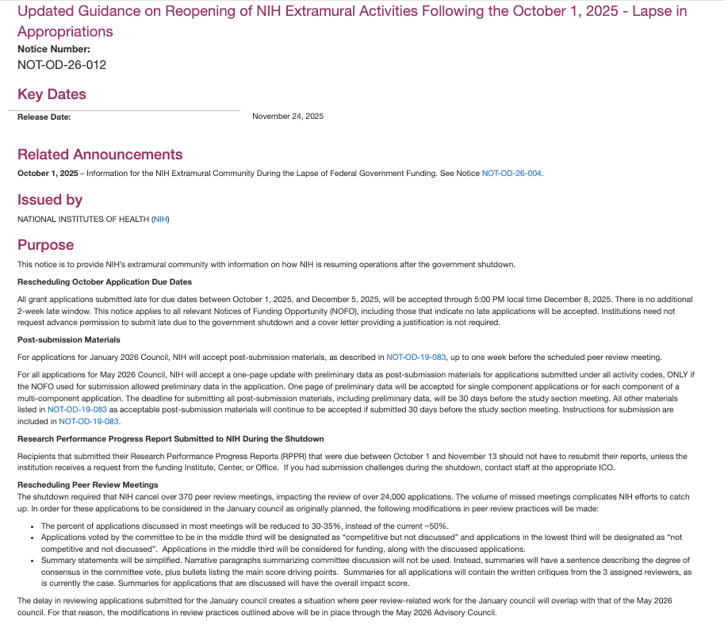
Modifications to Peer Review Practices implemented Nov 2025
Account for meetings missed during lapse of appropriations in 2025 (NOT-OD-26-012).
For applications submitted for the January and May 2026 Advisory Councils
Fewer applications discussed: reduction from ~50% to 30–35% in most meetings
Top third of applications: competitive and discussed
Middle third of applications: competitive but not discussed
Lowest third of applications: not competitive and not discussed
Summary statements will be simplified:
Will not include narrative paragraphs summarizing committee discussion.
Instead, bullets will describe the main score driving points.
Summaries for all applications will contain the written critiques from the 3 assigned reviewers, as is currently the case.
Summaries for applications that are discussed will include the overall impact score.
POs have reached out for more info on middle-third apps.
If this happens to you, read the letter carefully (they might not want a full rebuttal ro review comments, e.g., where in the grant ”missing” information was provided).
Rapport with PO can be helpful.
Applications in middle third will be considered for funding, along with the discussed applications.
https://grants.nih.gov/grants/guide/notice-files/NOT-OD-26-012.html
Notes:
Also consider the effects of the Fall government shutdown
Fewer applications are being discussed in study section
Even for the applications that are discussed, less information is being provided about that discussion.

Slide 27
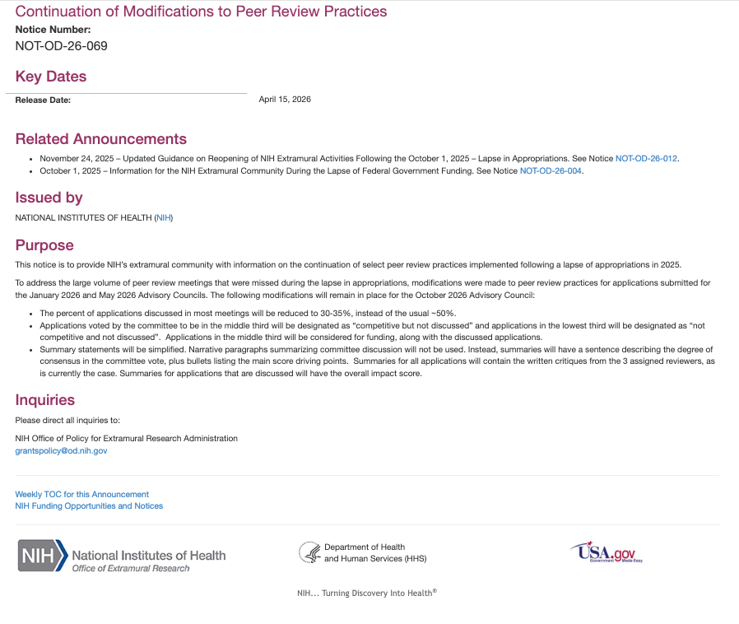
Modifications to Peer Review Practices extended
For the October 2026 Advisory Council
NOT-OD-26-069
Account for meetings missed during lapse of appropriations in 2025 (NOT-OD-26-012).
For applications submitted for the January and May 2026 Advisory Councils
Fewer applications discussed: reduction from ~50% to 30–35% in most meetings
Top third of applications: competitive and discussed
Middle third of applications: competitive but not discussed
Lowest third of applications: not competitive and not discussed
Summary statements will be simplified:
Will not include narrative paragraphs summarizing committee discussion.
Instead, bullets will describe the main score driving points.
Summaries for all applications will contain the written critiques from the 3 assigned reviewers, as is currently the case.
Summaries for applications that are discussed will include the overall impact score.
https://grants.nih.gov/grants/guide/notice-files/NOT-OD-26-069.html

Slide 28
Take advantage of SERCC Resources
Notes:
Even if your department/center doesn't contribute to costs of editing, you can still take advantage of:
Resources we provide on our website and
Our Ask-the-Editor sessions

Slide 29

How we can help
Edit/Help Write
Research Proposals and Manuscripts
Large-Scale Proposal Development Service
We work with
Faculty
Staff
Fellows
Postdocs
Graduate students
Collaborate with Other UI Offices and Programs, e.g.:
CCOM Research Office
Obermann Working Group for Teaching with Writing (campus-wide)
Research Development Office (OVPR)
Keep Current on Funding Agency and Journal Expectations
Host Internships in Scientific Editing
(Free)
Host Ask-the-Editor Sessions
Host Open Writing Sessions
Present (and Host)
Seminars, Workshops
Develop and
Disseminate
Resources
Teach Courses and
Course Lectures
Notes:
We work with scientists at all career level, and many of our activities are directly relevant to our work with faculty:
Do mostly editing (and some writing for large-scale proposals)
To do that well, we keep track of requirements, especially those of funding agencies
That helps us develop resources and with our teaching – e.g., seminars and workshops
Free: SERCC Ask-the-Editor sessions are open to faculty

Slide 30
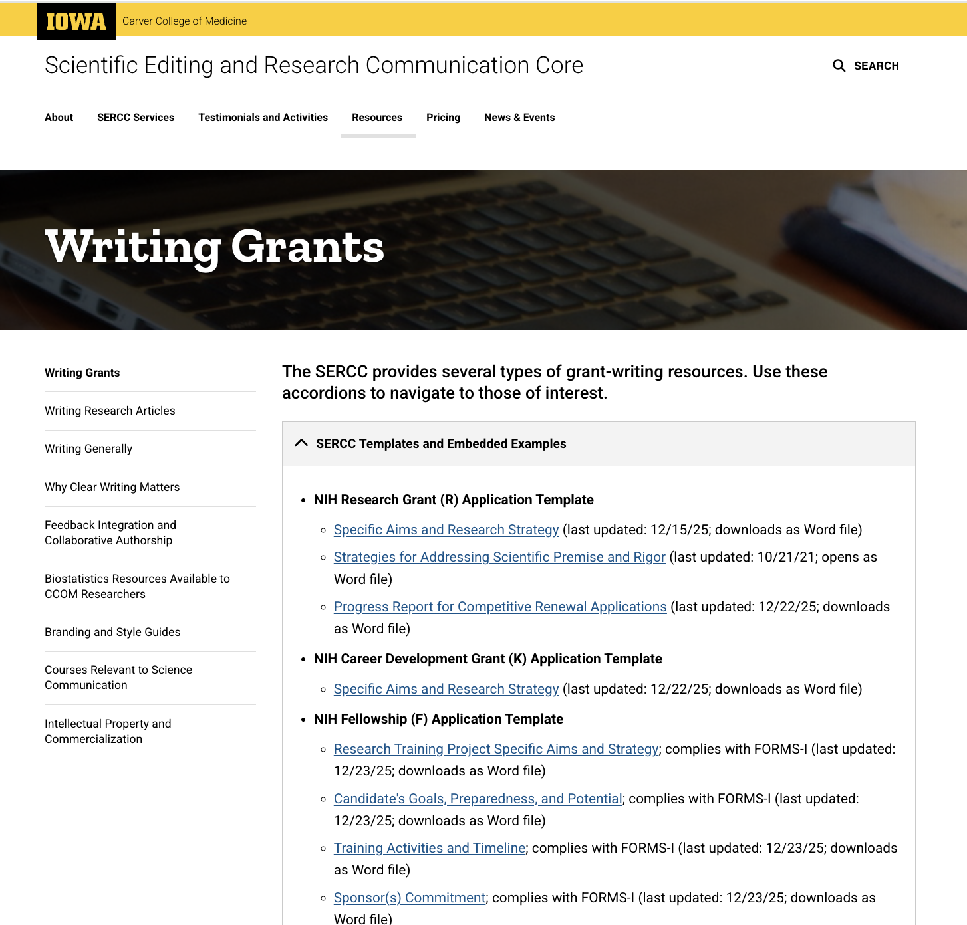
Where to find templates
SERCC Template for writing a fellowship research plan
https://sercc.medicine.uiowa.edu/resources/writing-grants#accordion-item-1116-0
Notes:
Templates are available on this page
We also provide many other resources:
Instructions for preparing NIH Biosketches using SciENcv (Common and Supplementary forms)
Boilerplate text for facilities supported by the CCOM
Advice for writing Data Management and Sharing (DMS) plans
Links to resources from other UI offices and funding agencies.
Explore our website!

Slide 31
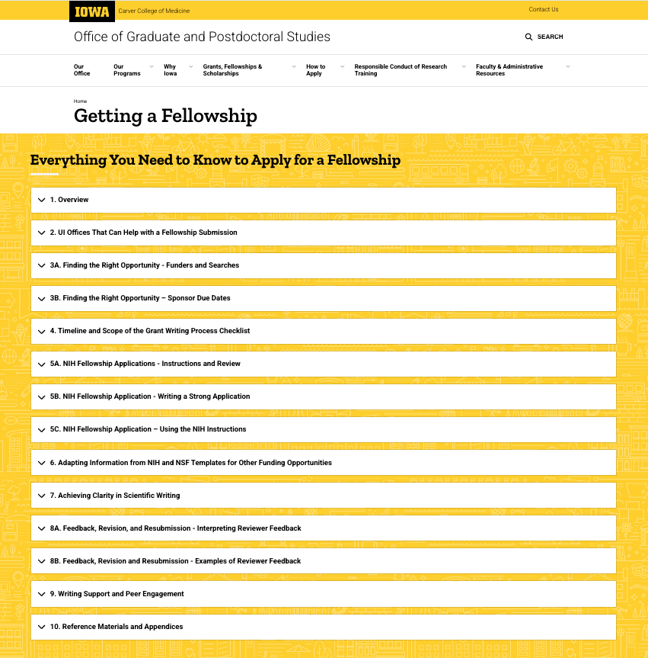
NEW online resource for your trainees
A CCOM initiative involving
the CCOM Research Office, the Office of Graduate and Postdoctoral Studies (OGPS), and the SERCC
Officially going live in June
(but check it out now)
Chapters:
Overview
UI Offices That Can Help with a Submission
Finding the Right Opportunity
Timeline and Scope of the Grant Writing Process
NIH Fellowship Applications
Adapting Information from Existing Templates
Achieving Clarity in Scientific Writing
Feedback, Revision, and Resubmission
Writing Support and Peer Engagement
Reference Materials
https://ogps.medicine.uiowa.edu/getting-fellowship
Notes:
A new resource currently being "beta tested".

