Slide 1

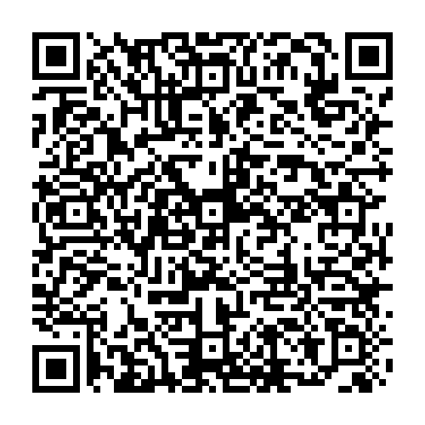
Resources and Tips for Writing Fellowship Applications
Use QR code to download PPT of presentation
Scientific Editing and Research Communication Core (SERCC)
November 2026

Slide 2
Documents Required for an NIH Fellowship Application
Fellowship Applications include:
A Research Strategy component
A Training Plan component
Research Strategy
Training Plan
  Project Summary/Abstract
  Project Narrative
Research Training Project Specific Aims
Research Training Project Strategy
Facilities and Resources, Equipment
Training in the Responsible Conduct of Research
Introduction (for resubmissions only)
Candidate’s Goals, Preparedness, Potential
Training, Activities, and Timeline
Student’s Biosketch
Sponsor(s)’ Commitment (Statements)
Sponsor(s)’ Biosketch(es)
Referee Letters
Institutional Commitment
Components are written by:
The trainee (i.e., the PI of the grant)
The sponsor(s) of the trainee
Referees and institutional officials

Slide 3
Resources
  From the Office of Graduate and Postdoctoral Studies (OGPS)
    Getting a Fellowship guide
  From the Scientific Editing and Research Communication Core (SERCC)
    Resources that are free of charge:
      Grant Writing Templates/Instructions and boilerplate text
      Lecture recordings on writing fellowship (and other) applications
      SERCC Newsletter
      Free writing advice from SERCC editors
    Editing for strategy, flow, clarity (and support to cover service fees)
  From other UI Offices and Funding Agencies

Slide 4

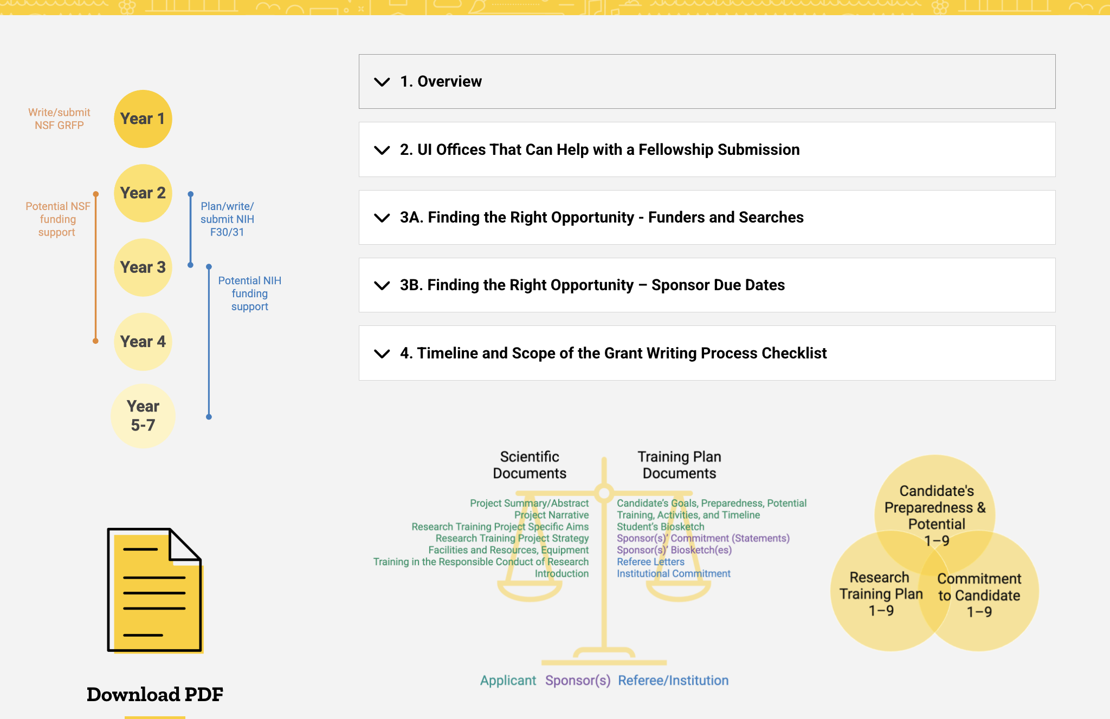
Housed on the OGPS Website: Getting a Fellowship Guide
Developed collaboratively by the:
CCOM Research Office
Office of Graduate and Postdoctoral Studies (OGPS)
Scientific Editing and Research Communication Core (SERCC)
Chapters:
Overview
UI Offices That Can Help with a Submission
Finding the Right Opportunity
Timeline and Scope of the Grant Writing Process
NIH Fellowship Applications
Adapting Information from Existing Templates
Achieving Clarity in Scientific Writing
Feedback, Revision, and Resubmission
Writing Support and Peer Engagement
Reference Materials
To view or download:
https://ogps.medicine.uiowa.edu/getting-fellowship

Slide 5
Resources
  From the Office of Graduate and Postdoctoral Studies (OGPS)
    Getting a Fellowship guide
  From the Scientific Editing and Research Communication Core (SERCC)
    Resources that are free of charge:
      Grant Writing Templates/Instructions and boilerplate text
      Lecture recordings on writing fellowship (and other) applications
      SERCC Newsletter
      Free writing advice from SERCC editors
    Editing for strategy, flow, clarity (and support to cover service fees)
  From other UI Offices and Funding Agencies

Slide 6




Generated by the SERCC Editors…
Christine M Blaumueller, PhD
  Director, Senior Scientific Editor and Writing Consultant
Over 14 years as a laboratory researcher | 6 years as a journal editor (EMBO) | Editor in CCOM since 2006 | Est SERCC in 2017
PhD from Yale University | Postdoctoral training at the European Molecular Biology Laboratory (EMBL)
Jennifer Y Barr, PhD
  Assistant Director of SERCC, Grant Writer in Large-Scale Proposal Development Service (LSPDS)
Over 12 years of experience as a laboratory researcher | SERCC editing internship 2015–2017 | SERCC editor since 2017
PhD and Postdoctoral training at UI | Has developed many of author resources and directs Scientific Editing Internship Program
Michael R Rebagliati, PhD
  Scientific Editor and Writing Consultant
Ove 30 years of experience as a laboratory researcher.
PhD from Harvard University | Postdoctoral training at the NICHD | Primary editor for the Stead Family Department of Pediatrics
Emily Huber, PhD
  Scientific Editor and Writing Consultant
Over 10 years of research experience in cell biology, genomics, and virology | Has edited for academic and industry laboratories
PhD in human and statistical genetics from Washington University in St. Louis
Notes:
Resources are generated by the SERCC editors

Slide 7
…Based on Our Editing and Teaching
Provide input on drafts of writing projects
Provide one-on-one consultation on writing strategy
Brainstorm with groups of authors and faculty on Specific Aims
Teach scientific writing
Collect and generate resources
  Changes in funding agency requirements
  Grant writing templates (NIH “R”/“K/“F” grants)
Liaise with other RD professionals
  National Organization of Research Development Professionals (NORDP)
  Scientific Editors Network (ScENe)
  American Medical Writers Association (AMWA)
Notes:
Complementary activities go into training good writers
We provide direct feedback on and input into writing – helps us with our teaching
Teach scientific writing (courses, seminars, workshops)
To help our clients, we collect and generate resources – helps us with our teaching

Slide 8

Resources Are Free and Accessible via Our Home Page
Resources
Pricing
Services
Schedule a Project
Contact us
https://sercc.medicine.uiowa.edu/

Slide 9
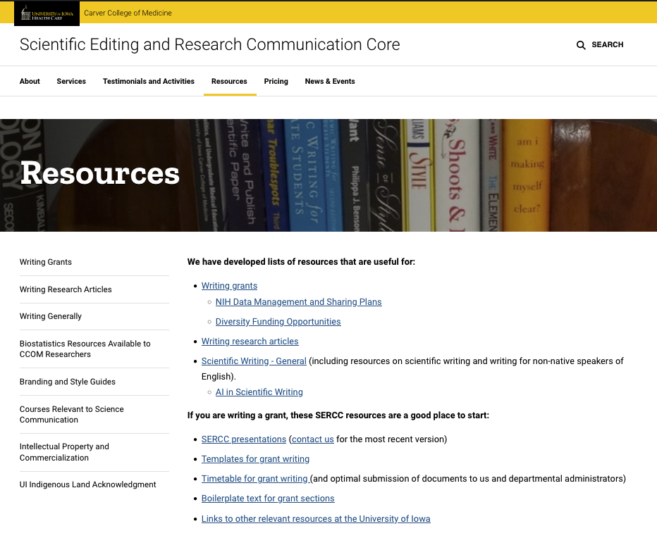
Highlights
Writing Grants:
Templates
Core facility descriptions
List of available lectures/recordings
Links to other resources
Writing Research Articles:
Tips for paper sections
List of available lectures
Suggested books
Writing Generally:
List of available lectures
Suggested articles/books
Resources for non-native speakers
https://sercc.medicine.uiowa.edu/resources
Notes:
Overview of resources available on our website

Slide 10
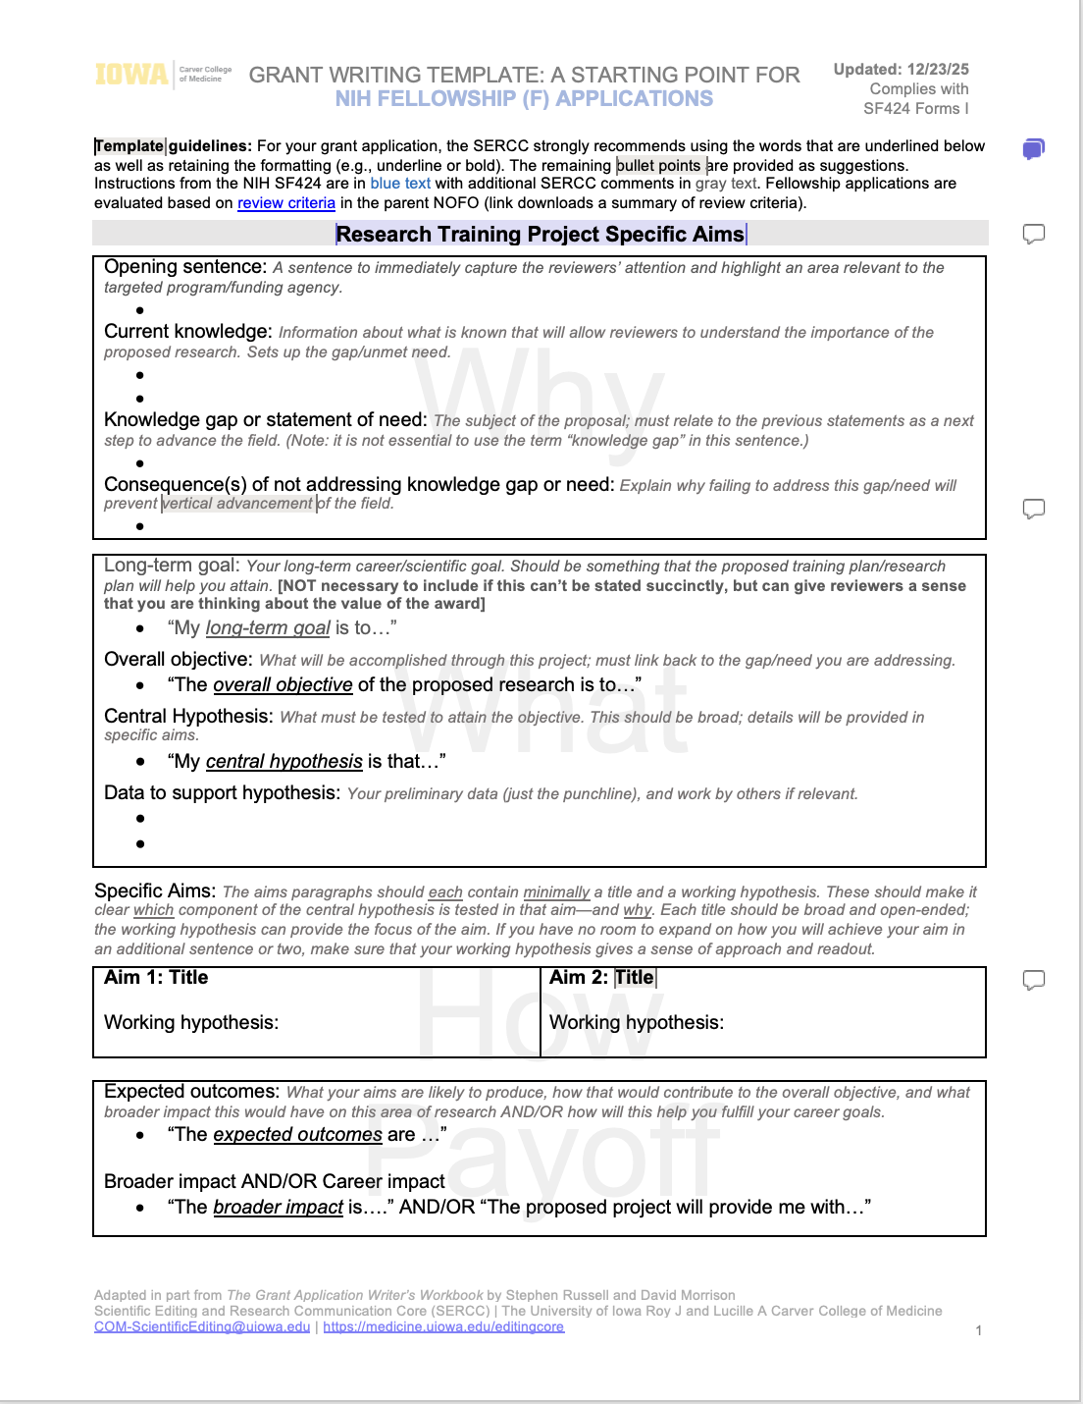
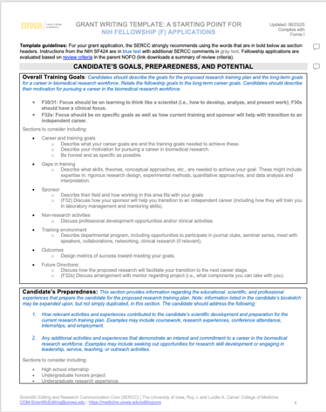
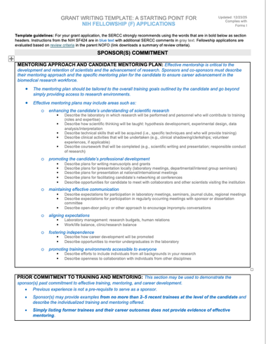
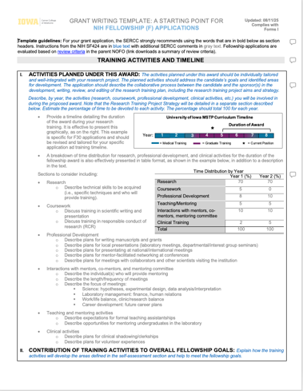
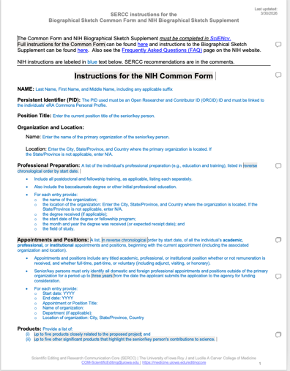
Grant Writing Templates and Biosketch Instructions from the SERCC
Including NIH Instructions, outlines, and tips from numerous grant-writing resources
Updated regularly to reflect changes in NIH policy and requirements
Specific Aims page and Research Strategy
    Candidate’s Goals, Preparedness, and Potential
    Sponsor(s)’
    Statement
    Training, Activities and Timeline
Biosketch (Instructions)
https://sercc.medicine.uiowa.edu/resources/writing-grants#accordion-item-1116-0
Scientific Editing and Research Communication Core

Slide 11
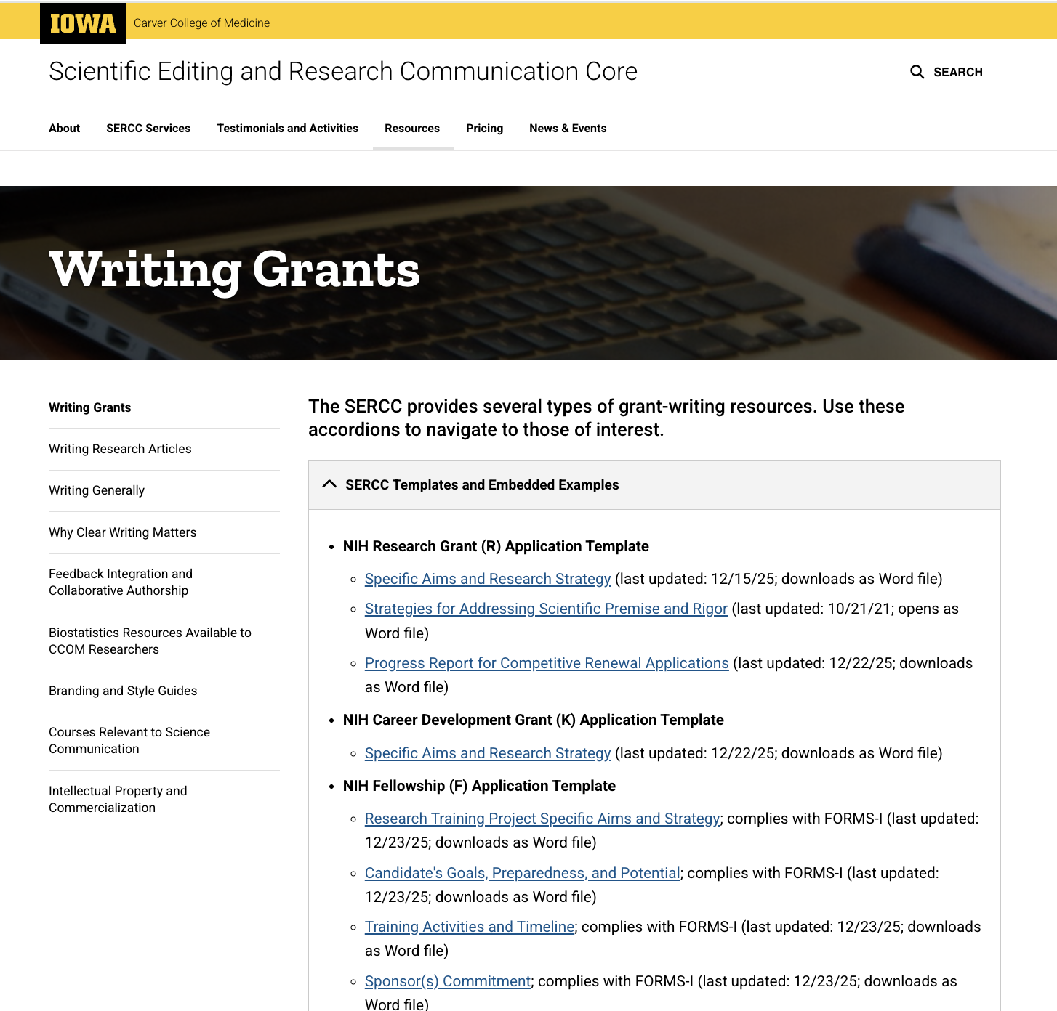
Where to Find Templates
Research Training Project Specific Aims and Strategy
https://sercc.medicine.uiowa.edu/resources/writing-grants#accordion-item-1116-0
Scientific Editing and Research Communication Core
Notes:
Templates are available on this page
We also provide many other resources:
Instructions for preparing NIH Biosketches using SciENcv (Common and Supplementary forms)
Boilerplate text for facilities supported by the CCOM
Advice for writing Data Management and Sharing (DMS) plans

Slide 12
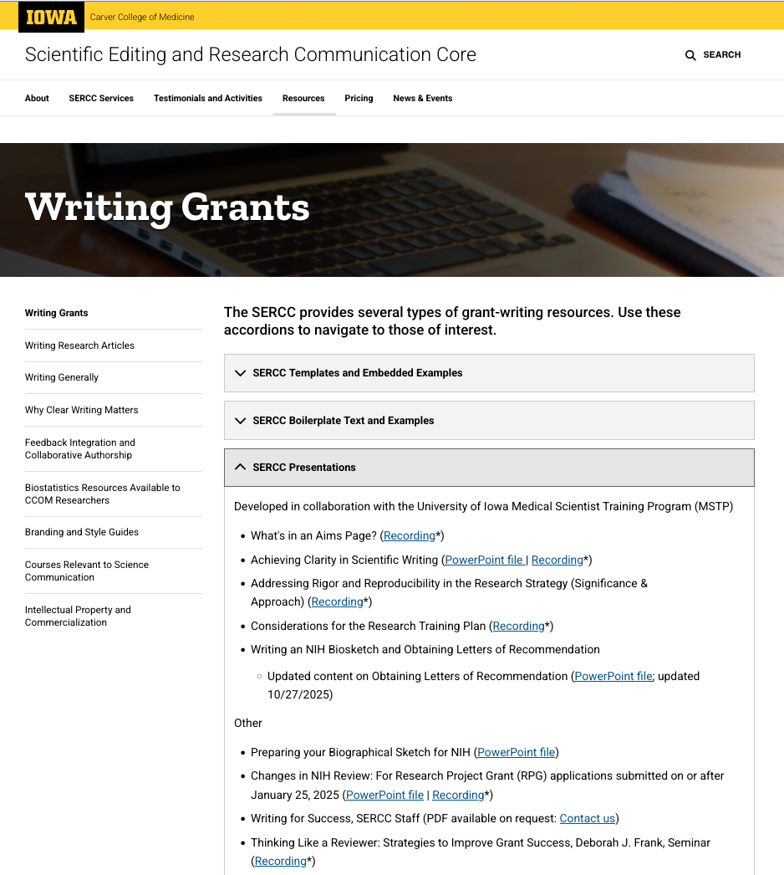
Lecture Recordings and Powerpoint Files
SERCC Presentations:
Writing a Specific Aims page
Achieving Clarity in Scientific Writing
Addressing Rigor and Reproducibility in the Research Strategy
Considerations for the Research Training Plan
Writing an NIH Biosketch and Obtaining Letters of Recommendation
Thinking Like a Reviewer: Strategies to Improve Grant Success
Grants, Grantsmanship, and Peer Review
https://sercc.medicine.uiowa.edu/resources/writing-grants#accordion-item-1116-0
Scientific Editing and Research Communication Core
Notes:
Templates are available on this page
We also provide many other resources:
Instructions for preparing NIH Biosketches using SciENcv (Common and Supplementary forms)
Boilerplate text for facilities supported by the CCOM
Advice for writing Data Management and Sharing (DMS) plans

Slide 13
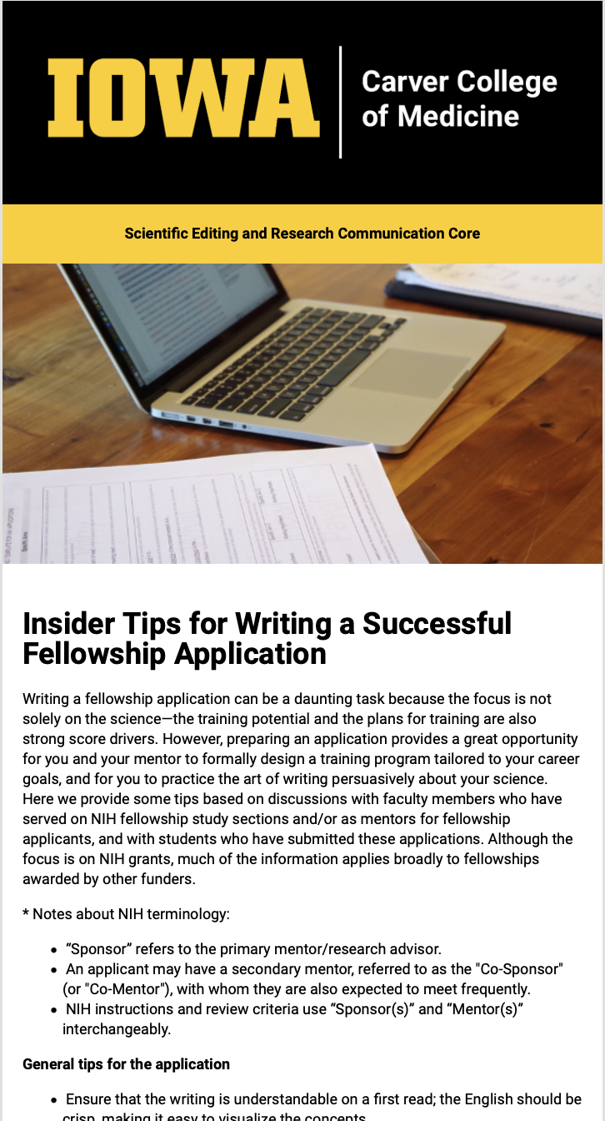
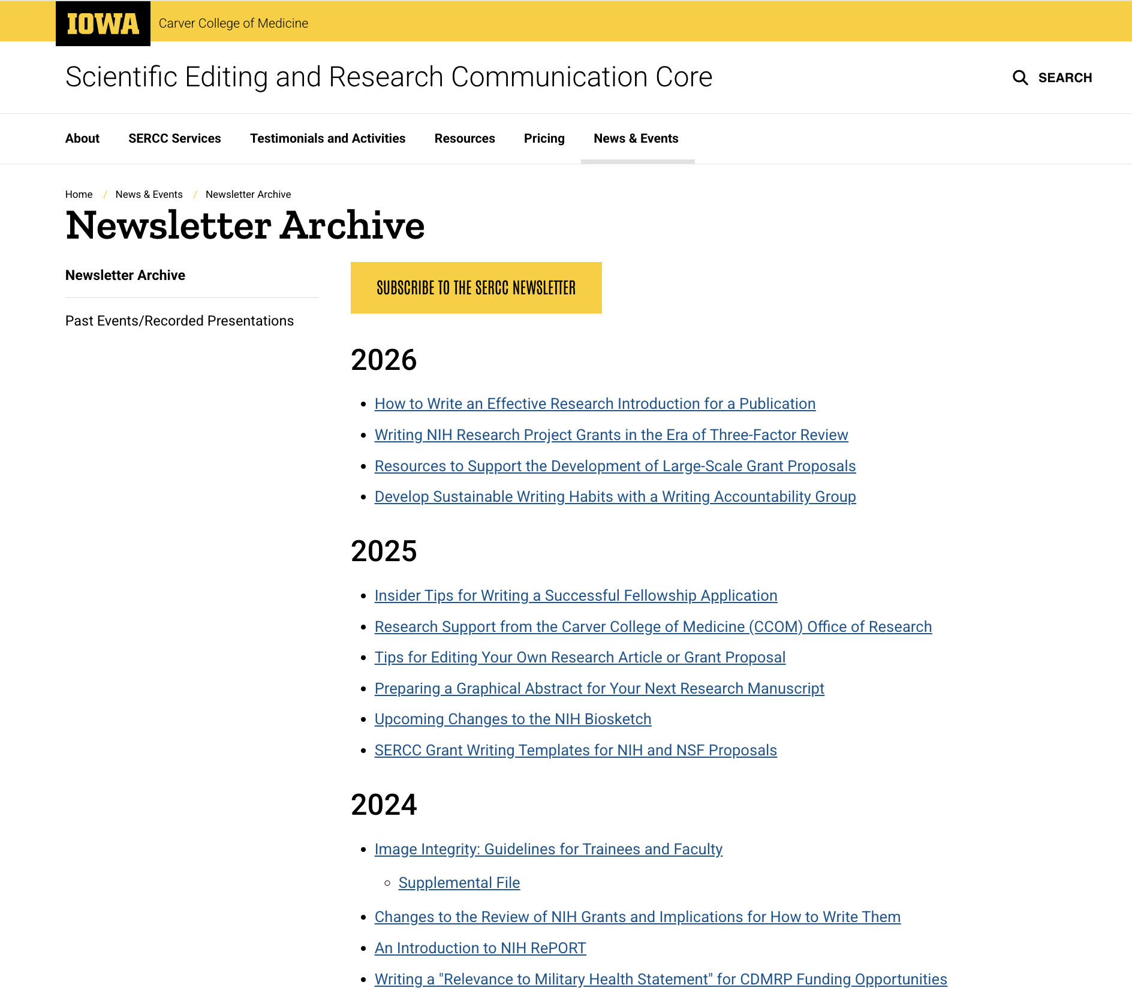
SERCC Newsletters – Recent Examples
The Power of Feedback: Strengthening Your Scientific Writing Through Strategic Review
– Oct 2026
Writing NIH Research Project Grants in the Era of 3-Factor Review
– May 2026
Insider Tips for Writing A Successful Fellowship Application
– Nov 2025
Upcoming Changes to the NIH Biosketch
– March 2025
SERCC Grant Writing Templates for NIH and NSF Proposals
– January 2025
Subscribe at:
https://sercc.medicine.uiowa.edu/form/subscribe-to-the-sercc-newslette
Notes:
All past newsletters are available in our archive

Slide 14
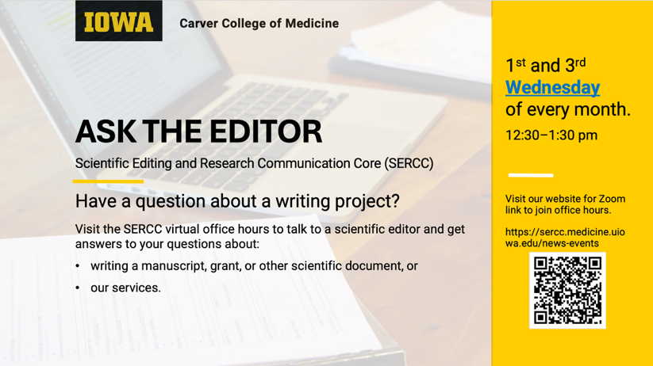
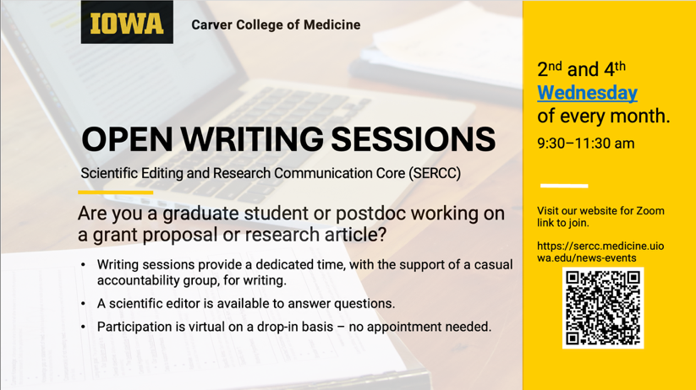
Free SERCC Drop-in Sessions
Writing consultation –
and an accountability group!
Ask the Editor
https://sercc.medicine.uiowa.edu/news/2025/12/ask-editor
Open Writing Sessions
https://sercc.medicine.uiowa.edu/news/2026/01/open-writing-sessions

Slide 15
To Schedule an Editing Project
Resources
Pricing
Services
Schedule a Project
Contact us
https://sercc.medicine.uiowa.edu/

Slide 16
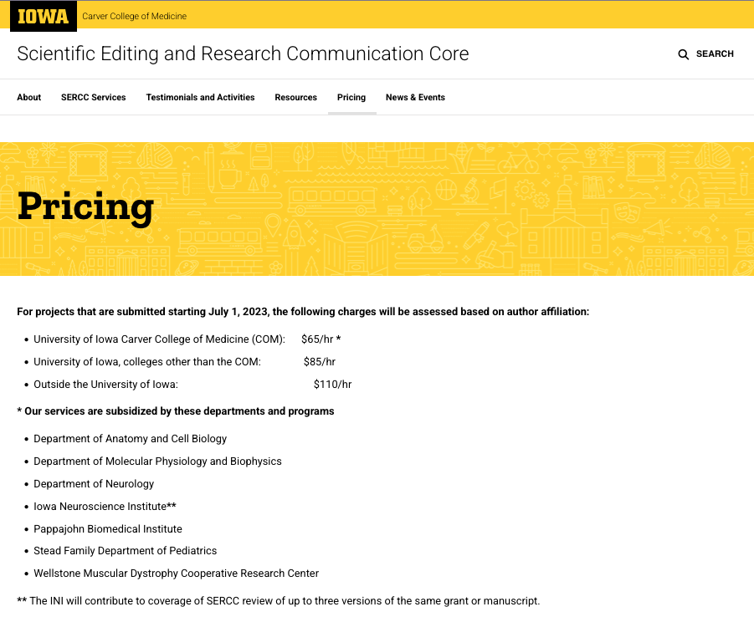
Editing and cost:
Editing for
  Strategy
  Flow
  Clarity
Departments/ Centers that may provide subsidies
Check with us if you have questions.
Notes:
If you would like one-on-one help from the SERCC on a proposal, you can take advantage of the Fellowship Incentive Program (FIP) from the Graduate College (see next slide)
Especially if you don’t have departmental or lab coverage of the fee

Slide 17
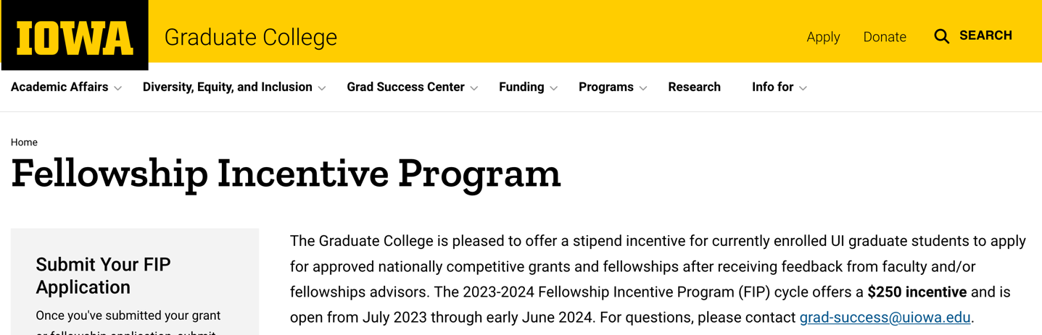
Additional Support:
The Graduate College provides $250 to students who have:
applied for a national predoctoral fellowships
after obtaining input from faculty and/or fellowship advisors
  includes SERCC editors
https://grad.uiowa.edu/fellowship-incentive-program
Notes:
If you do want one-on-one help on a proposal, you can take advantage of the FIP
Especially if you don’t have departmental or lab coverage of the fee

Slide 18
Resources
  From the Office of Graduate and Postdoctoral Studies (OGPS)
    Getting a Fellowship guide
  From the Scientific Editing and Research Communication Core (SERCC)
    Resources that are free of charge:
      Grant Writing Templates/Instructions and boilerplate text
      Lecture recordings on writing fellowship (and other) applications
      SERCC Newsletter
      Free writing advice from SERCC editors
    Editing for strategy, flow, clarity (and support to cover service fees)
  From other UI Offices and Funding Agencies

Slide 19
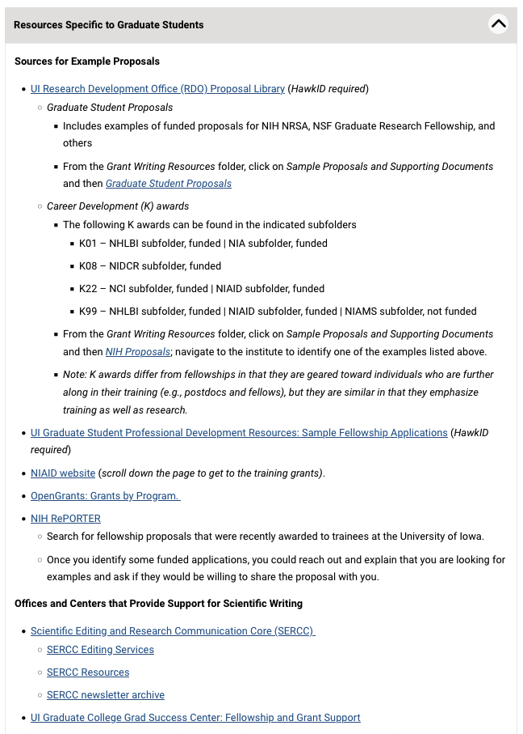
Resources Elsewhere
Sources for Example Proposals:
  OVPR/RDO (e.g., Resource Library)
  UI Graduate College
Support for Scientific Writing:
  UI Graduate College Success Center
  The Writing Center (CLAS)
  Hanson Center for Communication (Eng)
Funding Agencies and Other
  National Institutes of Health (NIH, NAIAD)
  Open Grants
https://sercc.medicine.uiowa.edu/resources/writing-grants#accordion-item-1116-5
Notes:
We also provide links to resources from other groups – at UI, Outside of UI

Slide 20
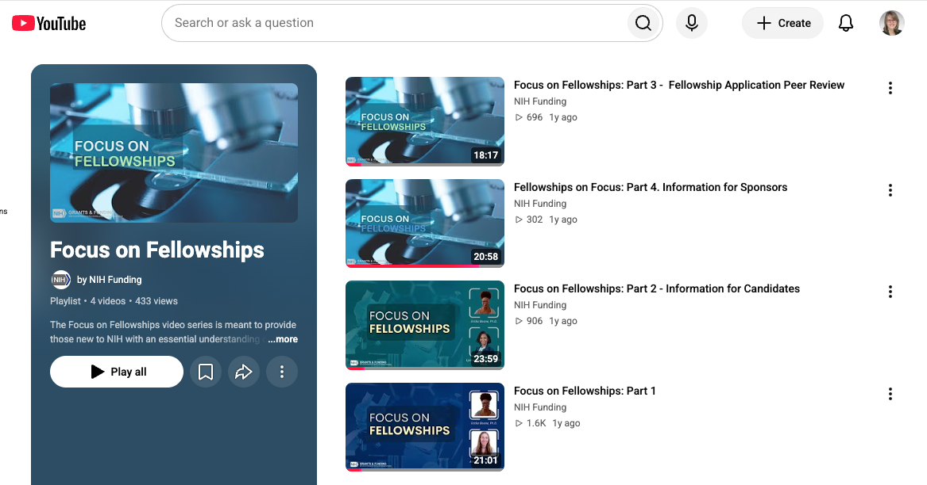
Recent NIH Fellowship Webinars (2025):
Focus on Fellowships: Part 1
  General overview of fellowships
Focus on Fellowships: Part 2 – Information for Candidates
  More details on instructions to use
Focus on Fellowships Part 3 – Fellowship Application Review
Focus on Fellowships Part 4 – Information for Sponsors
NIH “Focus on Fellowships” series: an Overview of the Changes” Home page
https://www.youtube.com/playlist?list=PLOEUwSnjvqBKiRa5iTl7LpOY1MJgiZF0F
https://sercc.medicine.uiowa.edu/resources/writing-grants#accordion-item-1116-4

Slide 21
Tips From Faculty and SERCC Students
Research Strategy
Training Plan
  Project Summary/Abstract
  Project Narrative
Research Training Project Specific Aims
Research Training Project Strategy
Facilities and Resources, Equipment
Training in the Responsible Conduct of Research
Introduction (for resubmissions only)
Candidate’s Goals, Preparedness, Potential
Training, Activities, and Timeline
Student’s Biosketch
Sponsor(s)’ Commitment (Statements)
Sponsor(s)’ Biosketch(es)
Referee Letters
Institutional Commitment

Slide 22

A Recurring Theme:
It is essential to show connection/complementarity/balance between the:
Research Strategy
Training Plan
Input from a UI Faculty member, April 2026:
I served on study section for F31/F32s this year and was struck by how different the review process is compared to even a year ago.
So much emphasis on the training plan
  How it connects the self assessment to future goals and
  How the sponsor and research plan are well integrated with the goals of the training plan.
Having a well funded lab or established investigator as a sponsor is no longer needed – and comments about this are unallowable.
Scientific Editing and Research Communication Core

Slide 23
Tips From the “Getting a Fellowship Guide”
For Trainees
For Mentors
Submit your proposal: an application that is never submitted has no chance of being funded.
Make it high quality: a weak proposal will not be funded but a strong and clearly articulated proposal has a chance.
Balance the training plan and the research plan: the proposed training is as important as the proposed research.
Coordinate with your mentor: input from your mentor is key and reviewers want to know that you are on the same page.
Start early and have fun: once you start this formal exercise, you may find that it leads you in exciting new directions.
Steer trainees to resources as early as possible, including an administrative contact who can help them submit their application.
Coordinate with trainees on the training plan, e.g., for NIH Fellowship applications:
  What you write in the “Sponsor(s) Commitment” document must align with
  What they write in the “Training Activities and Timeline” and “Candidate's Goals, Preparedness, and Potential” documents.
Tailor the documents you provide specifically to each trainee
https://ogps.medicine.uiowa.edu/getting-fellowship (Chapter 1)

Slide 24
Tips From SERCC Students Who Have Applied for Fellowships
On Timing
On Training
Did not appreciate how long it would take to write components besides the research plan
Recommendations for writing efficiently:
  The grant is a good checklist task; set mini-deadlines e.g., break Specific Aims into chunks
  Give yourself tasks by section (half a day to one day)
Write the science part first and sleep on it for a few days before coming back to edit
  Writing the science is daunting and cerebrally taxing
  Have multiple tasks going in parallel
Write the parts that require less energy between the hard parts
Whatever the deadline is, you need to submit to the UI Division of Sponsored Programs a week ahead of time
Multi-disciplinarity can be viewed positively:
  May need to have more than one mentor (also called sponsors)
  Co-Mentors (co-sponsors) should have complementary skillsets
  For MD/PhD students with a PhD as mentor, may need a co-mentor with an MD to cover translational aspects, especially if doing clinical research
  It may be beneficial to have the mentor and co-mentor write their statement together; it must be clear that both contributed significantly
  Explain frequency of meetings with mentor, and co-mentor, if relevant (e.g., every 2 weeks for co-mentor)
Training potential must be obvious from proposal
  May need to explain if you already have many skills

Slide 25
Tips From SERCC Students Who Have Applied for Fellowships #2
Work with your Program Official
Use schematics if possible
An established rapport with the NIH Program Official was helpful
Was able to find extra money for the resubmitted application even though it didn’t quite cross the payline
It helped to include a schematic of the experimental system
  Helped break up text
  Showed what was being done more effectively than writing it
Image created
using BioRender

